Slide 1
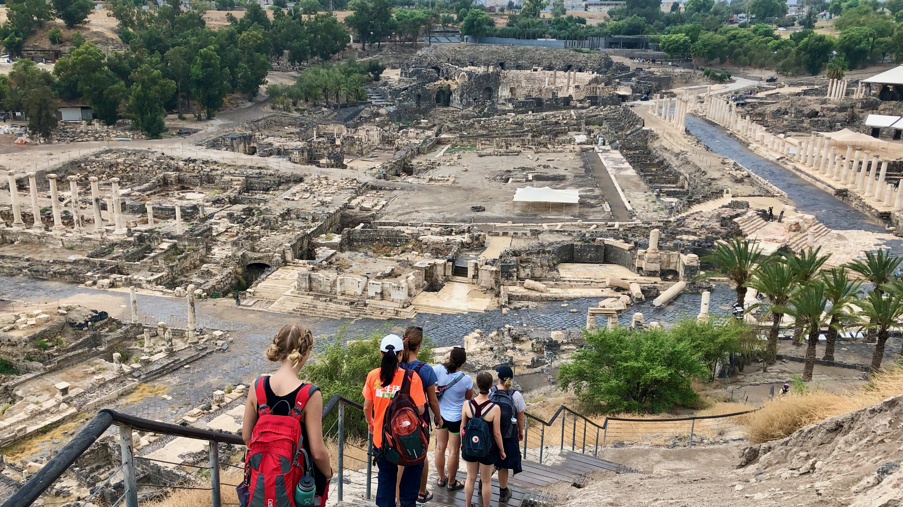
Ancient Insights
The Cultural Context of Jesus’s Teachings

Slide 2
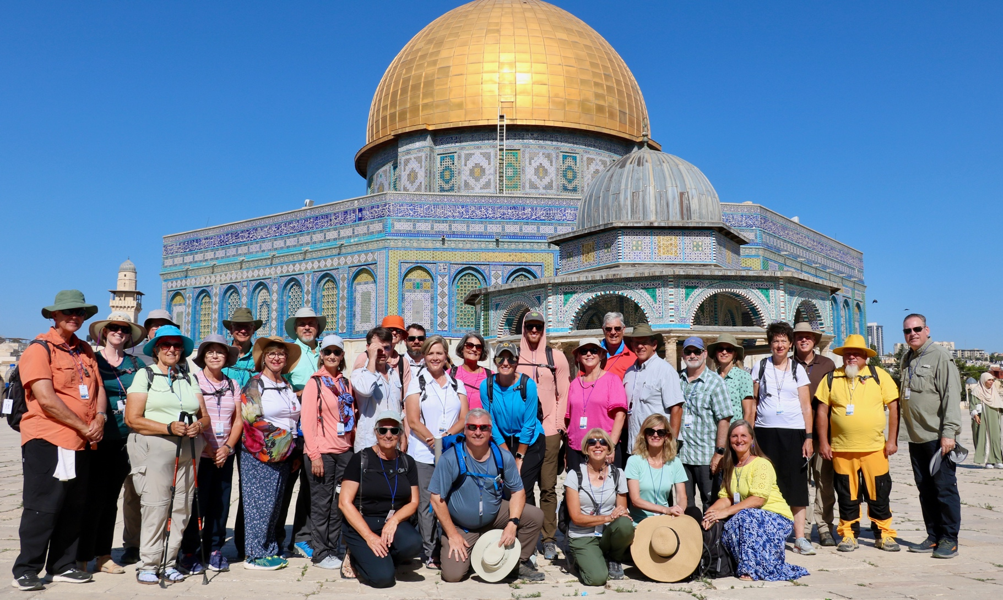
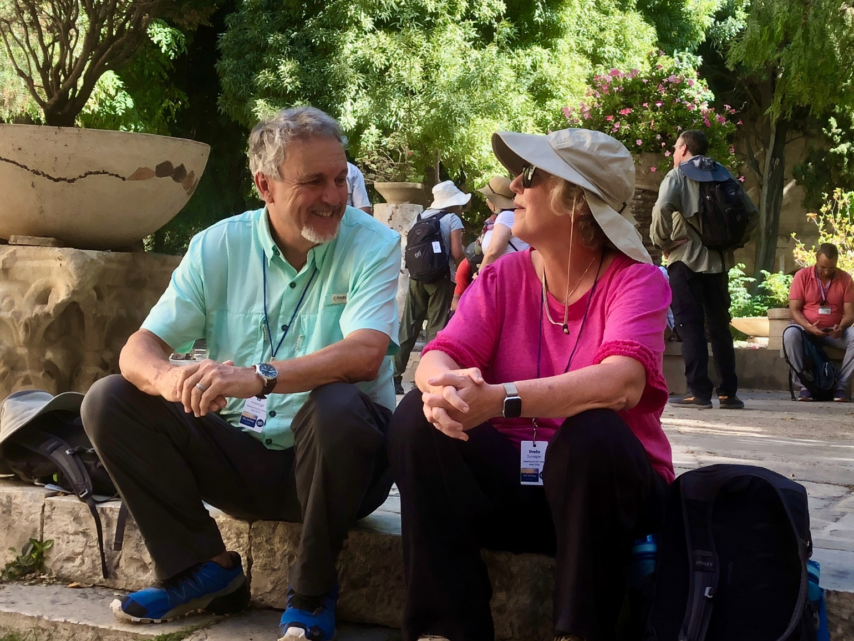
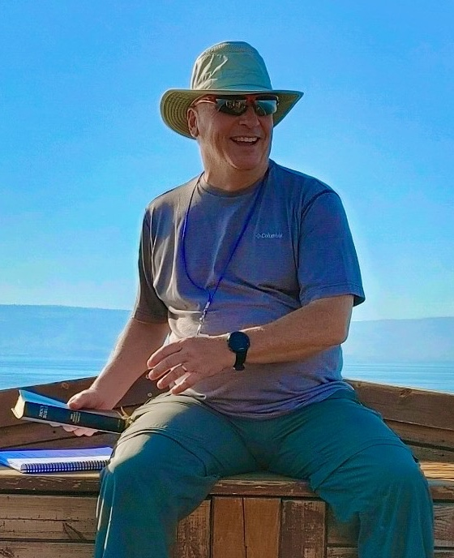
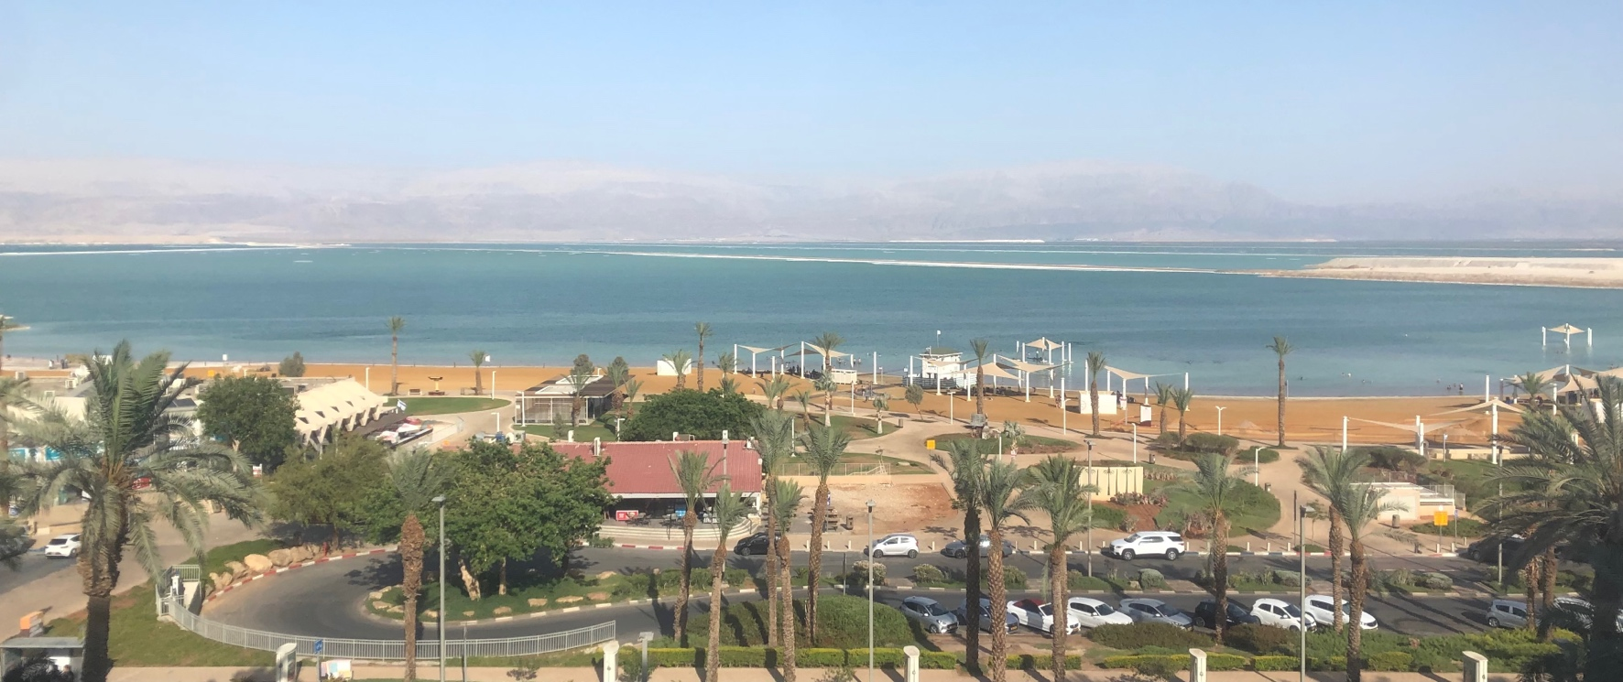
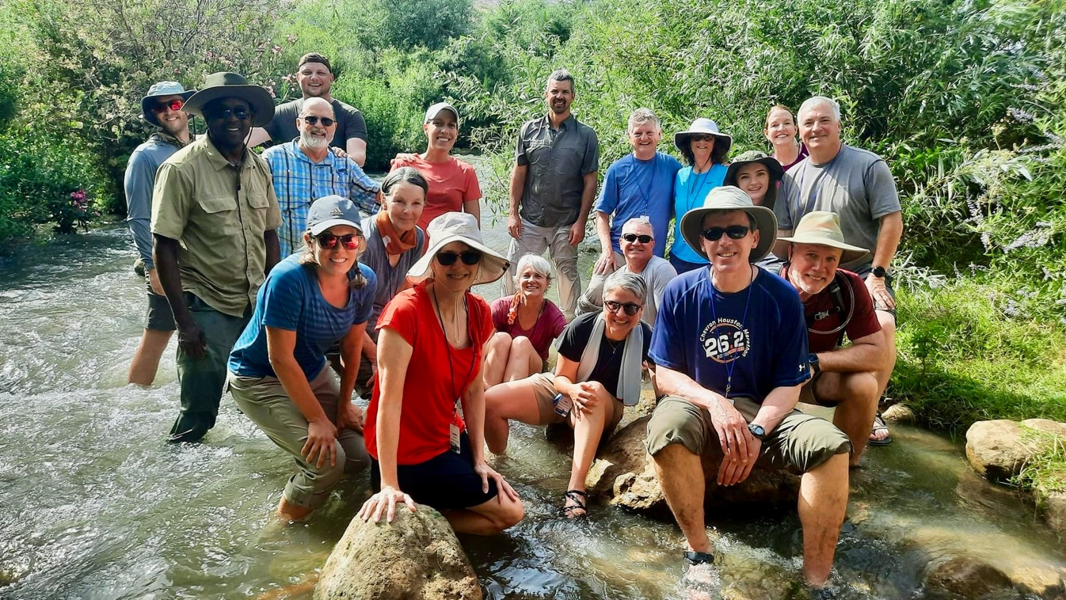
Israel Study Tour
June 30–July 12, 2024
Registration Open!

Slide 3
SteppingIntoTheJordan.com

Slide 4
Direct Link
https://steppingintothejordan.com/study-trips/

Slide 5
Objective and Method
70 Faces of Scripture
Different lenses reveal different insights.
The teachings of Jesus in the Gospels reflect the “culture of the day.”
Our Lens: Examine the culture of the Second Temple Period to shed light on Jesus’s teachings.

Slide 6
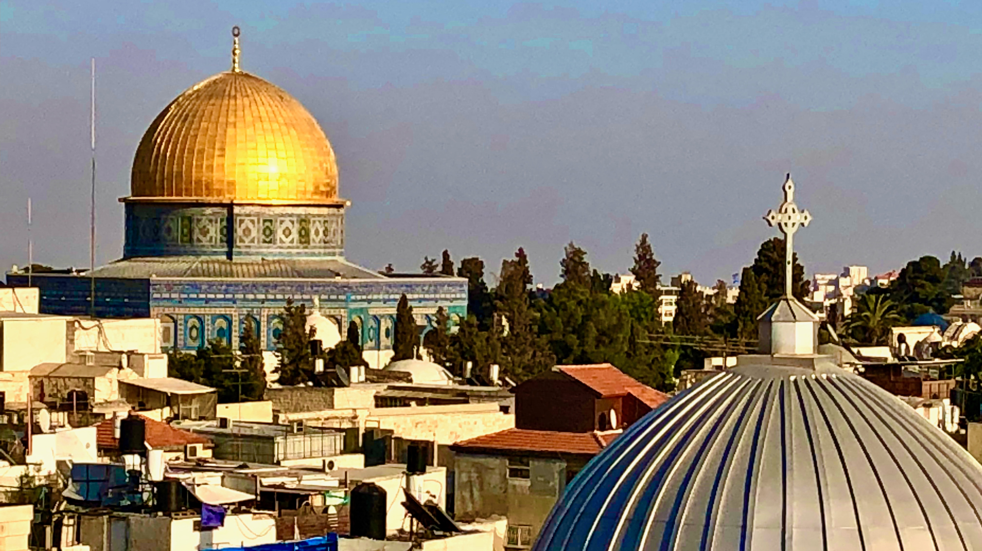
In the last days...

Slide 7
Reading Against the Grain
If we read between the lines of the Old Testament, the picture becomes clear.
Ancient Israel was polytheistic. They worshipped other gods.
According to Deuteronomy, Joshua, Judges, 1-2 Samuel, and 1-2 Kings. This was why they ended up in exile.

Slide 8
Prophetic Warnings
You are going to be punished for worshipping other gods.
Repent!!!
Even though you will be punished, there is hope for a better future.
The Davidic monarchy will be restored.

Slide 9
In 539 BCE everything changes.
They return to the Promised Land
They appear to be monotheistic.

Slide 10
Challenges of Monotheism
The problem of evil.
If there is only one God, why is there evil in the world?
How can God allow the righteous to suffer?
Foreign powers still rule Judah.
When will the prophetic promises come to pass?
Why do the righteous suffer under oppression?
How can the God of the Universe properly govern the affairs of all nations and people?

Slide 11
How do (some) Jews respond?
Evil is the fault of fallen angels.
Ha-Satan (the accuser) becomes Satan.
Angels get names
God is more distant. Angels carry out God’s bidding.
Evolution of Deut. 32:8–9
Angels do cosmic administration of nations.

Slide 12
How do (some) Jews respond?
God’s will make things right in the “age to come.”
Judgment will be a sudden cosmic upheaval.
The social order will be turned upside-down.
The oppressors will be defeated.
The righteous will rule in their place.
The kingship of David’s line will be restored.
Everything will be as God intended from the beginning.
Resurrection of the dead to eternal life.

Slide 13
The Rise of Apocalyticism

Slide 14
Apocalyptic Literature
A new genre of literature
Starts in the 4th century BCE.
Apocalyptic Features:
Secret knowledge revealed to a person from the past.
Often written as a first-person account (pseudonymous).
Revealed in visions and dreams
Guided and interpreted by an angel/heavenly being.
Pulls back the curtain on the supernatural forces at work behind the course of human affairs.
Judgment and destruction of the wicked.
A sudden cosmic end/renewal.

Slide 15
Jewish Apocalyptic Works
Early traces in Ezek 16, 40–48; Zech 1–8, 14
Daniel
1–2 Enoch
4 Ezra
2–3 Baruch
Apocalypse of Abraham
Testament of Levi 2–5
fragmentary Apocalypse of Zephaniah.
Apocalyptic literature is different from prophetic literature.

Slide 16
1 Enoch
At that place, I saw the One to whom belongs the time before time. And his head was white like wool, and there was with him another individual, whose face was like that of a human being. His countenance was full of grace like that of one among the holy angels. And I asked the one—from among the angels—who was going with me, and who had revealed to me all the secrets regarding the One who was born of human beings, “Who is this, and from whence is he who is going as the prototype of the Before-Time?” And he answered me and said to me, “This is the Son of Man, to whom belongs righteousness, and with whom righteousness dwell...This Son of Man whom you have seen is the One who would remove the kings and the mighty ones from their comfortable seats and the strong ones from their thrones.”
1 Enoch 46:1–3, 5

Slide 17
Who/What is the Messiah?

Slide 18
Messianism
In the OT, messiah (mashiach) means “anointed.”
Kings and Priests are anointed
Not a divine figure.
Isaiah calls Cyrus YHWH’s messiah.

Slide 19
Messianism
Thus says the LORD to his anointed, to Cyrus,
whose right hand I have grasped
to subdue nations before him
and strip kings of their robes,
to open doors before him—
and the gates shall not be closed:
I will go before you
and level the mountains,
I will break in pieces the doors of bronze
and cut through the bars of iron,
I will give you the treasures of darkness
and riches hidden in secret places,
so that you may know that it is I, the LORD,
the God of Israel, who call you by your name.

Slide 20
Messianism
In the OT, mashiach means “anointed.”
Kings and Priests are anointed
Not a divine figure.
Isaiah calls Cyrus YHWH’s messiah.
In Second Temple Period, “The Messiah” was expected to restore the Davidic monarchy.
The Hasmoneans were considered pretenders to the throne.

Slide 21
Messianism in Jewish Literature
A wide range of views
Will subdue the nations and save them.
A warrior-king (wins through Divine means)
An Elijah-like prophet
Some mention 2 Messiahs:
Davidic Messiah
Levitical Messiah.

Slide 22
How do we see this in the New Testament?

Slide 23
Now when Jesus came into the district of Caesarea Philippi, he asked his disciples, “Who do people say that the Son of Man is?” And they said, “Some say John the Baptist, but others Elijah, and still others Jeremiah or one of the prophets.” He said to them, “But who do you say that I am?” Simon Peter answered, “You are the Messiah, the Son of the living God.” And Jesus answered him, “Blessed are you, Simon son of Jonah! For flesh and blood has not revealed this to you, but my Father in heaven. And I tell you, you are Peter, and on this rock I will build my church, and the gates of Hades will not prevail against it. I will give you the keys of the kingdom of heaven, and whatever you bind on earth will be bound in heaven, and whatever you loose on earth will be loosed in heaven.” Then he sternly ordered the disciples not to tell anyone that he was the Messiah.
Matt 16:13–20 (NRSV)

Slide 24
“When the Son of Man comes in his glory, and all the angels with him, then he will sit on the throne of his glory. All the nations will be gathered before him, and he will separate people one from another as a shepherd separates the sheep from the goats, and he will put the sheep at his right hand and the goats at the left. Then the king will say to those at his right hand, ‘Come, you that are blessed by my Father, inherit the kingdom prepared for you from the foundation of the world.”
Matt 25:31–34

Slide 25
After his suffering he presented himself alive to them by many convincing proofs, appearing to them during forty days and speaking about the kingdom of God. While staying with them, he ordered them not to leave Jerusalem, but to wait there for the promise of the Father. “This,” he said, “is what you have heard from me; for John baptized with water, but you will be baptized with the Holy Spirit not many days from now.”
So when they had come together, they asked him, “Lord, is this the time when you will restore the kingdom to Israel?” He replied, “It is not for you to know the times or periods that the Father has set by his own authority. But you will receive power when the Holy Spirit has come upon you; and you will be my witnesses in Jerusalem, in all Judea and Samaria, and to the ends of the earth.” When he had said this, as they were watching, he was lifted up, and a cloud took him out of their sight.
Acts 1:3–9

Slide 26
Now concerning the times and the seasons, brothers and sisters, you do not need to have anything written to you. For you yourselves know very well that the day of the Lord will come like a thief in the night. When they say, “There is peace and security,” then sudden destruction will come upon them, as labor pains come upon a pregnant woman, and there will be no escape! But you, beloved, are not in darkness, for that day to surprise you like a thief; for you are all children of light and children of the day; we are not of the night or of darkness.
1 Thess 5:1–5
But do not ignore this one fact, beloved, that with the Lord one day is like a thousand years, and a thousand years are like one day. The Lord is not slow about his promise, as some think of slowness, but is patient with you, not wanting any to perish, but all to come to repentance. But the day of the Lord will come like a thief, and then the heavens will pass away with a loud noise, and the elements will be dissolved with fire, and the earth and everything that is done on it will be disclosed.
1 Pet 3:8–10

Slide 27
Then I saw a new heaven and a new earth; for the first heaven and the first earth had passed away, and the sea was no more. And I saw the holy city, the new Jerusalem, coming down out of heaven from God, prepared as a bride adorned for her husband. And I heard a loud voice from the throne saying,
“See, the home of God is among mortals.
He will dwell with them as their God;
they will be his peoples,
and God himself will be with them;
he will wipe every tear from their eyes.
Death will be no more;
mourning and crying and pain will be no more,
for the first things have passed away.”
And the one who was seated on the throne said, “See, I am making all things new.” Also he said, “Write this, for these words are trustworthy and true.” Then he said to me, “It is done! I am the Alpha and the Omega, the beginning and the end. To the thirsty I will give water as a gift from the spring of the water of life. Those who conquer will inherit these things, and I will be their God and they will be my children. But as for the cowardly, the faithless, the polluted, the murderers, the fornicators, the sorcerers, the idolaters, and all liars, their place will be in the lake that burns with fire and sulfur, which is the second death.”
Rev 21:1–8

Slide 28
Why might Jews reject Jesus as the Messiah?

Slide 29
Summary
Understanding the apocalyptic worldview and messianism helps us understand the New Testament.
Jesus’s ministry and all the NT books share this worldview and their understanding of how God was working in the world.
We live under a very similar worldview today.

Slide 30
Next Week
Noah and the Flood
Bring your favorite children’s story of Noah.

