Slide 1
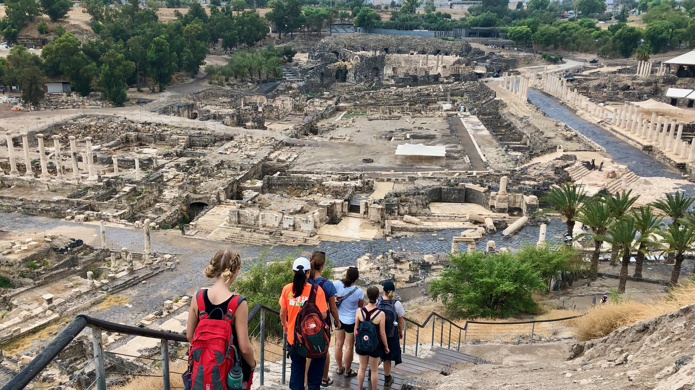
Ancient Insights
The Cultural Context of Jesus’s Teachings

Slide 2
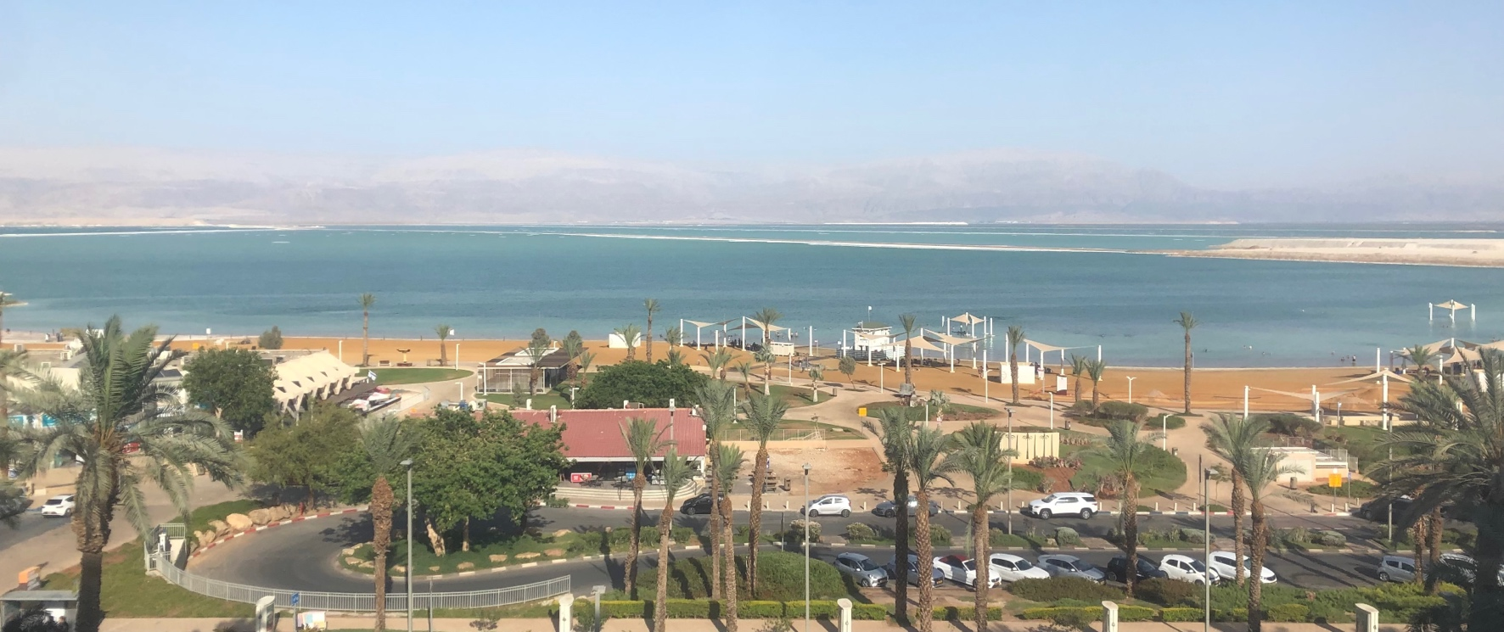
Israel Study Tour
June 30–July 12, 2024
Registration Open!

Slide 3
SteppingIntoTheJordan.com

Slide 4
Direct Link
https://steppingintothejordan.com/study-trips/

Slide 5
Objective and Method
70 Faces of Scripture
Different lenses reveal different insights.
The teachings of Jesus in the Gospels reflect the “culture of the day.”
Our Lens: Examine the culture of the Second Temple Period to shed light on Jesus’s teachings.

Slide 6
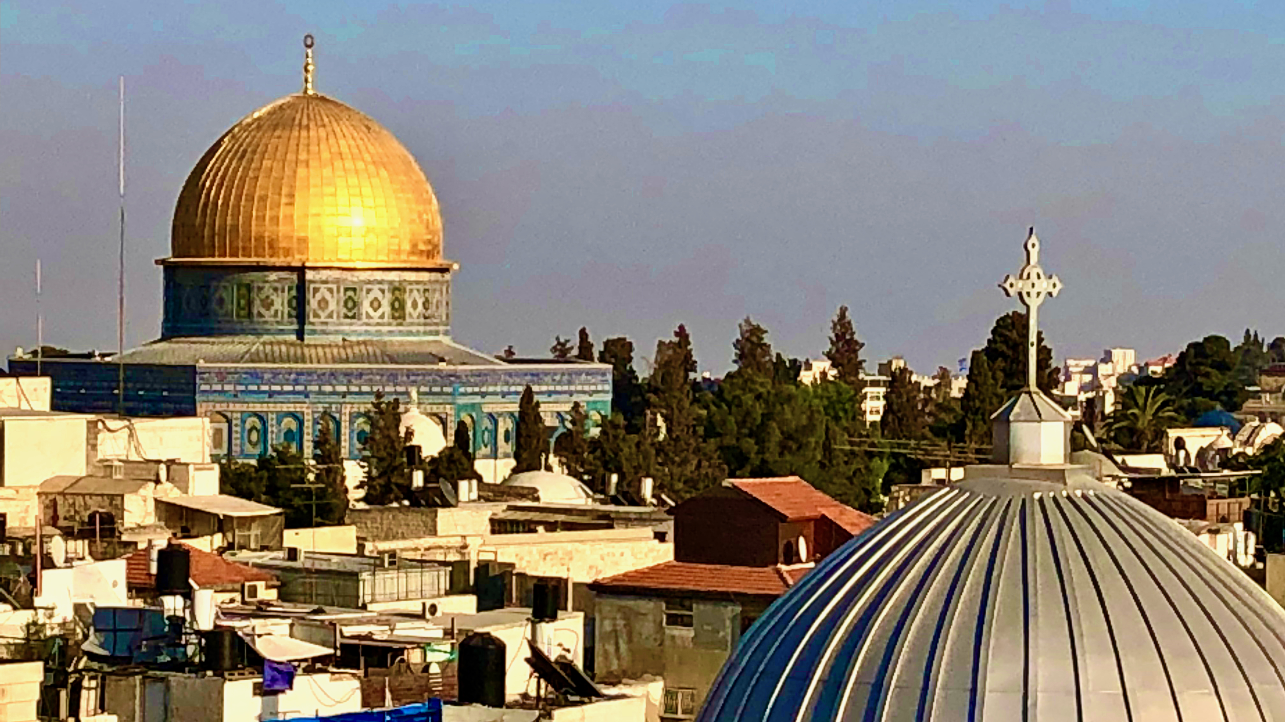
In the last days...

Slide 7
Are there concepts we read about in the New Testament that are not in the Old Testament?

Slide 8
Missing from the Old Testament
The idea of a soul
Satan/the Devil
Angels with Names
A Fiery Hell
Eternal Life

Slide 9
Was ancient Israel
polytheistic or monotheistic?

Slide 10
What do you make of this Scripture?
When the Most High apportioned the nations,
when he divided humankind,
he fixed the boundaries of the peoples
according to the number of the gods;
the LORD’S own portion was his people,
Jacob his allotted share.
Deut 32:8–9 (NRSV)

Slide 11
Ancient View of Deities
General belief that gods were geo-local.
Gods were allotted to people groups.
Chemosh: Moab
Milcom: Ammon
Ba’al: Phoenicia (and others)
Hadad: Aram
Dagon: Philistines
YHWH: Israel

Slide 12
Gods are local
The servants of the king of Aram said to him, “Their gods are gods of the hills, and so they were stronger than we; but let us fight against them in the plain, and surely we shall be stronger than they.
1 Kings 20:23

Slide 13
Gods are local
The king of Assyria brought people from Babylon, Cuthah, Avva, Hamath, and Sepharvaim, and placed them in the cities of Samaria in place of the people of Israel; they took possession of Samaria, and settled in its cities. When they first settled there, they did not worship the LORD; therefore the LORD sent lions among them, which killed some of them. So the king of Assyria was told, “The nations that you have carried away and placed in the cities of Samaria do not know the law of the god of the land; therefore he has sent lions among them; they are killing them, because they do not know the law of the god of the land.” Then the king of Assyria commanded, “Send there one of the priests whom you carried away from there; let him go and live there, and teach them the law of the god of the land.” So one of the priests whom they had carried away from Samaria came and lived in Bethel; he taught them how they should worship the LORD.
2 Kings 17:24–28

Slide 14
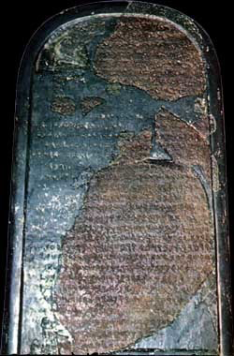
The Mesha Stele
Omri was king of Israel, and oppressed Moab during many days, and Chemosh was angry with his aggressions. His son succeeded him, and he also said, I will oppress Moab. In my days he said, Let us go, and I will see my desire upon him and his house, and Israel said, I shall destroy it for ever. Now Omri took the land of Madeba, and occupied it in his day, and in the days of his son, forty years. And Chemosh had mercy on it in my time. And I built Baal-meon and made therein the ditch, and I built Kiriathaim.

Slide 15
In 722 BCE Israel exiled by Assyria
In 587 BCE Judah exiled by Babylon
Why were they exiled?
Idolatry: Worshipping other gods

Slide 16
Reading Against the Grain
If we read between the lines of the Old Testament, the picture becomes clear.
Ancient Israel was polytheistic. They worshipped other gods.
According to Deuteronomy, Joshua, Judges, 1-2 Samuel, and 1-2 Kings. This was why they ended up in Babylon.

Slide 17
Prophetic Warnings
You are going to be punished for worshipping other gods.
Repent!!!
Even though you will be punished, there is hope for a better future.
The Davidic monarchy will be restored.

Slide 18
In 539 BCE Persia lets them return.
Did anything change?
Yes!
They appear to be monotheistic.

Slide 19
Does belief in only one God— the God of the Universe— cause any problems that you don’t have if you believe in many gods?

Slide 20
Challenges of Monotheism
The problem of evil.
If there is only one God, why is there evil in the world?
How can God allow the righteous to suffer?
Foreign powers still rule Judah.
When will the prophetic promises come to pass?
Why do the righteous suffer under oppression?
How can the God of the Universe properly govern the affairs of all nations and people?

Slide 21
How do (some) Jews respond?
Evil is the fault of fallen angels.
Ha-Satan (the accuser) becomes Satan.
Angels get names
God is more distant. Angels carry out God’s bidding.
Evolution of Deut. 32:8–9
Angels do cosmic administration of nations.

Slide 22
He said to me, “Daniel, greatly beloved, pay attention to the words that I am going to speak to you. Stand on your feet, for I have now been sent to you.” So while he was speaking this word to me, I stood up trembling. He said to me, “Do not fear, Daniel, for from the first day that you set your mind to gain understanding and to humble yourself before your God, your words have been heard, and I have come because of your words. But the prince of the kingdom of Persia opposed me twenty-one days. So Michael, one of the chief princes, came to help me, and I left him there with the prince of the kingdom of Persia, and have come to help you understand what is to happen to your people at the end of days. For there is a further vision for those days.”...
Then he said, “Do you know why I have come to you? Now I must return to fight against the prince of Persia, and when I am through with him, the prince of Greece will come. But I am to tell you what is inscribed in the book of truth. There is no one with me who contends against these princes except Michael, your prince.
Dan 10:11–14, 20–21

Slide 23
How do (some) Jews respond?
God’s will make things right in the “age to come.”
Judgment will be a sudden cosmic upheaval.
The social order will be turned upside-down.
The oppressors will be defeated.
The righteous will rule in their place.
The kingship of David’s line will be restored.
Everything will be as God intended from the beginning.
Resurrection of the dead to eternal life.

Slide 24
How do (some) Jews respond?
A new genre of literature: Apocalyptic
Starts in the 4th century BCE.

Slide 25
Summary
When Jews came to understand God as the ONLY God, they had to face the problem of evil in the world.
We see them wrestle with this in Scripture.
Scripture begins to help answer these questions.
The rise of a new genre: Apocalyptic literature.

Slide 26
Next Week
Apocalyptic Literature.
Since this apocalyptic worldview was so prevalent in the 1st century...
What does it mean that Jesus is the Messiah?

