Slide 1
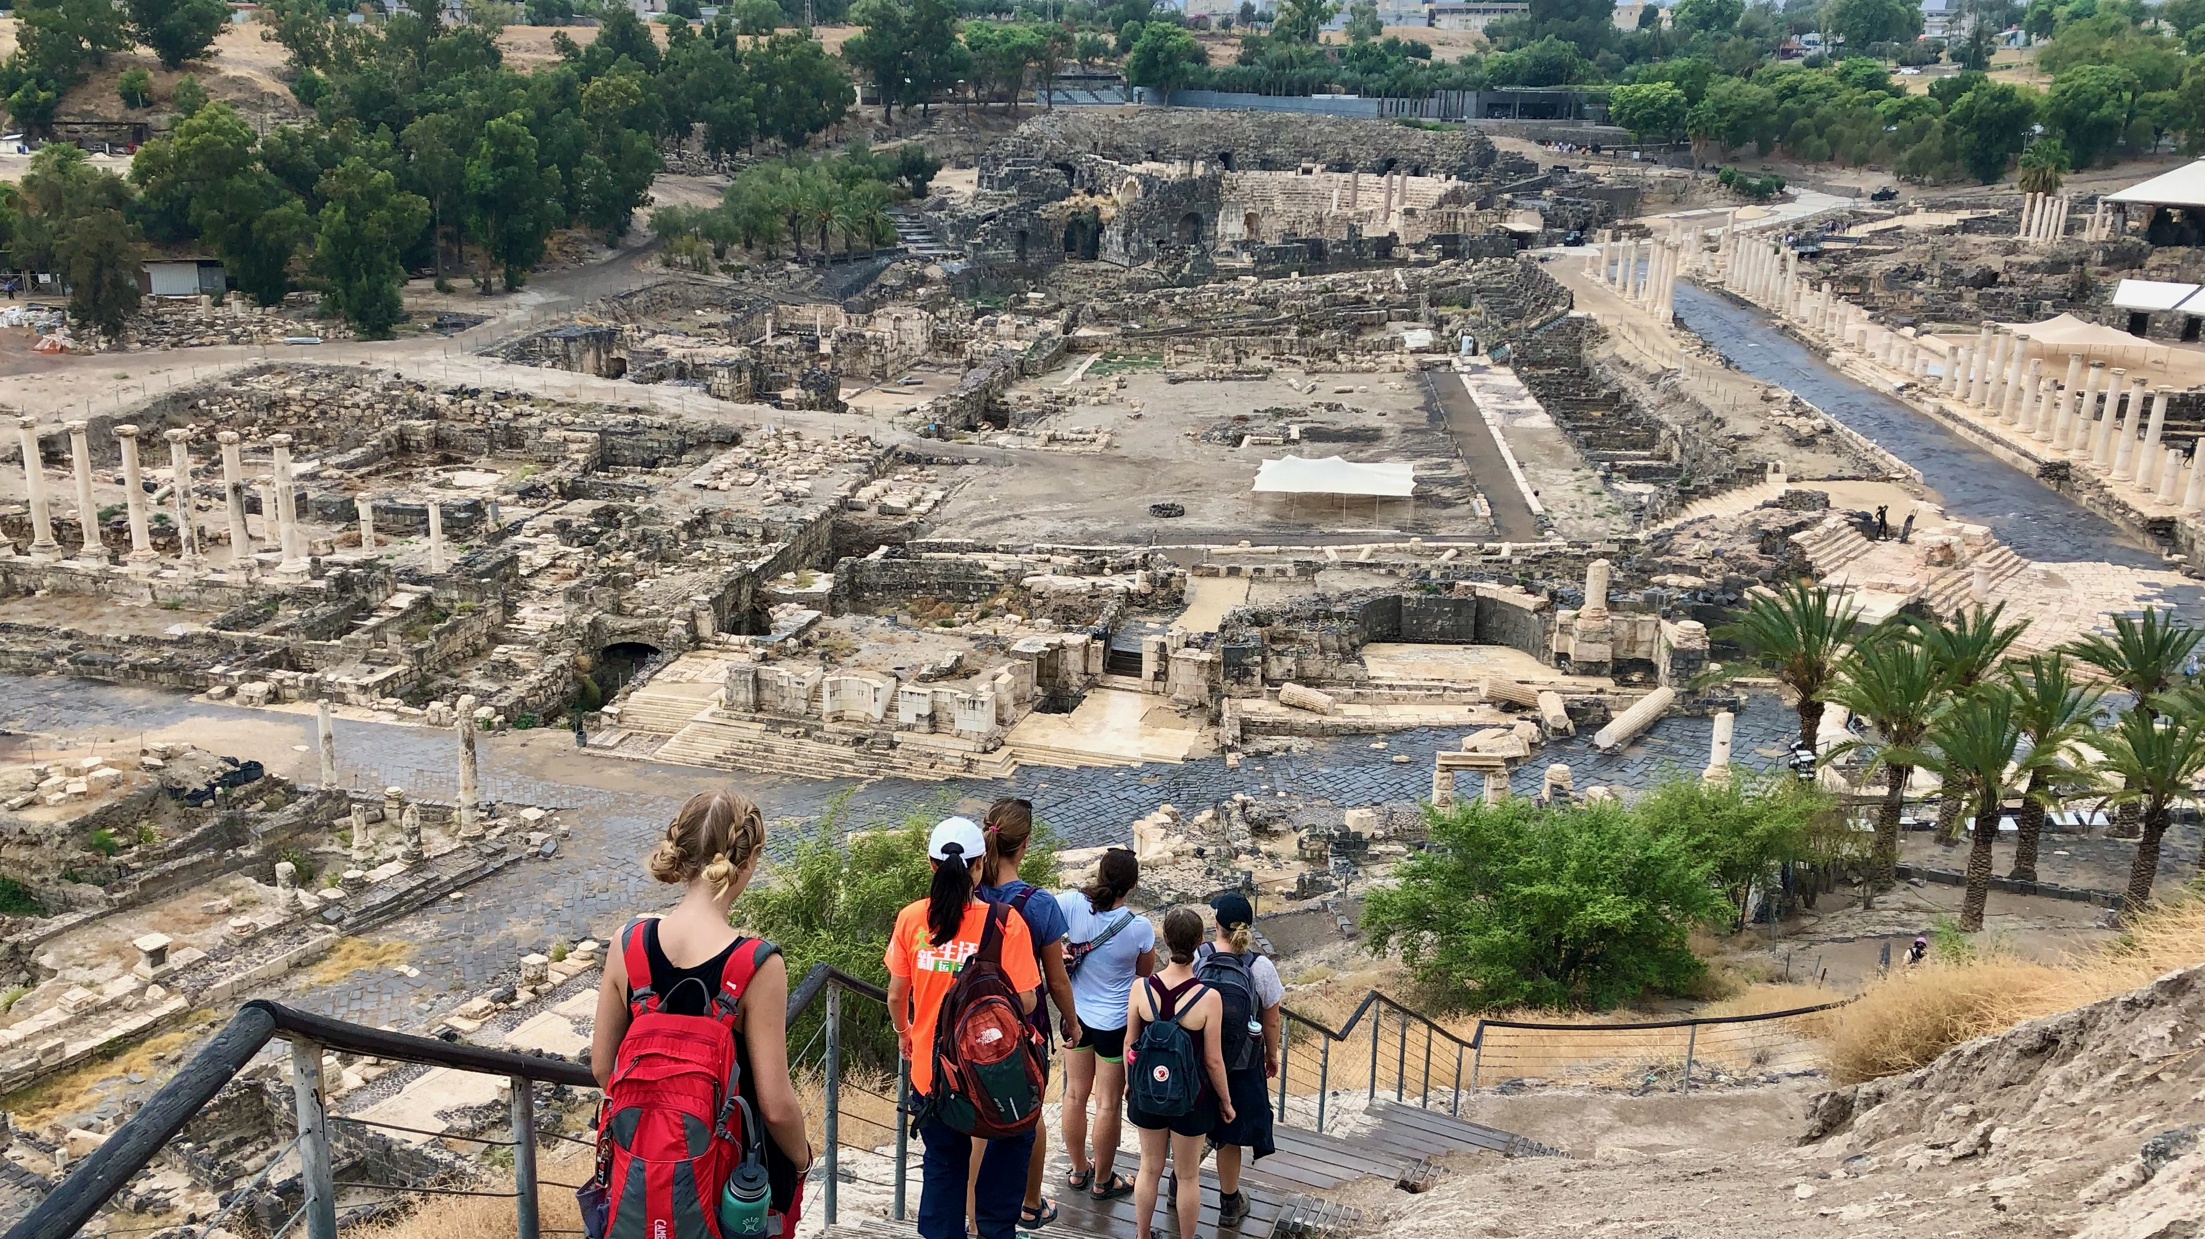
Ancient Insights
The Cultural Context of Jesus’s Teachings

Slide 2
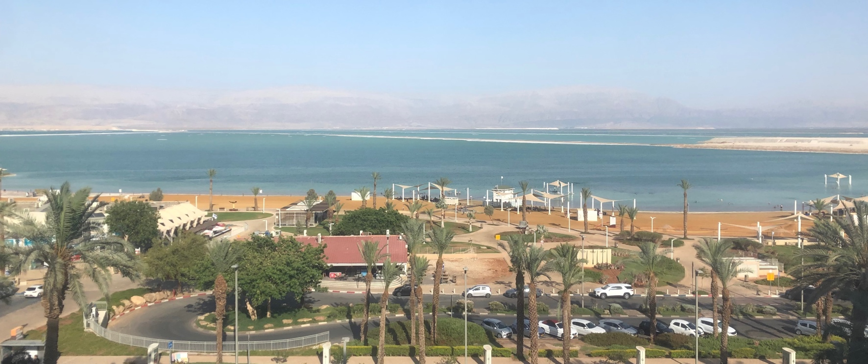
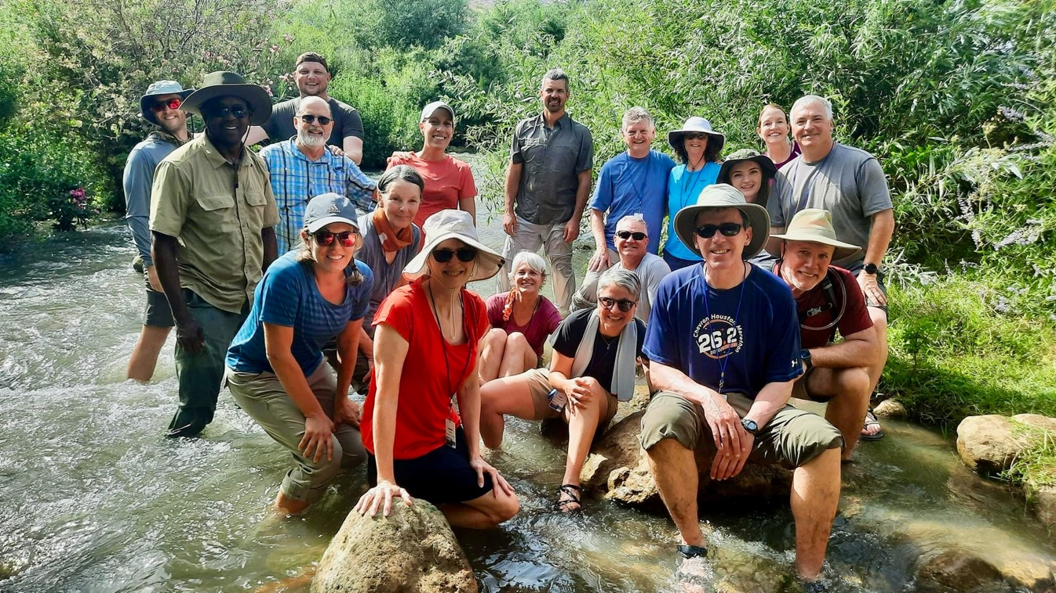
Israel Study Tour
June 30–July 12, 2024
Registration Open!

Slide 3
SteppingIntoTheJordan.com

Slide 4
Direct Link
https://steppingintothejordan.com/study-trips/

Slide 5
Objective and Method
70 Faces of Scripture
Different lenses reveal different insights.
The teachings of Jesus in the Gospels reflect the “culture of the day.”
Our Lens: Examine the culture of the Second Temple Period to shed light on Jesus’s teachings.

Slide 6
Jesus and the Canaanite Woman

Slide 7
Do you agree or disagree?
All meaning comes from the reader.

Slide 8
A Fun Example...
AI Prompt:
An image of Jesus flipping over tables.

Slide 9
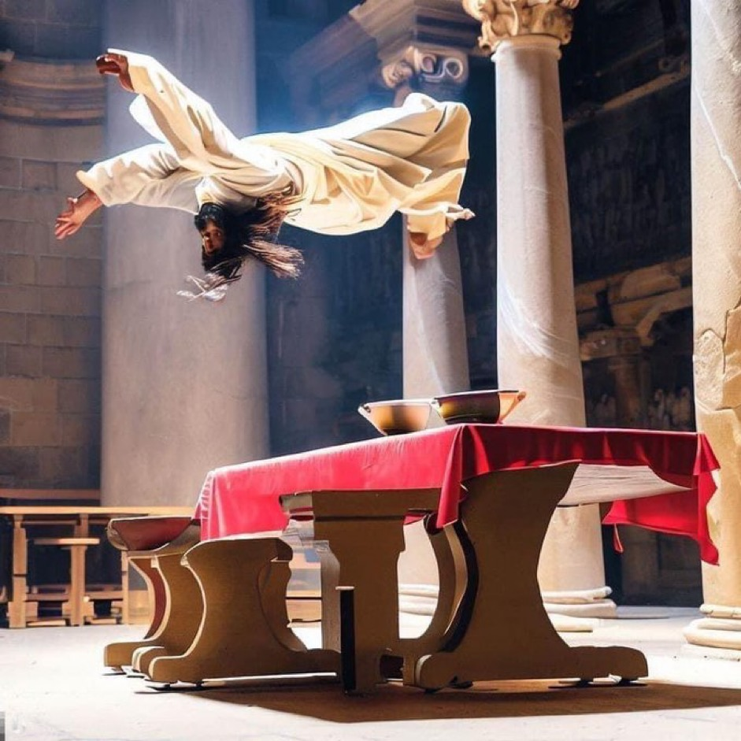
The Result
What is “flipping?”
What color is Jesus?
What kind of hair?
What sort of table is it?
What’s on the table?
What’s the location?

Slide 10
Elijah at Mt. Horeb
Then the word of the LORD came to him, saying,
“What are you doing here, Elijah?”
1 Kings 19:9b (NRSV)
What tone do you give to this question?
Where do you place the emphasis?

Slide 11
How do you read it?
“What are you doing here, Elijah?”
“What are you doing here, Elijah?”
“What are you doing here, Elijah?”
“What are you doing here, Elijah?”
“What are you doing here, Elijah?”

Slide 12
Same, Same...but Different
For I know the plans I have for you,” declares the LORD, “plans to prosper you and not to harm you, plans to give you hope and a future.
Jer 29:11 (NIV)
How many have received a card with this Scripture?
What is the context of this passage?
In this case, the reader creates meaning by ignoring context.

Slide 13
The Reader Generates Meaning
There is more “white space” than “black” in the Bible.
The reader is left to fill in the “white space.”
Our social location always influences how we read the text (i.e., fill in the “white space”).
There are multiple ways to read a text to generate meaning.
There is incredible value in looking at new ways to read the biblical text.

Slide 14
Jesus and the Canaanite Woman

Slide 15
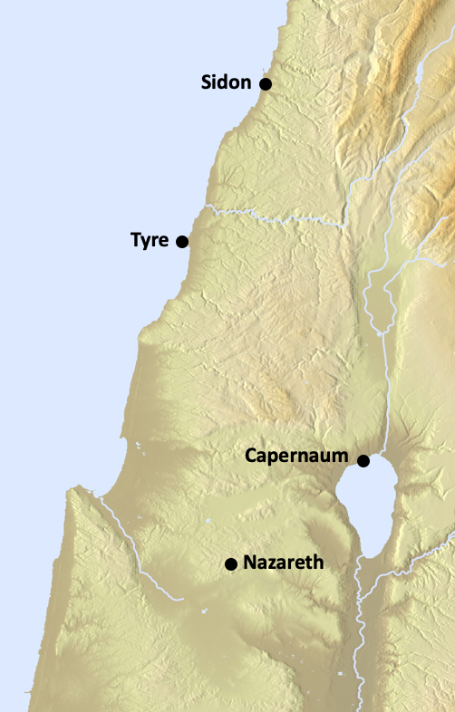
Jesus left that place and went away to the district of Tyre and Sidon. Just then a Canaanite woman from that region came out and started shouting, “Have mercy on me, Lord, Son of David; my daughter is tormented by a demon.” But he did not answer her at all. And his disciples came and urged him, saying, “Send her away, for she keeps shouting after us.” He answered, “I was sent only to the lost sheep of the house of Israel.” But she came and knelt before him, saying, “Lord, help me.” He answered, “It is not fair to take the children’s food and throw it to the dogs.” She said, “Yes, Lord, yet even the dogs eat the crumbs that fall from their masters’ table.” Then Jesus answered her, “Woman, great is your faith! Let it be done for you as you wish.” And her daughter was healed instantly.
Matt 15:21–28

Slide 16
What do you make of Jesus’s response?
Does it seem harsh?
How do read Jesus’s response?

Slide 17
Jesus left that place and went away to the district of Tyre and Sidon. Just then a Canaanite woman from that region came out and started shouting, “Have mercy on me, Lord, Son of David; my daughter is tormented by a demon.” But he did not answer her at all. And his disciples came and urged him, saying, “Send her away, for she keeps shouting after us.” He answered, “I was sent only to the lost sheep of the house of Israel.” But she came and knelt before him, saying, “Lord, help me.” He answered, “It is not fair to take the children’s food and throw it to the dogs.” She said, “Yes, Lord, yet even the dogs eat the crumbs that fall from their masters’ table.” Then Jesus answered her, “Woman, great is your faith! Let it be done for you as you wish.” And her daughter was healed instantly.
Matt 15:21–28

Slide 18
Is there another way to read this exchange?
His statements are directed at the disciples.

Slide 19
Disciples out of their comfort zone
In Tyre and Sidon (maybe for the first time).
Very few Jews up here (if any).
You are Israel’s Messiah!
They are annoyed...and this woman is drawing even more attention to them!

Slide 20
What if...
What is Jesus’s response is directed at them?
What if he says it with a sarcastic tone?
How would it change the meaning of this text?

Slide 21
Jesus left that place and went away to the district of Tyre and Sidon. Just then a Canaanite woman from that region came out and started shouting, “Have mercy on me, Lord, Son of David; my daughter is tormented by a demon.” But he did not answer her at all. And his disciples came and urged him, saying, “Send her away, for she keeps shouting after us.” He answered, “I was sent only to the lost sheep of the house of Israel.” But she came and knelt before him, saying, “Lord, help me.” He answered, “It is not fair to take the children’s food and throw it to the dogs.” She said, “Yes, Lord, yet even the dogs eat the crumbs that fall from their masters’ table.” Then Jesus answered her, “Woman, great is your faith! Let it be done for you as you wish.” And her daughter was healed instantly.
Matt 15:21–28

Slide 22
If we read Jesus’s tone in this way,
what is the faith lesson for the disciples?

Slide 23
Summary
We always bring meaning to the text.
We fill in the “white space.”
This passage becomes less troublesome if we assume that Jesus directs his comments to the disciples more than the woman.
It’s a lesson for them about who is “in” vs. “out” in the Kingdom of God.

Slide 24
Next Week
What does it mean that Jesus is the Messiah?
Does believing there is only one God cause problems that you don’t have if you believe in many gods?

