Slide 1
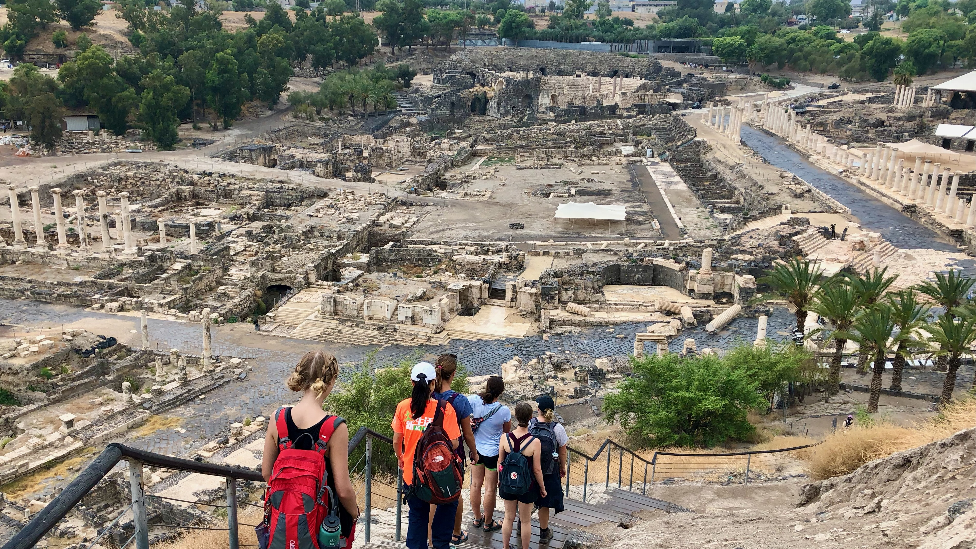
Ancient Insights
The Cultural Context of Jesus’s Teachings

Slide 2





Israel Study Tour
June 30–July 12, 2024
Early Registration Access

Slide 3
Objective and Method
70 Faces of Scripture
  Different lenses reveal different insights.
The teachings of Jesus in the Gospels reflect the “culture of the day.”
Our Lens: Examine the culture of the Second Temple Period to shed light on Jesus’s teachings.

Slide 4
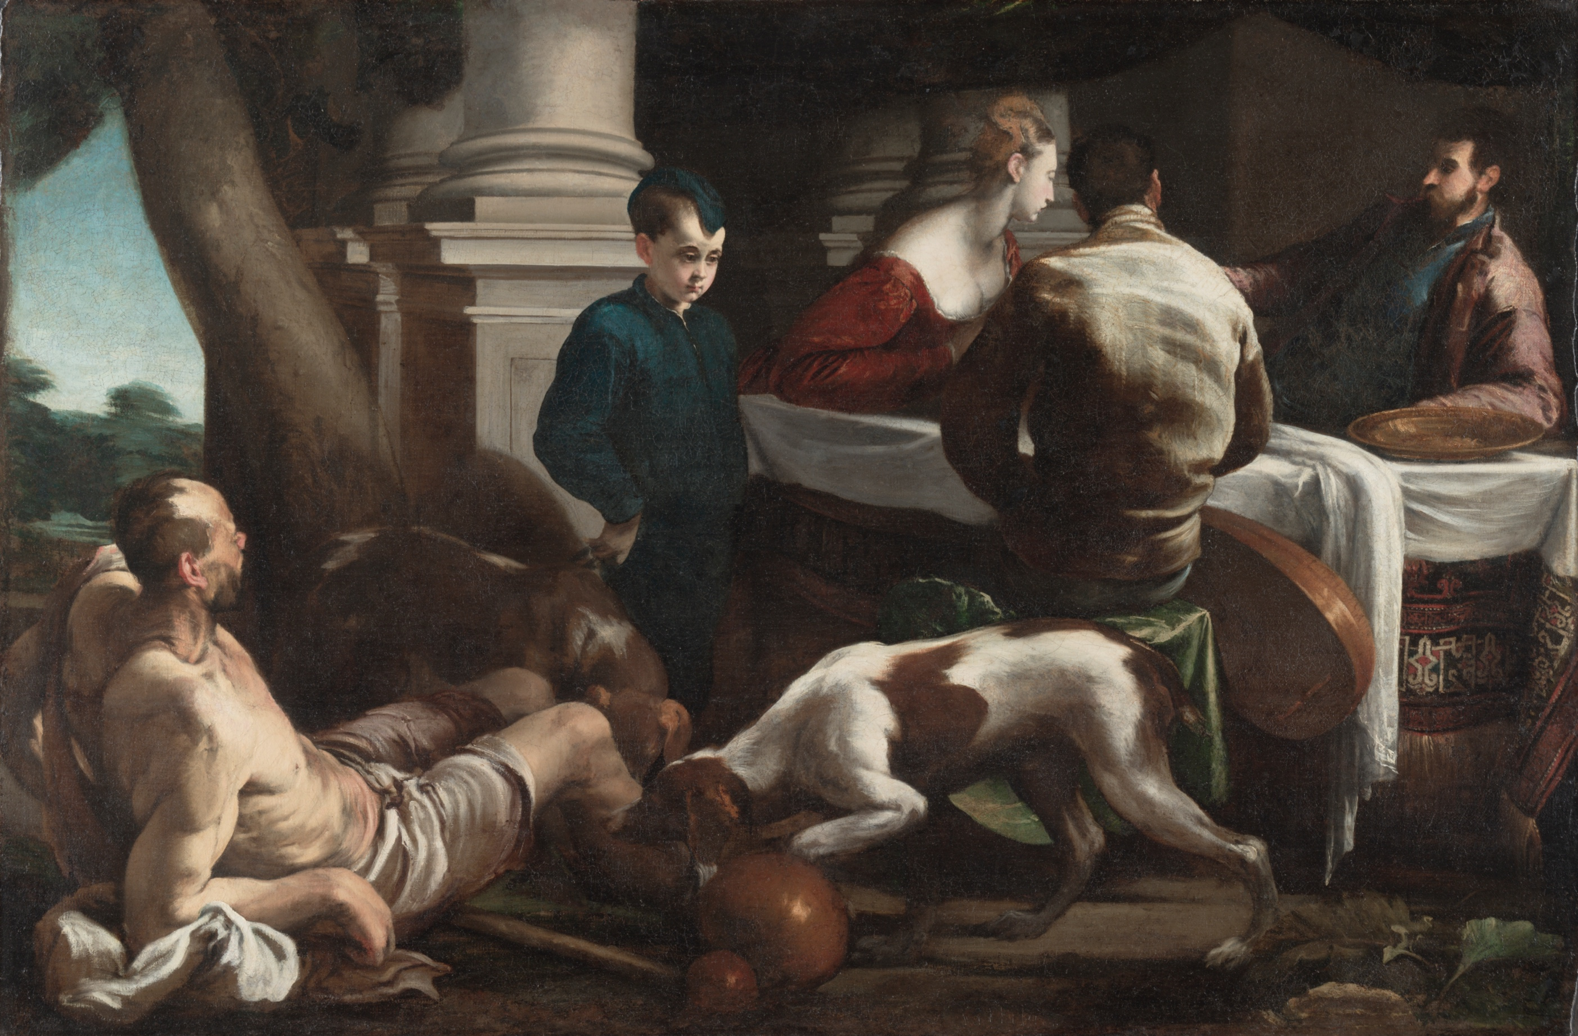
The Parable of the Rich Man and Lazarus

Slide 5
A Note about Luke
Luke is critical of wealth.
The wealthy come off as negative in the Gospel.
His criticism of wealth is noteworthy given that the gospel was probably commissioned by a wealthy patron.

Slide 6
Literary Context
This parable is only told in Luke.
Part of Luke’s “special material.”
Luke 16:19–31

Slide 7
Literary Context
“Now all the tax collectors and sinners were coming near to listen to him. And the Pharisees and the scribes were grumbling and saying, ‘This fellow welcomes sinners and eats with them.’” (Luke 15:1–2, NRSV)
The “Lost” Parables: Sheep, Coin, Son (15:3–32)
The Parable of the Dishonest Manager (16:1–13)

Slide 8
Literary Context
The Pharisees, who were lovers of money, heard all this, and they ridiculed him. So he said to them, “You are those who justify yourselves in the sight of others; but God knows your hearts; for what is prized by human beings is an abomination in the sight of God.
Luke 16:14–15
Teaching about the Law (16:16–17)
Teaching about Divorce (16:18)

Slide 9
The Parable
There was a rich man who was dressed in purple and fine linen and who feasted sumptuously every day. And at his gate lay a poor man named Lazarus, covered with sores, who longed to satisfy his hunger with what fell from the rich man’s table; even the dogs would come and lick his sores. The poor man died and was carried away by the angels to be with Abraham. The rich man also died and was buried.
Luke 19:19–22

Slide 10
The Parable
In Hades, where he was being tormented, he looked up and saw Abraham far away with Lazarus by his side. He called out, ‘Father Abraham, have mercy on me, and send Lazarus to dip the tip of his finger in water and cool my tongue; for I am in agony in these flames.’ But Abraham said, ‘Child, remember that during your lifetime you received your good things, and Lazarus in like manner evil things; but now he is comforted here, and you are in agony. Besides all this, between you and us a great chasm has been fixed, so that those who might want to pass from here to you cannot do so, and no one can cross from there to us.’
Luke 19:23–26

Slide 11
The Parable
“He said, ‘Then, father, I beg you to send him to my father’s house—for I have five brothers—that he may warn them, so that they will not also come into this place of torment.’ Abraham replied, ‘They have Moses and the prophets; they should listen to them.’ He said, ‘No, father Abraham; but if someone goes to them from the dead, they will repent.’ He said to him, ‘If they do not listen to Moses and the prophets, neither will they be convinced even if someone rises from the dead.’”
Luke 19:27–31

Slide 12
What do we know about the moral character
of Lazarus or the rich man?
Very Little

Slide 13
Where does this story come from?
Afterlife stories all around the ancient Mediterranean.
Egyptian: Setme Khamuas & Si-Osiris
Greco-Roman
  Tale of Cataplus (and Micyllus)
  Homer’s Odyssey
Jewish
  Poor Scholar & Rich Tax Collector
  Rich Man and his Wife
  1 Enoch

Slide 14
Setme and Si-Osiris
Egyptian story (2nd half of 1st century)
  Or possibly earlier
Egyptian underworld: Amente
Setme: Father of Si-Osiris
  Si-Osiris was reincarnated to deal with an Ethiopian magician.

Slide 15
Setme and Si-Osiris
Setme & Se-Osiris witness 2 funerals
  Rich man’s lavish funeral
  Pauper’s plain ceremony (no mourners)
Setme declares he would rather have the rich man’s fate in Amente.
Se-Osiris tells him he hopes he has the fate of the Pauper.

Slide 16
Setme and Si-Osiris
Si-Osiris takes his father on a tour of Amente to show the reversal of fortunes.
3 Classes of the Dead:
  Good Deeds > Bad Deeds (the Pauper)
  Bad Deeds > Good Deeds (the Rich Man)
  Good Deeds = Bad Deeds

Slide 17
Setme and Si-Osiris
The Pauper: Elevated to a high rank
The Rich Man:
  The pivot of a well-used door affixed into his eye.

Slide 18
What do you see that’s similar?
Rich man and poor man.
Concerned with the fate of the dead.
Rich man punished/Poor man rewarded
  Reversal of fortune in the afterlife.
Both are vague about the nature of good and evil.

Slide 19
The Tale of Cataplus
Greco Roman Tale (Lucian of Samosata)
  Cynic
Micyllus: A shoemaker
  Not poor, but on the social margins
  Endures insults and beatings from the powerful.
  Goes hungry from morning until evening.
  Eats a meager evening meal

Slide 20
The Tale of Cataplus
Megapenthes
  A rich man
  Tyrranical
  Neighbor of Micyllus
  Dressed in fine purple
  Ate lavish feasts
  “The aroma of meat tantalized Mycillus and he longed to be part of the feasts.”

Slide 21
The Tale of Cataplus
Both die.
Both go to Hades
Mycillus’s soul is judged pure.
  Sent to the Isles of the Blessed.

Slide 22
The Tale of Cataplus
Megapenthes:
  Tries to run away from Hermes
  Bargains with the fate, Chloe.
  Charged with killing people to confiscate their wealth and unbridled licentiousness.
  Not allowed to drink the water of Lethe.
    Condemned to remember all that he had in life.

Slide 23
The Tale of Cataplus
Cynics’ criticism of Greco-Roman Symposia.
  Not just banquets, but rampant with sexual immorality.
Micyllus’s long work hours are a model of virtue and self-control (no time for vices).
The idle rich spend their time satisfying their personal desires.

Slide 24
The Rich Man and His Wife
Jewish Story
A Godless Wealthy Couple
  The Wife dies and goes to Hades.
A boy offers to travel to Hades on the husband’s behalf.
The wife sends a message back with the boy:
  “turn over a new leaf, for the power of repentance is great.”
The Husband repents.

Slide 25
Literary Motifs
Stories about fate in the afterlife were very common.

Slide 26
Parables are stories with a twist.
The similarities may not be as important
as the differences.
What is the plot twist in the parable?

Slide 27
Based on these common stories,
how might you expect the parable to go?

Slide 28
The “Expected” Parable
Rich Man and Lazarus
Both die: Rich man punished, Lazarus rewarded.
Rich man begs Abraham to send Lazarus back to warn his brothers.
Lazarus returns to warn his brothers.
The brothers repent.

Slide 29
What’s the Plot Twist?
There is no message from beyond the grave.
  Abraham refuses to send Lazarus back.
Notice the Rich Man’s reaction:
  “Certainly not, father Abraham! but if someone goes to them from the dead, they will repent”
  (my translation).
The Law and the Prophets are sufficient.

Slide 30
What does this mean in Context?
The Pharisees, who were lovers of money, heard all this, and they ridiculed him. So he said to them, “You are those who justify yourselves in the sight of others; but God knows your hearts; for what is prized by human beings is an abomination in the sight of God.
Luke 16:14–15
There is a message about blatant social inequity.

Slide 31
What does this mean in Context?
The wealthy have a social responsibility.
  Care for the less fortunate and poor.
The Poor have hope in God’s justice.
To understand the injustice of wealth inequity, one only needs to read Moses and the Prophets.

Slide 32
Summary
Jesus’s parable expands on a rich body of afterlife literature.
The plot twist: no warnings from beyond.
Luke uses the parable as a commentary on the injustice of wealth inequity.
The poor should have faith in God’s justice.
The rich should beware of God’s justice.

Slide 33

Next Week

Slide 34
In Two Weeks...
Reception for the Maloneys

Slide 35
In Three Weeks...
What’s so special about Elijah?
Matt 16:13–14
Matt 17:1–13
Matt 27:45–50

