Slide 1
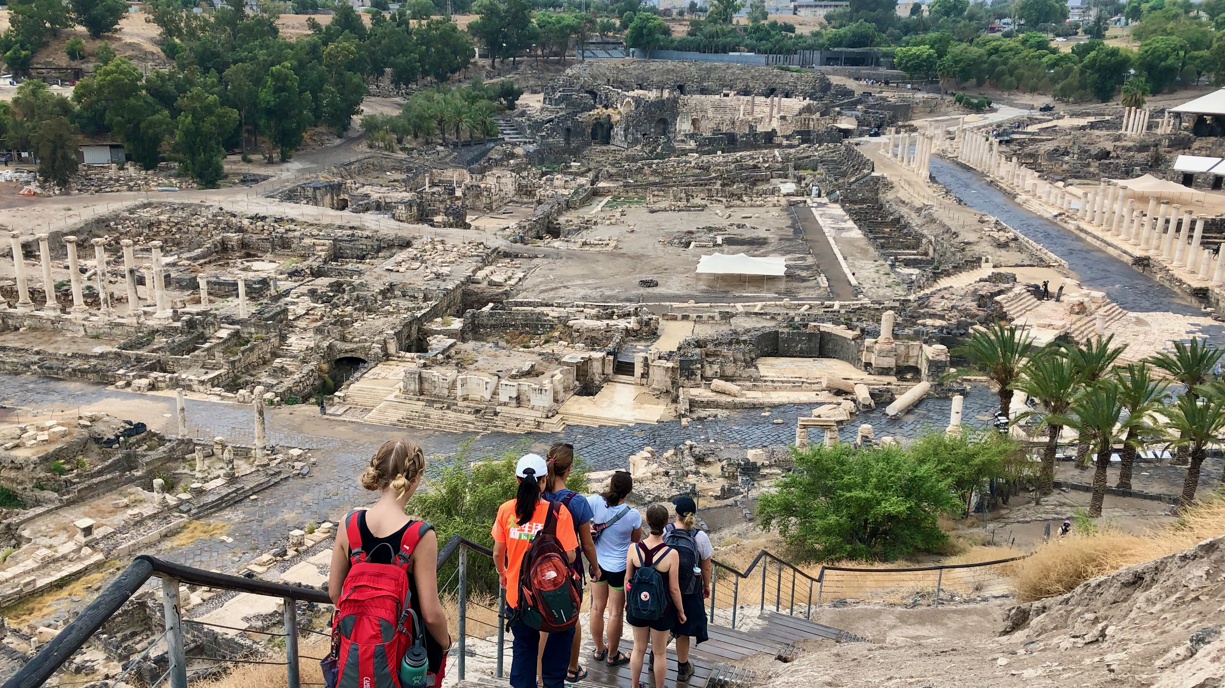
Ancient Insights
The Cultural Context of Jesus’s Teachings

Slide 2
Objective and Method
70 Faces of Scripture
Different lenses reveal different insights.
The teachings of Jesus in the Gospels reflect the “culture of the day.”
Our Lens: Examine the culture of the Second Temple Period to shed light on Jesus’s teachings.

Slide 3
Jesus and Current Events

Slide 4
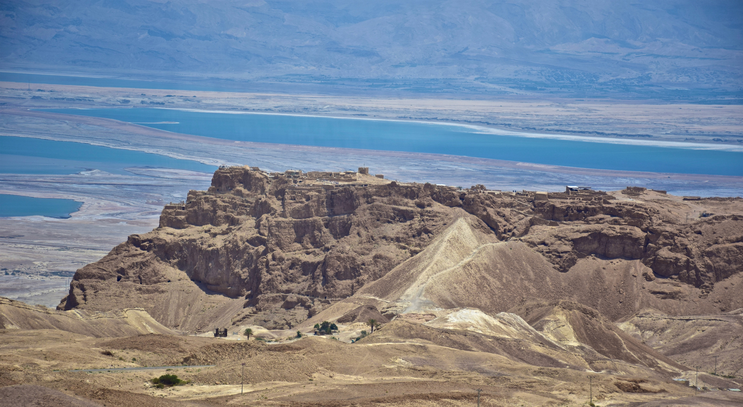
Herod the Great (and Family)

Slide 5
A Brief History...
1250 BCE(?) – Israel enters Promised Land
1060 BCE – Saul appointed King
1000 BCE – David becomes King
960 BCE – Solomon becomes King
920 BCE – Divided Kingdom (Israel & Judah)
722 BCE – Assyria conquers Israel
Exiles elite from Northern Kingdom
Judah becomes a vassal of Assyria
612 BCE – Babylon conquers Assyria

Slide 6
A Brief History...
587 BCE Babylonians Destroy Jerusalem and Temple. Babylonian exile.
539 BCE Persian conquest of Babylonia by Cyrus the Great
530s–520s BCE Waves of Jews return from Babylonia
516 BCE Temple rebuilt
458–432 BCE Ezra & Nehemiah
333/34 BCE Alexander the Great conquers Persia
301 BCE Macedonia Ptolemies rule Judea
200 BCE Seleucids rule Judea
168/7 BCE Antiochus Epiphanes (Seleucid) Persecution
164 BCE Maccabees reconquer and purify the temple
164–63 BCE Start of Maccabean/Hasmonean rule
63 BCE Start of the Roman period

Slide 7
The Problem with Herod
Herod (72–4 BCE)
Father (Antipater) was an Idumean (Edomite).
Mother (Cypros) was Nabatean from Petra.
Idumeans were converts to Judaism.
Herod’s detractors did not consider him to be a “real” Jew.
Apparently this was a sore point for Herod.
Herod was not born to Jewish aristocracy.
He was of common birth.
Herod marries Miramme, a Hasmonean princess.
Gain Jewish credibility / ensure his sons are considered Hasmoneans.

Slide 8
Herod: A Complex Figure
Accomplished military leader
Master politician
Unparalleled builder
Paranoid ruler
Ruthless psychopath

Slide 9
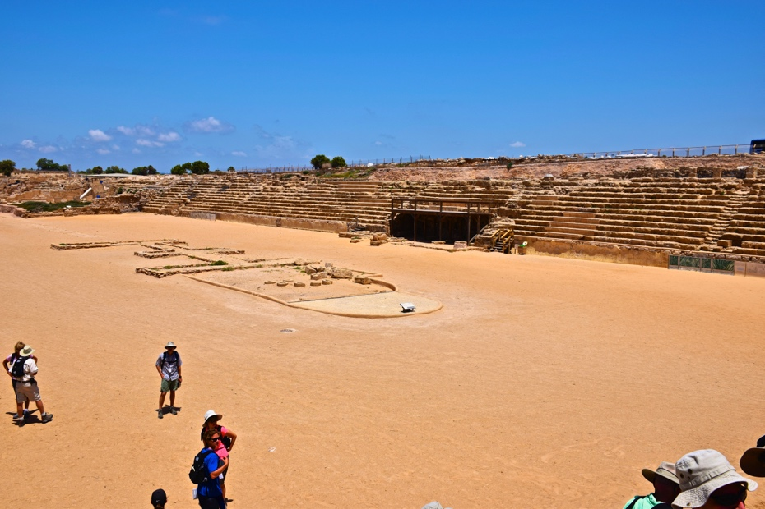
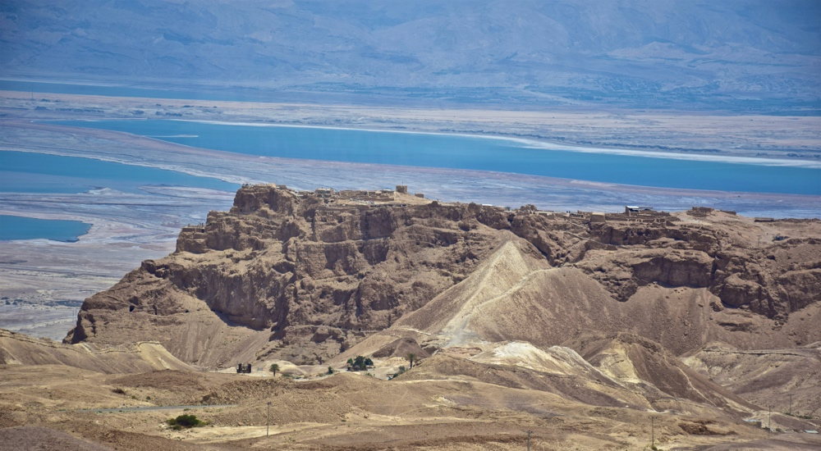
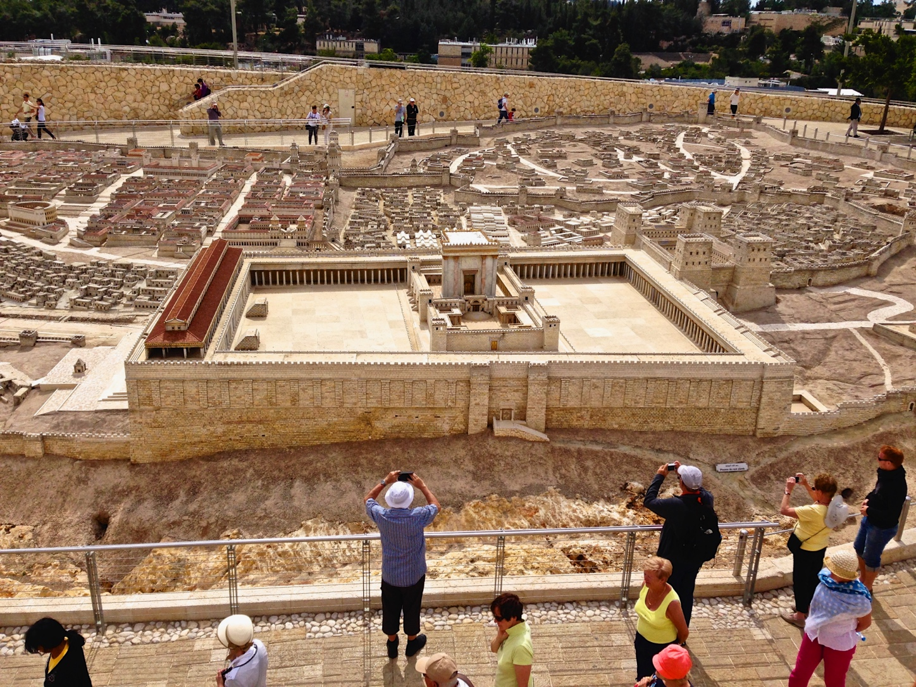
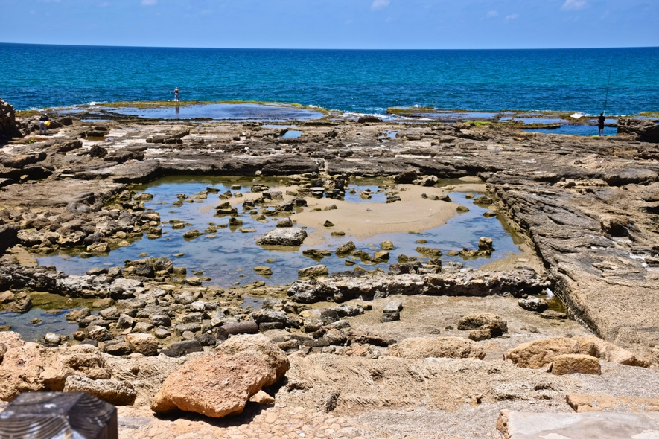
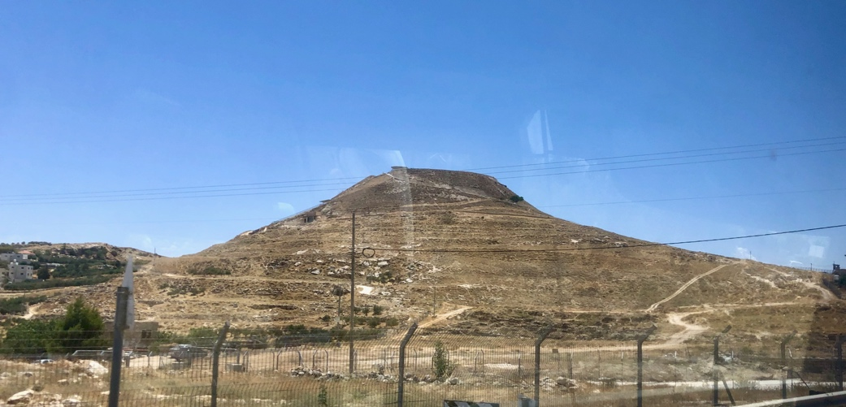
Herod the Builder

Slide 10
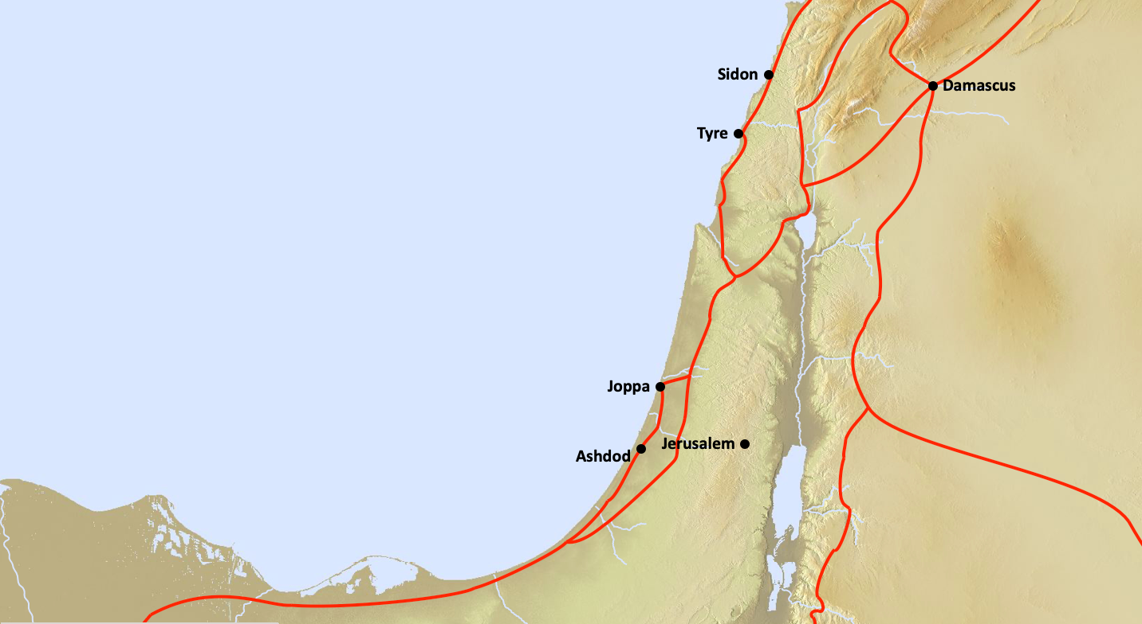
Judea’s Trade Problem

Slide 11
Herod’s Solution:
Caesarea Maritime

Slide 12
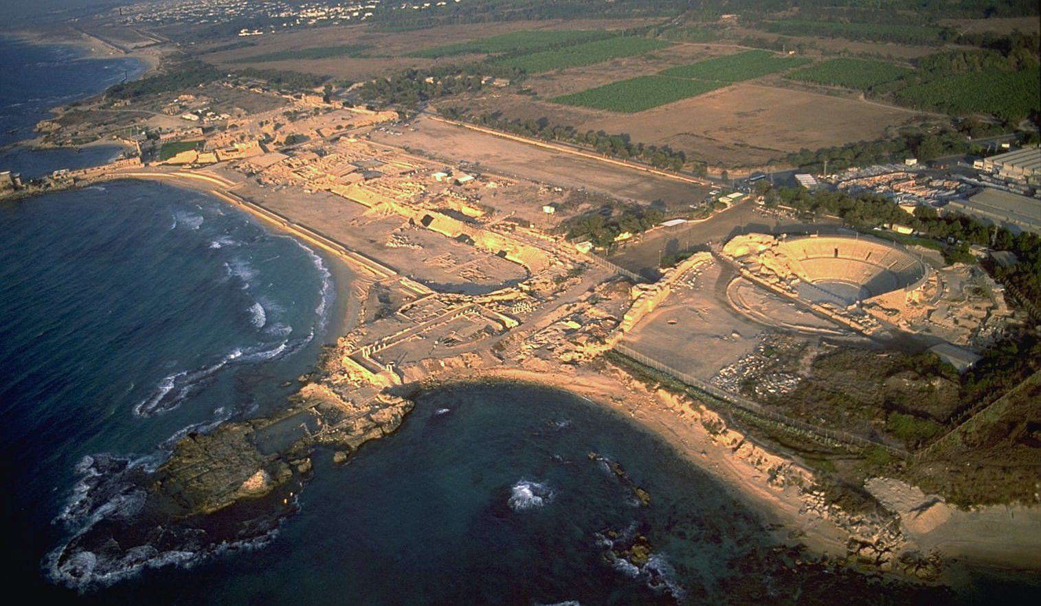
Caesarea Maritima

Slide 13
Caesarea Maritima
For the whole seaboard from Dora to Joppa, midway between which the city lies, was without a harbor, so that vessels bound for Egypt along the coast of Phoenicia had to ride at anchor in the open when menaced by the south-west wind; for even a moderate breeze from this quarter dashes the waves to such a height against the cliffs, that their reflux spreads a wild commotion far out to sea. However, by dint of expenditure and enterprise, the king [Herod the Great] triumphed over nature and constructed a harbor larger than the Piraeus [at Athens], including other deep roadsteads within its recesses...Notwithstanding the totally recalcitrant nature of the site, he grappled with the difficulties so successfully, that the solidity of his masonry defied the sea, while its beauty was such as is no obstacle had existed.
Josephus, War i.409–411

Slide 14
Caesarea Maritima

Slide 15
Masada
Herod’s “Safe Room”
An Oasis in the Desert

Slide 16
The Temple

Slide 17
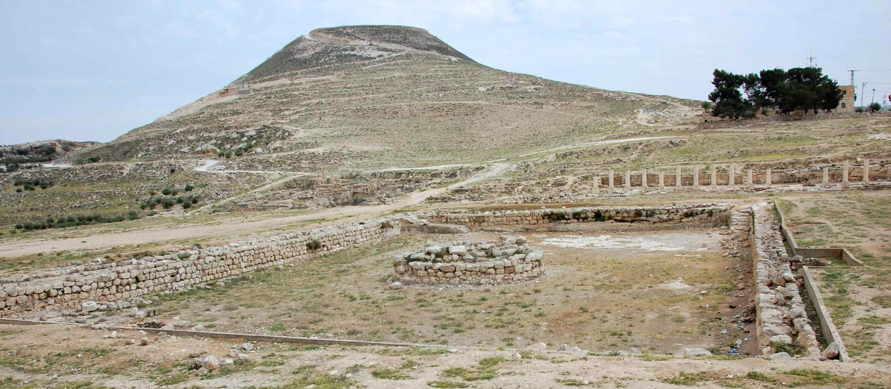
Herodium

Slide 18
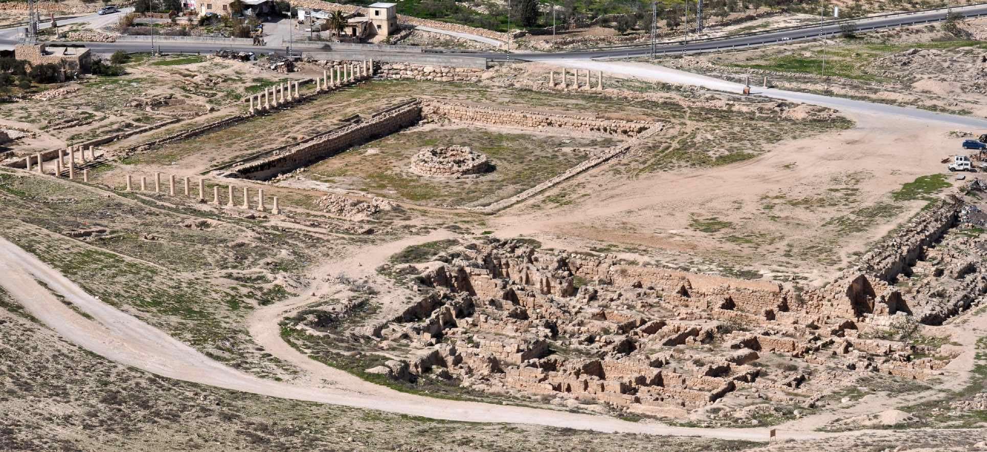
Herodium

Slide 19
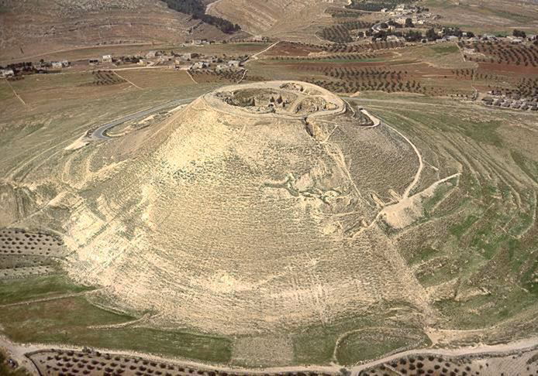
Herodium

Slide 20
Herodium
One of 11 fortresses/palaces
3 miles from Bethlehem/8 miles from Jerusalem.
Site of Herod’s victory of Antigonus
his Hasmonean rival
Built a fortress/palace on a hilltop
Problem: The hill wasn’t tall enough.
Solution: Take dirt from neighboring hill to make it higher.

Slide 21
Matt 17:14–20
When they came to the crowd, a man came to him, knelt before him, and said, “Lord, have mercy on my son, for he is an epileptic and he suffers terribly; he often falls into the fire and often into the water. And I brought him to your disciples, but they could not cure him.” Jesus answered, “You faithless and perverse generation, how much longer must I be with you? How much longer must I put up with you? Bring him here to me.” And Jesus rebuked the demon, and it came out of him, and the boy was cured instantly. Then the disciples came to Jesus privately and said, “Why could we not cast it out?” He said to them, “Because of your little faith. For truly I tell you, if you have faith the size of a mustard seed, you will say to this mountain, ‘Move from here to there,’ and it will move; and nothing will be impossible for you.” (NRSV)

Slide 22
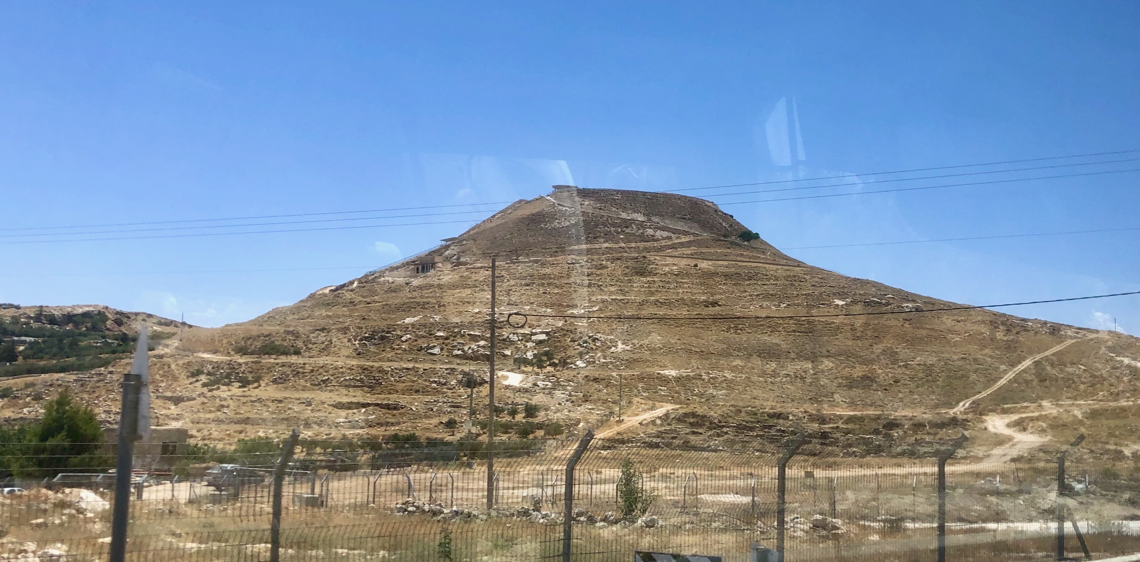
Then the disciples came to Jesus privately and said, “Why could we not cast it out?” He said to them, “Because of your little faith. For truly I tell you, if you have faith the size of a mustard seed, you will say to this mountain, ‘Move from here to there,’ and it will move; and nothing will be impossible for you.”

Slide 23
How does Jesus use
current events in this parable?

Slide 24
My Thoughts...
The moving of the mountain was not an impossible feat. It was a real event.
Jesus is not promising magical powers.
Jesus promises faithful empowerment.
Even for those with the minutest faith.

Slide 25
Summary
Jesus uses well-known, current events as the basis for (some of) his teachings.
These events add context to provide possible new meanings for the text.
The 10 servants upend the social order through their faithful service.
Even those with the smallest faith are promised empowerment.

Slide 26
Next Week
The Parable of the Persistent Widow
Read Luke 18:1–8
What Jewish interpretive technique does Jesus use with this parable?
How do YOU read this parable?

