Slide 1
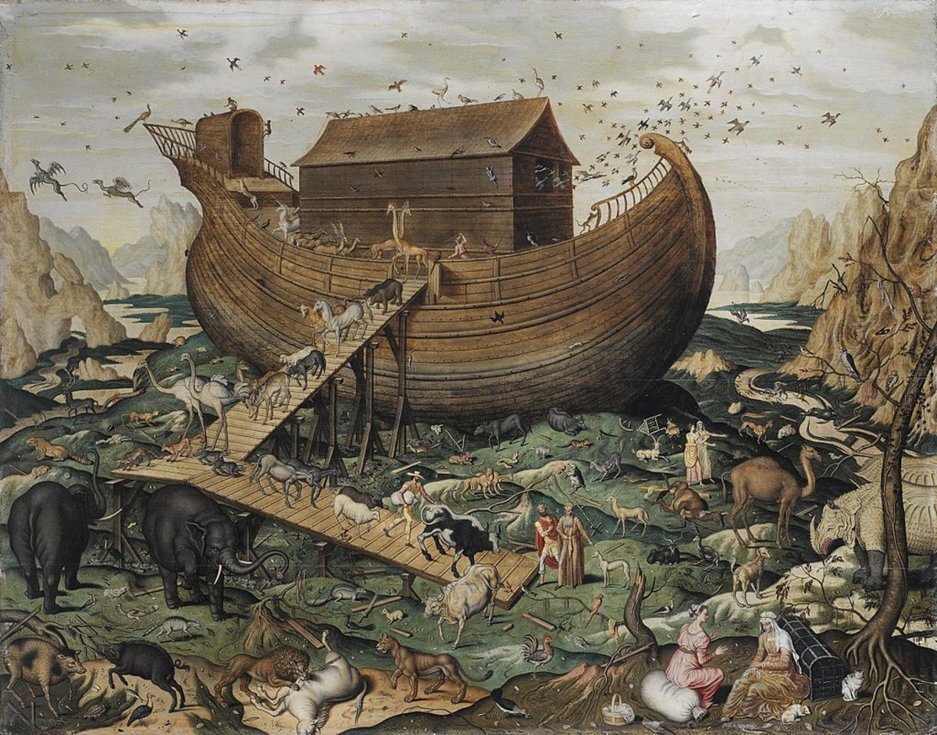
The Flood

Slide 2
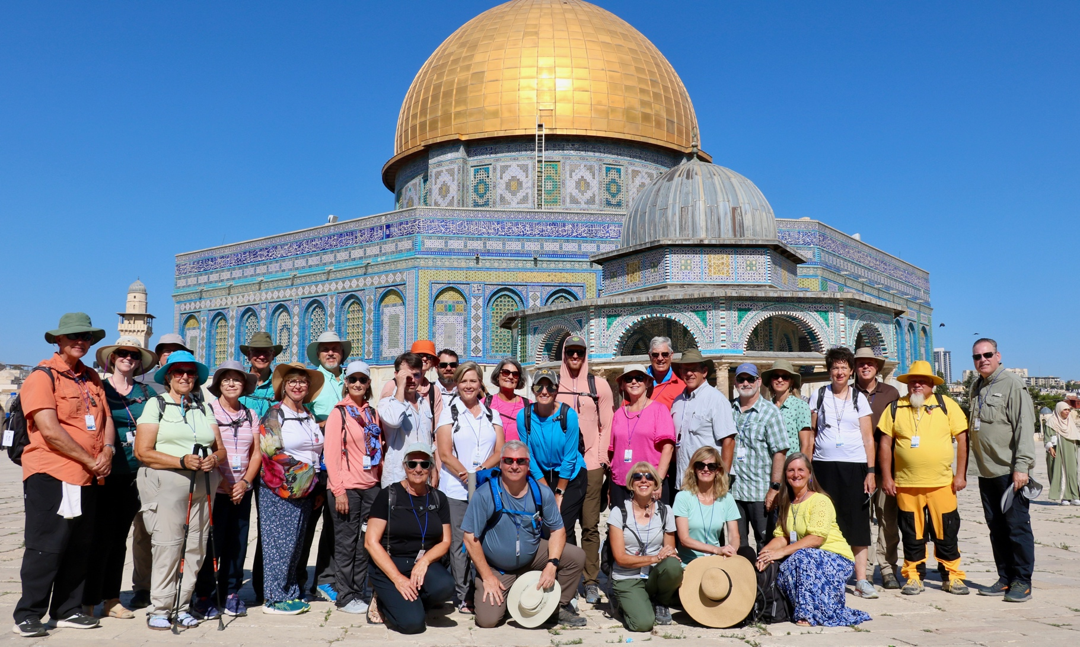
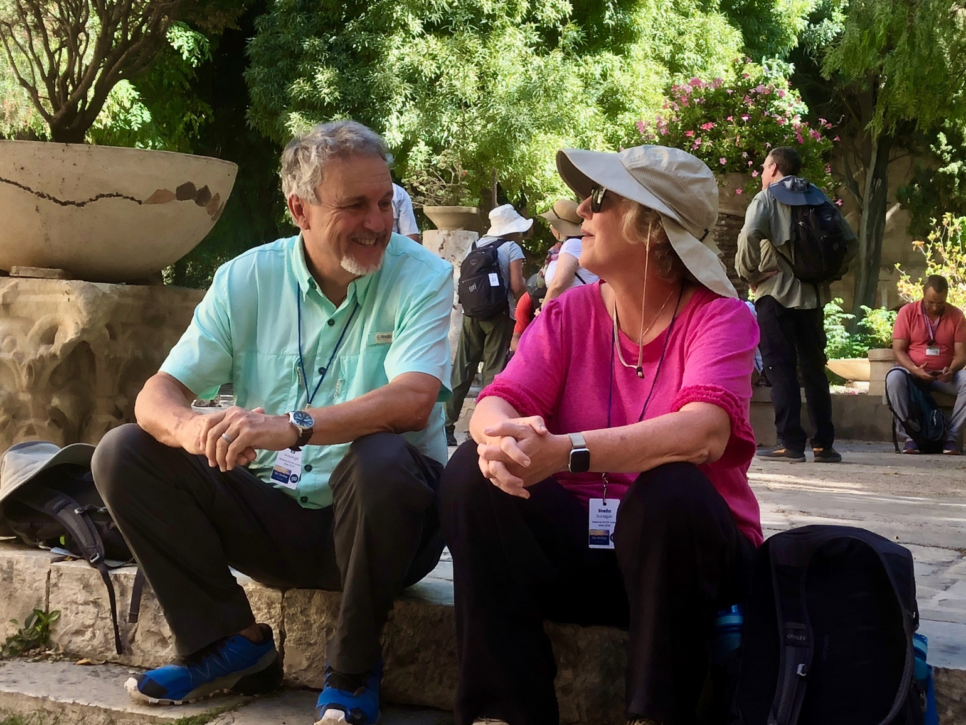
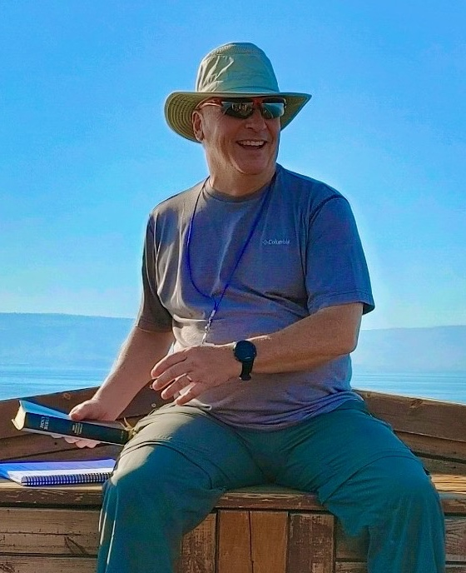
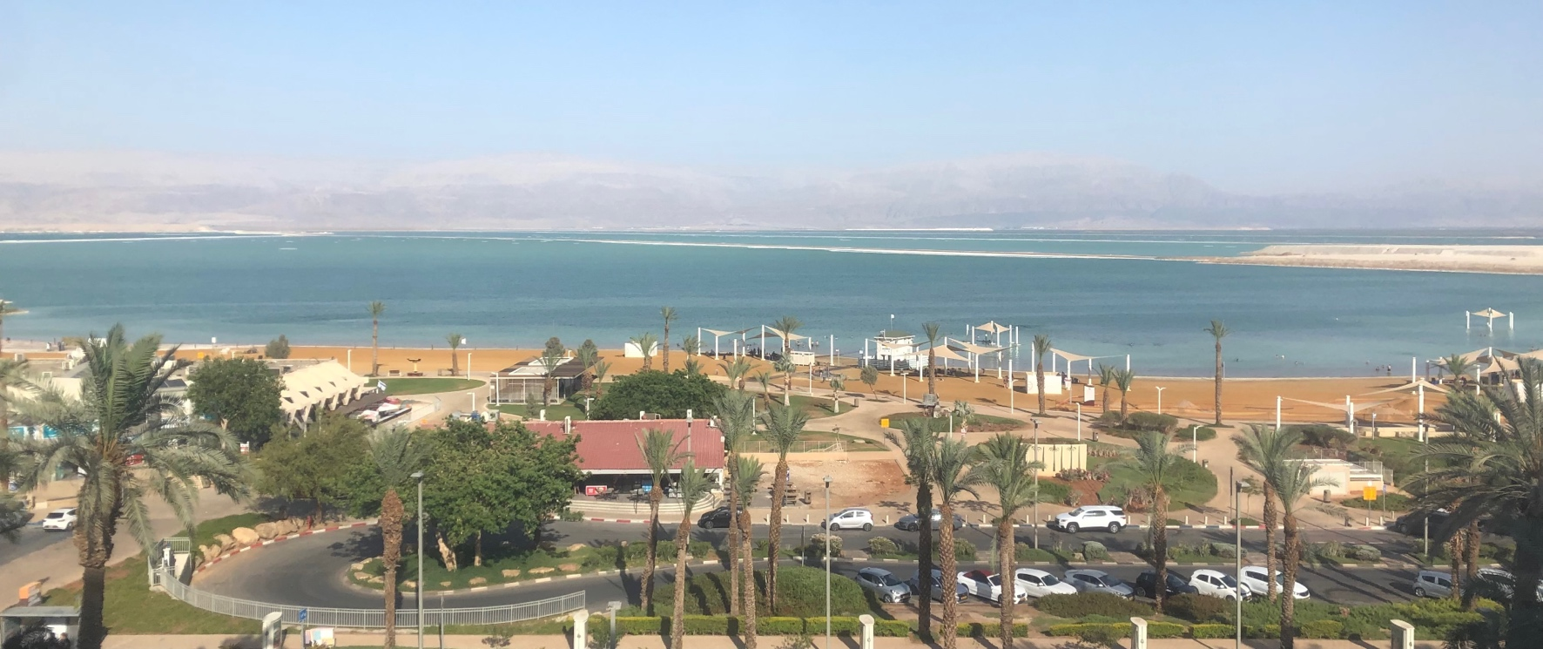
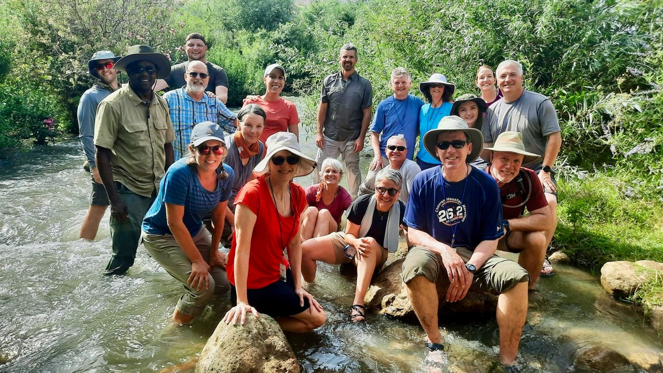
Israel Study Tour
June 30–July 12, 2024
Registration Open!

Slide 3
SteppingIntoTheJordan.com

Slide 4
Direct Link
https://steppingintothejordan.com/study-trips/

Slide 5
Objective and Method
70 Faces of Scripture
Different lenses reveal different insights.
What can we learn by looking at the flood stories through different lenses?

Slide 6
Our Lenses
Children Stories
“Asking Questions...”
Ancient Near Eastern Flood Stories
Film Adaptations

Slide 7
The Flood
What we tell our children.

Slide 8
What to Look For:
What aspects of the flood are shown?
What questions/issues are behind the book?
What is missing from the flood story?
What do you learn from that?

Slide 9
The Lego Bible
https://thebrickbible.com/legacy/genesis/god_drowns_everyone/01_gn06_12p11.html

Slide 10
Do we really advance beyond the flood story
we learn as children?

Slide 11
Summary
I am NOT criticizing what we tell our kids.
What we tell our children is only a starting point for our understanding this text.
Do we move beyond this understanding?

Slide 12
Next Week
Read Gen 5:28–9:28
Make a list of questions you think the text doesn’t answer.
What is in the “white space” of the text?

