Slide 1
Being God’s Image
Women and Men in the Kingdom of God

Slide 2
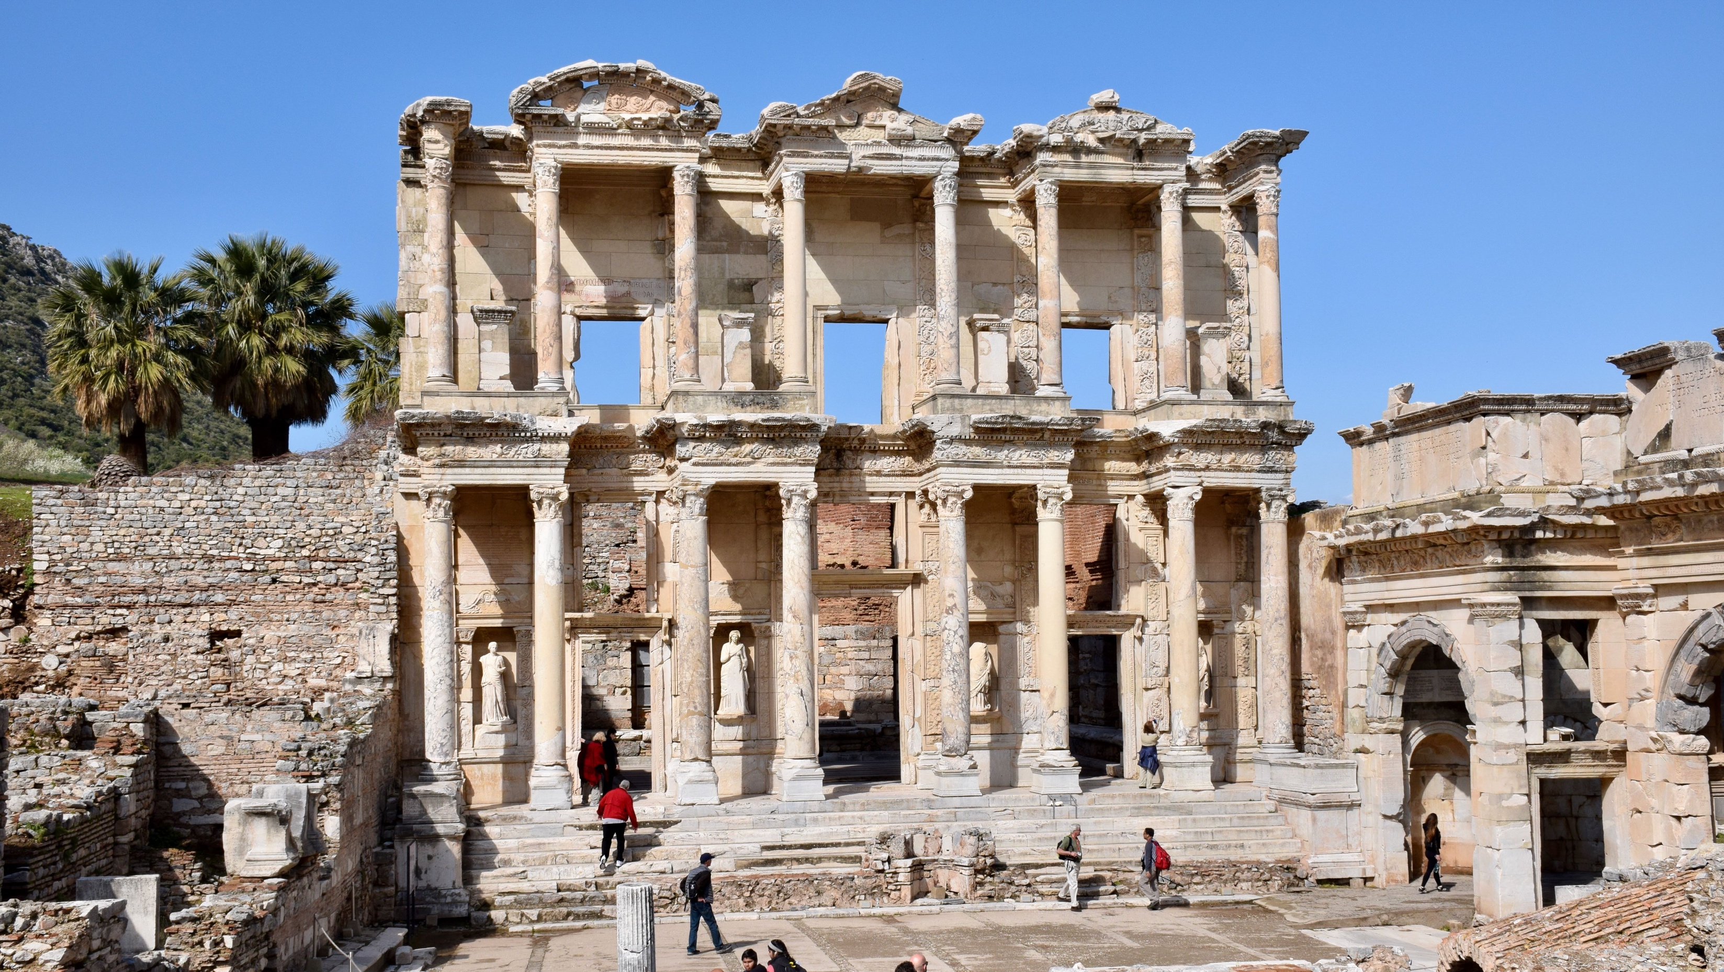
Biblical Study Tour: July 1–12, 2024

Slide 3
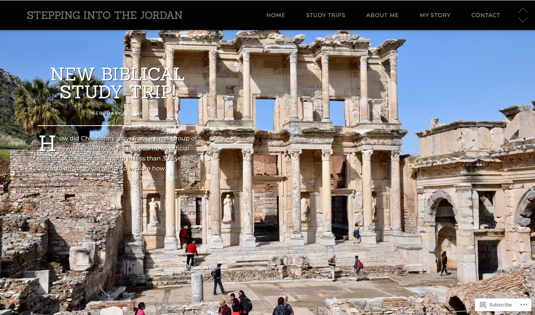
www.SteppingIntoTheJordan.com

Slide 4
Direct Link
https://steppingintothejordan.com/study-trips/

Slide 5
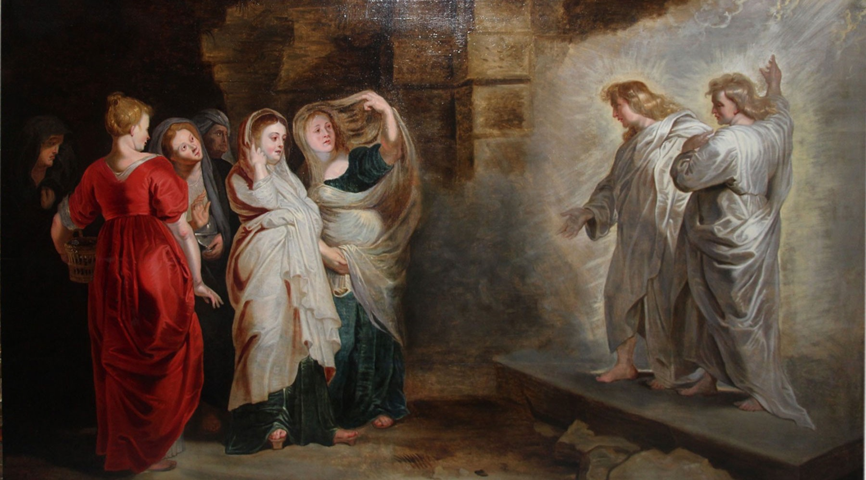
Jesus and Women

Slide 6
So Many Possibilities
Women in the genealogies of Jesus
Elizabeth, John the Baptist’s mother
Mary, the mother of Jesus
Anna in the Temple
The Samaritan woman at the well
The woman healed from bleeding
Mary and Martha
Jairus’s daughter
Women at the Tomb
Disciples on the Road to Emmaus (one was probably a woman)
We will consider a different group of women.

Slide 7
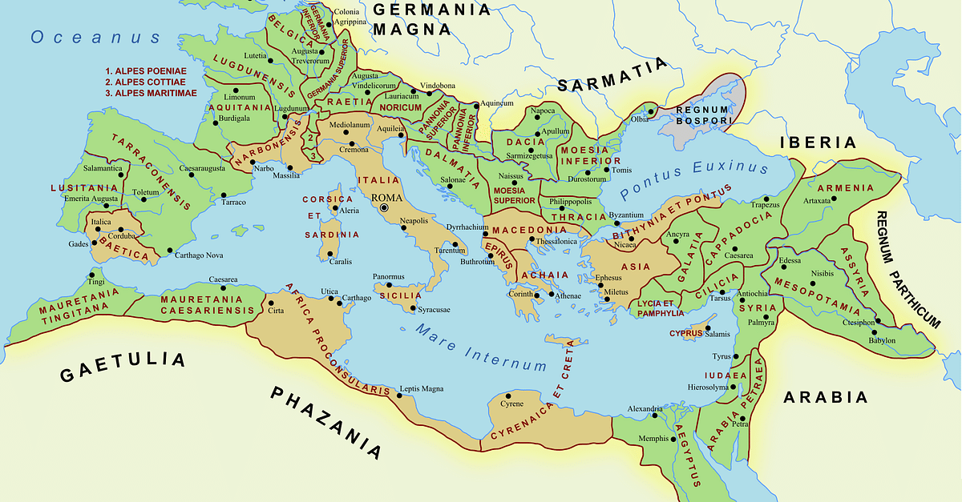
How did Rome control such a vast empire?

Slide 8
Not with armies
Patronage

Slide 9
Patronage
A social system (Patrons and Clients)
The upper classes provided aid and support to the lower classes (plebians and freedmen).
Financial support, jobs, favors, protection, connections, food, etc...
Clients reciprocated to their patrons.
Loyalty, Praise, Honor, services, support, etc...

Slide 10
“Upper” and “Lower” are relative terms
There’s always someone higher (and lower)
Who is at the top of the patronage system?
The gods
Then Caesar

Slide 11
Roman Perspective
The gods are the ultimate patrons.
However, the gods are generally remote and can’t be bothered with the affairs of humans.
Caesar is the authorized agent of the gods to bestow their divine gifts upon the people.

Slide 12
Roman Perspective
Caesar becomes the patron of regional leaders
Regional leaders become patrons of local aristocracy.
Local aristocracy becomes patrons for lower levels.
The ultimate “trickle down” economics and social control.

Slide 13
Roman Perspective
Because Caesar is the authorized agent of the gods (deus), the Senate proclaims him to be “divine” (divi) and declares him a “son of god.”
He is NOT a god (deus).
He is divine (divi)—there’s a difference.
Because Caesar is the representative of the gods, he is worthy of glory and honor.
He is to be worshipped.

Slide 14
Res Gestae Divi Augusti
(The Deeds of the Divine Augustus)
17. Four times I assisted the treasury with my own money, so that I transferred to the administrators of the treasury 150,000,000 sesterces. In the consulship of Marcus Lepidus and Lucius Arruntius [AD 6], when the military treasury was founded by my advice for the purpose of paying rewards to soldiers who had served for twenty years or more, I transferred to it from my own patrimony 170,000,000 sesterces.
18. From the consulship of Gnaeus and Publius Lentulus [18 BC] onwards, whenever the taxes did not suffice, I made distributions of grain and money from my own granary and patrimony, sometimes to 100,000 persons, sometimes to many more.

Slide 15
So what does Roman Patronage
have to do with Jesus and women?

Slide 16
Soon afterwards he went on through cities and villages, proclaiming and bringing the good news of the kingdom of God. The twelve were with him, as well as some women who had been cured of evil spirits and infirmities: Mary, called Magdalene, from whom seven demons had gone out, and Joanna, the wife of Herod’s steward Chuza, and Susanna, and many others, who provided for them out of their resources.
Luke 8:1–3 (NRSV)
Who is supporting Jesus in his ministry?

Slide 17
Soon afterwards he went on through cities and villages, proclaiming and bringing the good news of the kingdom of God. The twelve were with him, as well as some women who had been cured of evil spirits and infirmities: Mary, called Magdalene, from whom seven demons had gone out, and Joanna, the wife of Herod’s steward Chuza, and Susanna, and many others, who provided for them out of their resources.
Luke 8:1–3 (NRSV)
Who is supporting Jesus in his ministry?

Slide 18
“Out of their own resources”
ἐκ τῶν ὑπαρχόντων αὐταῖς
A technical term for patronage.
Very Common in Greek inscriptions
So common, it often was abbreviated
Jesus had women patrons!

Slide 19
What is implied about these women?
They were wealthy.
Notice only 1 reference to a husband.
Independence
There were quite a few of them.
Only 3 mentioned by name.
Patronage implies influence (and honor).

Slide 20
Could Women be Patrons?
The Council and People honoured Menodora Megakleos, chief-priestess of the Sebastoi, priestess of Demeter and of all the gods, hierophant of the ancestral gods, founder, demiourgos, gymnasiarch paying for the oil, having completed the office of dekaprotos, daughter and grand-daughter and descendant of chief-priests, demiourgoi, gymnasiarchs paying for the oil and dekaprotoi...
Inscription of Menora at Sillyum (3rd Cent CE, Asia Minor)

Slide 21
Could Women be Patrons?
Rufina, a Jewess, head of the synagogue, built the tomb for her freed slaves and the slaves raised in her house. No one else has the right to bury anyone (here). If someone should dare to, he will pay 1,500 denarii to the sacred treasury and 1,000 denarii to the Jewish people. A copy of this inscription has been placed in the (public) archives.
Rufina Inscription Smyrna (2nd or 3rd century CE, Asia Minor)

Slide 22
Asia Minor Inscription Evidence
Title | Function | Women | Cities
Prytanis | Ceremonial host of the city | 28 | 8
Stephanephoros | Presided over civic entertainment for a city | 37 | 17
Agonothete | Responsibility for city-sponsored competitions | 18 | 14
Panegyriarch | Organizer and financier of civic festivals | 1 | 1
Hipparchos | “Master of the horse” title of highest civic office | 5 | 1
Gerousia | Aristocratic society of elders | 5 | 3
Strategos | Magisterial board of the city | 1 | 1

Slide 23
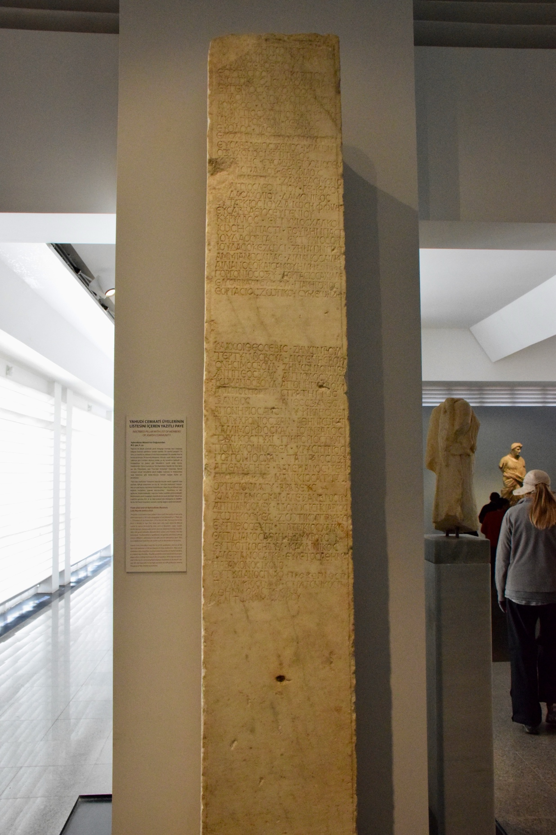
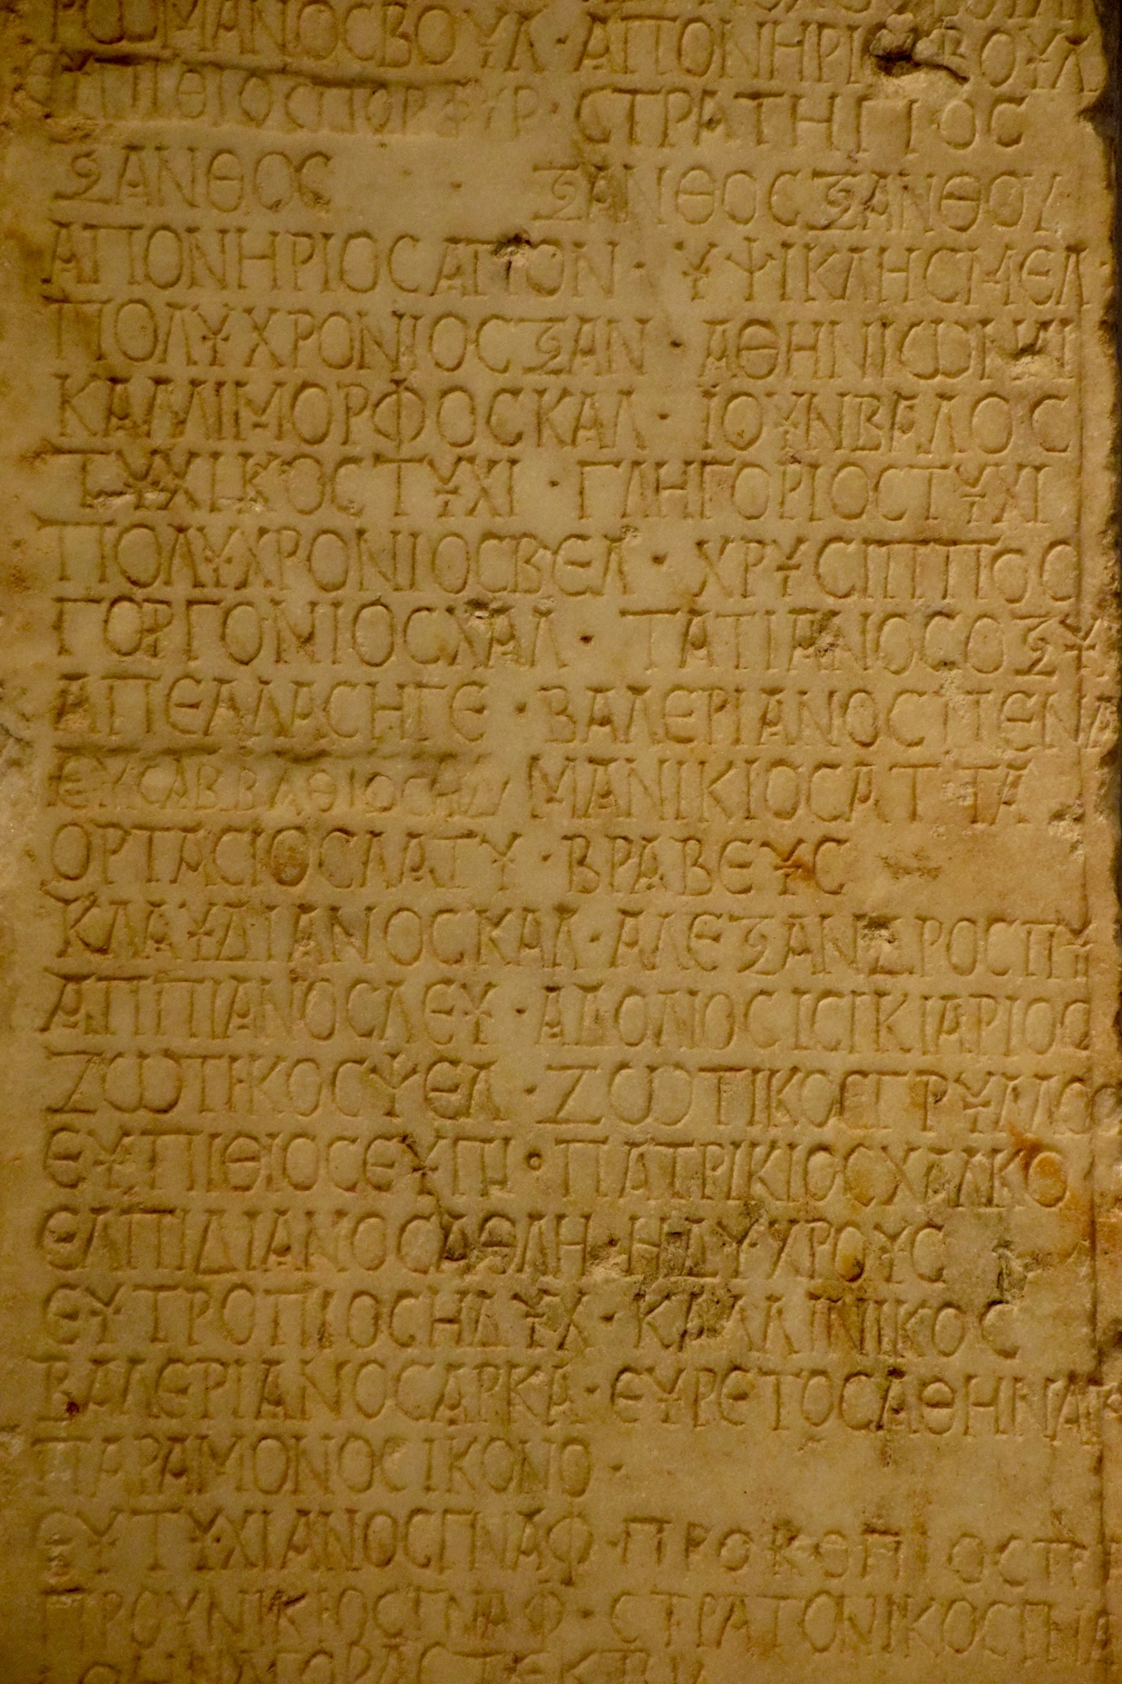

Slide 24
Jewish Women in Synagogue Inscriptions*
Name | Title | Location
Theopempte | ἀρχισυνάγωγος (Head of Synagogue) | Myndos, Caria
Jael | ἀρχισυνάγωγος (Head of Synagogue) | Aphrodisias, Caria
Sophia | πρεσβυτέρα & ἀρχισυναγώγισσα (Elder) | Crete
Peristeria | ἀρχήγισσα | Thebes, Thessaly
Rebecca | πρεσβυτέρα (elder) | Bizye, Thrace
3 Women | πρεσβυτέρα, μήτηρ (elder, mother) | Venosa, Italy
Coelia Paterna | μάτηρ συνάγογαε (mother of the synagogue) | Venetia, Italy
Sara Ura | πρεσβύτις (elder) | Rome, Italy
Guadentia | ἱέρισα (priestess) | Rome, Italy
Eulogia | πρεσβυτέρα (elder) | Malta
*2nd – 6th Century CE

Slide 25
Inscription Evidence (Asia Minor)
2 of the 7 known “Synagogue Leaders” were women.
Women were responsible for 36% of the synagogue donations (from inscriptions).
Much more prevalent in Asia Minor than in the rest of the Roman Empire.

Slide 26
Patronage in the Kingdom of God
Jesus (God’s authorized agent) is the ultimate benefactor.
Jesus bestows gifts (grace) to his followers
Healing, food, forgiveness of sins, etc...
Their response goes beyond “loyalty and praise.”
They become benefactors for not only Jesus, but the entire group.
Jesus does not only ensure “payment in kind” for himself, but for his other followers.
The women of Luke 8 are the first disciples to model this type of “Kingdom Patronage.”

Slide 27
Summary
Women (especially in Asia Minor) played an important role as Patrons/Benefactors.
Jewish women played important leadership roles in the synagogue.
Synagogue Leader
Elder
Jesus had women patrons.
They weren’t (necessarily) doing the cooking and laundry.
Provided financial support
These women model a new form of patronage in the Kingdom of God.

Slide 28
Next Week
Paul and Women
Read Acts 18 and Rom 16
Rom 16: Count the women.
What descriptions does he give them?
Who read/interpreted this letter to the church in Rome?

