Slide 1
Jude

Slide 2
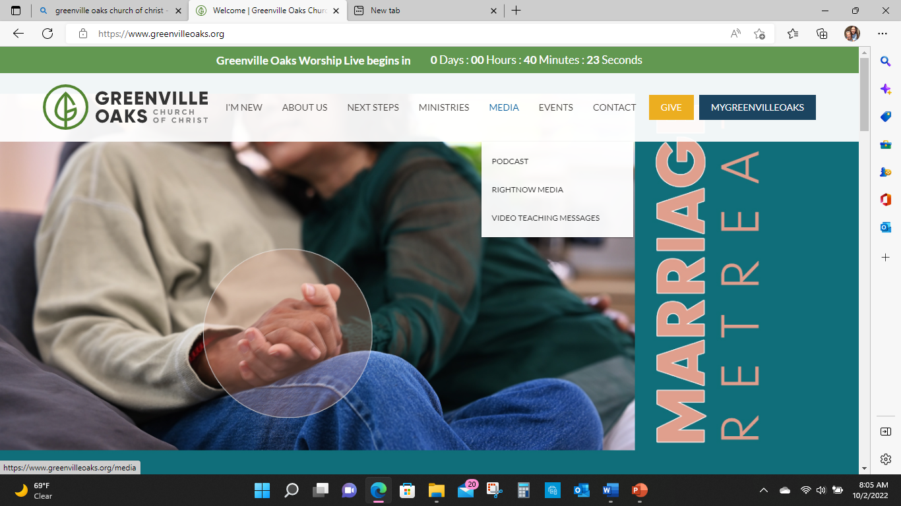

Slide 3
Jude 4
4For certain individuals whose condemnation was written about long ago
have secretly slipped in among you.
They are ungodly people, who pervert the grace of our God into a license for immorality and deny Jesus Christ our only Sovereign and Lord..

Slide 4
Jude 17
But, dear friends, remember what the apostles of our Lord Jesus Christ foretold.
18 They said to you, “In the last times there will be scoffers who will follow their own ungodly desires.”

Slide 5
Acts 2:17
this is what was spoken by the prophet Joel:
God declares“‘And in the last days it will be, that I will pour out my Spirit on all people, and your sons and your daughters shall prophesy, and your young men shall see visions, and your old men shall dream dreams”

Slide 6
1 Timothy 4
1Now the Spirit expressly states that in later times some will abandon the faith to follow deceitful spirits and the teachings of demons, 2influenced by the hypocrisy of liars, whose consciences are seared with a hot iron.

Slide 7
2 Timothy 3
1But understand this: In the last days terrible times will come.
2For men will be lovers of themselves, lovers of money, boastful, arrogant, abusive, disobedient to their parents, ungrateful, unholy, 3unloving, unforgiving, slanderous, without self-control, brutal, without love of good, 4traitorous, reckless, conceited, lovers of pleasure rather than lovers of God, 5having a form of godliness but denying its power. Turn away from such as these!

Slide 8
Jude 17
But, dear friends, remember what the apostles of our Lord Jesus Christ foretold.
18 They said to you, “In the last times there will be scoffers who will follow their own ungodly desires.”
19These are the people who divide you, who follow mere natural instincts and do not have the Spirit.
(v8 rely on their dreams, defile the flesh, reject authority, blaspheme glorious ones)

Slide 9
Jude 20
But you, dear friends, build yourselves up in your most holy faith and praying in the Holy Spirit,
keep yourselves in God’s love as you wait for the mercy of our Lord Jesus Christ to bring you to eternal life.

Slide 10
Jude 22
Be merciful to those who doubt;
save others by snatching them from the fire;
to others show mercy, mixed with respect
—hating even the clothing stained by corrupted flesh.

Slide 11
Jude 24
Now to him who is able to keep you from stumbling
and to present you blameless before the presence of his glory with great joy,
to the only God, our Savior, through Jesus Christ our Lord,
be glory, majesty, dominion, and authority, before all time and now and forever.

Slide 12
before all time and now and forever
Be (give) glory, majesty, dominion, and authority
to Him
Him who is able to keep you from stumbling
Him who is able to present you blameless
before the presence of His Glory
Present you blameless with great joy,
to the only God,
God- our Savior, through Jesus Christ our Lord,

Slide 13
AMEN

