Slide 1
Paul’s Worldview
Paul’s misuse of the Old Testament in Romans

Slide 2
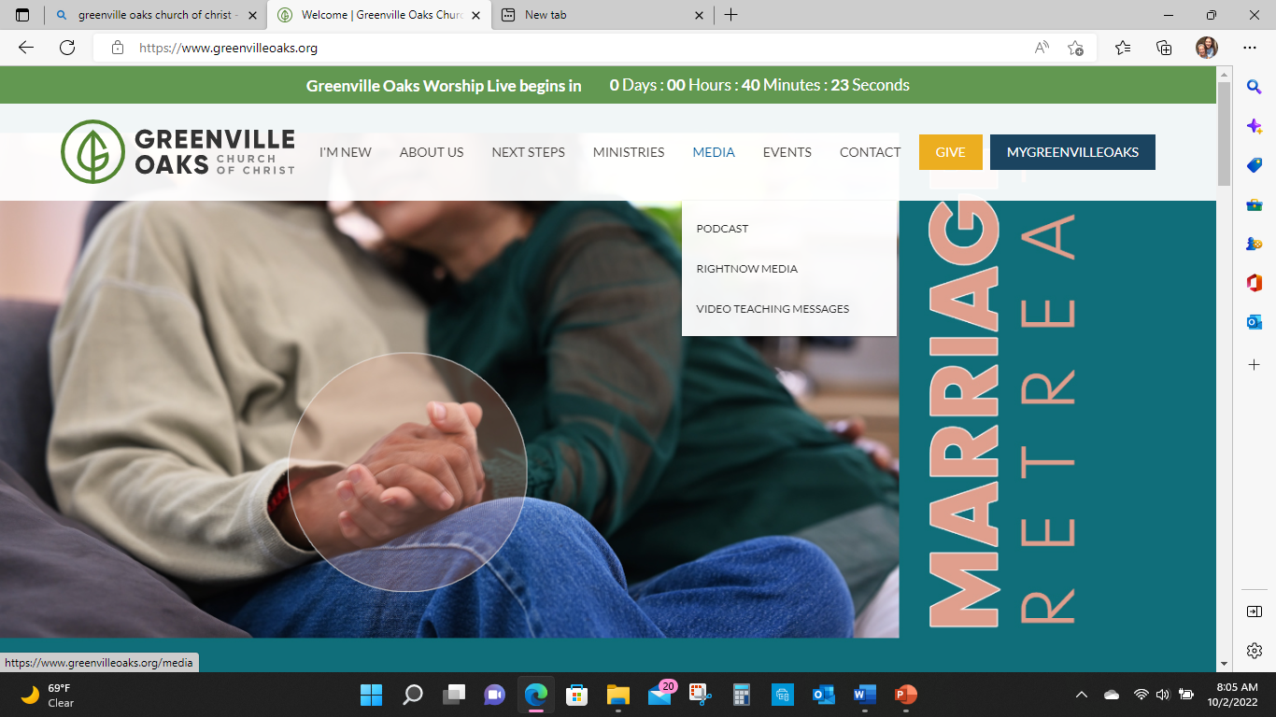

Slide 3
The Bible
It’s Not a jig saw puzzle
It’s a story with various motifs and mosaics that create a larger over arching revelation.
Individual stories foreshadow future events
Individual stories and prophecies are re-enacted and re-purposed later to re-tell the larger story line

Slide 4
John 12 (Matthew 26:6–13; Mark 14:3–9; Luke 7:36–50)
Mary anoints Jesus.
The triumphal entry/ feast of the passover
20Now there were some Greeks among those who went up to worship at the feast. They came to Philip,, and requested of him, “Sir, we want to see Jesus.” Philip relayed this appeal to Andrew, and both of them went and told Jesus.
23But Jesus replied, “The hour has come for the Son of Man to be glorified. Truly, truly, I tell you, unless a kernel of wheat falls to the ground and dies, it remains only a seed; but if it dies, it bears much fruit.

Slide 5
John 12
25Whoever loves his life will lose it, but whoever hates his life in this world will keep it for eternal life. If anyone serves Me, he must follow Me; and where I am, My servant will be as well. If anyone serves Me, the Father will honor him.
27Now My soul is troubled, and what shall I say? ‘Father, save Me from this hour’? No, it is for this purpose that I have come to this hour. Father, glorify Your name!”

Slide 6
John 12
Then a voice came from heaven: “I have glorified it, and I will glorify it again.”
29The crowd standing there heard it and said that it had thundered. Others said that an angel had spoken to Him.
30In response, Jesus said, “This voice was not for My benefit, but yours. Now judgment is upon this world; now the prince of this world will be cast out. And I, when I am lifted up from the earth, will draw ALL to Myself.”

Slide 7
John 12
34The crowd replied, “We have heard from the Law that the anointed one will remain forever.
So how can you say that the Son of Man must be lifted up? Who is this Son of Man?”

Slide 9
Daniel 7 (Revelation 13)
2 In the first year of Belshazzar king of Babylon Daniel declared: “In my vision in the night I looked, and suddenly the four winds of heaven were churning up the great sea. Then four great beasts came up out of the sea, each one different from the others:
4The first beast was like a lion, and it had the wings of an eagle. I watched until its wings were torn off and it was lifted up from the ground and made to stand on two feet like a man, and given the mind of a man.

Slide 10
5Suddenly another beast appeared, which looked like a bear. It was raised up on one of its sides, and it had three ribs in its mouth between its teeth. So it was told, ‘Get up and gorge yourself on flesh!’
6Next, as I watched, another beast appeared. It was like a leopard, and on its back it had four wings like those of a bird. The beast also had four heads, and it was given authority to rule.

Slide 11
7After this, as I watched in my vision in the night, suddenly a fourth beast appeared, and it was terrifying—dreadful and extremely strong—with large iron teeth. It devoured and crushed; then it trampled underfoot whatever was left. It was different from all the beasts before it, and it had ten horns. .
8While I was contemplating the horns, suddenly another horn, a little one, came up among them, and three of the first horns were uprooted before it. This horn had eyes like those of a man and a mouth that spoke pompous words.

Slide 12
9As I continued to watch,
thrones were set in place,
and one ancient of days took His seat.
His clothing was white as snow,
and the hair of His head was like pure wool.

Slide 13
A stream of fire issued and came out from before him; a thousand thousands served him, and ten thousand times ten thousand stood before him; the court sat in judgment, and the books were opened.

Slide 14
Then I kept watching because of the pompous words the horn was speaking.
As I continued to watch, the beast was slain, and its body was destroyed and thrown into the blazing fire.
As for the rest of the beasts, their dominion was removed, but they were granted an extension of life for a season and a time.

Slide 15
In my vision in the night I continued to watch,
and I saw One….. like the Son of Man (a human one)
coming with the clouds of heaven.
He approached the Ancient of Days
and was led into His presence.

Slide 16
14And He was given
dominion,
glory,
and kingship,
that the people of every nation and language
should serve Him.
His dominion is an everlasting dominion
that will not pass away,
and His kingdom is one
that will never be destroyed.

Slide 17
15 As for me, Daniel, my spirit within me was anxious and the visions of my head alarmed me. I approached one of those who stood there and asked him the truth concerning all this.
So he told me and made know to me the interpretation of the things.
These four great beasts are four kingdoms who shall arise out of earth.
But the saints of the Most High shall receive the kingdom and possess the kingdom forever and ever…..

Slide 18
As for the fourth beast,
there shall be a fourth kingdom on earth, which shall be different from all the kingdoms, and it shall devour the whole earth,
He shall speak words against the Most High, and shall wear out the saints of the Most High, and shall think to change the times and the law; and they shall be given into his hand for a period of time

Slide 19
26 But the court shall sit in judgment, and the 4th kingdom shall be taken away, to be consumed and destroyed to the end. and the kingdom and the dominion
and the greatness of the kingdoms under the whole heaven shall be given to the holy ones of the Most High; his kingdom shall be an everlasting kingdom, and all dominions shall serve and obey him.’

Slide 20
In my vision in the night I continued to watch,
and I saw One….. like the Son of Man (a human one)
coming with the clouds of heaven.
He approached the Ancient of Days
and was led into His presence.

Slide 21
14And He (son of man, human one) was given
dominion, glory, and kingship,
that the people of every nation and language
should serve Him.
His dominion is an everlasting dominion
that will not pass away,
and His kingdom is one
that will never be destroyed.

Slide 22
As for the fourth beast,
there shall be a fourth kingdom on earth, which shall be different from all the kingdoms, and it shall devour the whole earth,
He shall speak words against the Most High, and shall wear out the saints of the Most High, and shall think to change the times and the law; and they shall be given into his hand for a period of time

Slide 23
Four Kingdoms =

Slide 25
John 12 (Matthew 26:6–13; Mark 14:3–9; Luke 7:36–50)
23But Jesus replied, “The hour has come for the Son of Man to be glorified. Truly, truly, I tell you, unless a kernel of wheat falls to the ground and dies, it remains only a seed; but if it dies, it bears much fruit.

Slide 26
John 12
Then a voice came from heaven: “I have glorified it, and I will glorify it again.”
29The crowd standing there heard it and said that it had thundered. Others said that an angel had spoken to Him.
30In response, Jesus said, “This voice was not for My benefit, but yours. Now judgment is upon this world; now the prince of this world will be cast out.
And I, when I am lifted up from the earth, will draw ALL (earth, nations, people) to Myself.”

Slide 27
John 12
34The crowd replied, “We have heard from the Law that the Christ will remain forever. So how can you say that the Son of Man must be lifted up? Who is this Son of Man?”
So Jesus said to them, “The light is among you for a little while longer. Walk while you have the light, lest darkness overtake you. The one who walks in the darkness does not know where he is going. While you have the light, believe in the light, that you may become sons of light.”

Slide 29
Luke 5:21 (Matthew 9:1–8; Mark 2:1–12)
On one of those days, as he was teaching, Pharisees and teachers of the law were sitting there, who had come from every village of Galilee and Judea and from Jerusalem. And the power of the Lord was with him to heal.
18And, some men were bringing on a bed a man who was paralyzed, and they were seeking to bring him in and lay him before Jesus, but finding no way to bring him in, because of the crowd, they went up on the roof and let him down with his bed through the tiles into the midst before Jesus

Slide 30
Luke 5:21 (Matthew 9:1–8; Mark 2:1–12)
And when he saw their faith, he said, “Man, your sins are forgiven you.”
21And the scribes and the Pharisees began to question, saying, “Who is this who speaks blasphemies? Who can forgive sins but YAHWEH alone?”

Slide 31
Luke 5:21 (Matthew 9:1–8; Mark 2:1–12)
When Jesus perceived their thoughts, he answered them,
“Why do you question in your hearts?
Which is easier, to say, ‘Your sins are forgiven you,’ or to say, ‘Rise and walk’?
But that you may know that the Son of Man has authority on earth to forgive sins”—he said to the man who was paralyzed—“I say to you, rise, pick up your bed and go home.”

Slide 32
Luke 5:21 (Matthew 9:1–8; Mark 2:1–12)
25And immediately he rose up before them and picked up what he had been lying on and went home, glorifying God.
26And amazement seized them all, and they glorified God and were filled with awe, saying, “We have seen extraordinary things today.”

Slide 33
14And He was given
dominion,
glory,
and kingship,
that the people of every nation and language
should serve Him.

Slide 35
Luke 6:1 Matthew 12:1–8; Mark 2:23–28)
1One Sabbath Jesus was passing through the grainfields, and His disciples began to pick the heads of grain, rub them in their hands, and eat them.
But some of the Pharisees asked,
“Why are you doing what is unlawful on the Sabbath?”

Slide 36
Luke 6:1 Matthew 12:1–8; Mark 2:23–28)
3Jesus replied, “Have you not read what David did when he and his companions were hungry? He entered the house of God, took the consecrated bread and gave it to his companions, and ate what is lawful only for the priests to eat.”
5Then Jesus declared, “The Son of Man is Lord of the Sabbath.

Slide 38
Mark 8:31
Jesus feeds the 4000
Heals the blind man at Bethsaida
Peters' confession that Jesus is the christ (anointed messiah)
31Then He began to teach them that the Son of Man must suffer many things and be rejected by the elders, chief priests, and scribes, and that He must be killed and after three days rise again

Slide 39
Mark 8:31
34Then Jesus called the crowd to Him along with His disciples, and He told them,
“If anyone wants to come after Me, he must deny himself and take up his cross and follow Me. For whoever wants to save his life will lose it, but whoever loses his life for My sake and for the gospel will save it.

Slide 40
Mark 8:31
36What does it profit a man to gain the whole world, yet forfeit his soul? Or what can a man give in exchange for his soul?
If anyone is ashamed of Me and My words in this adulterous and sinful generation, the Son of Man will also be ashamed of him when He comes in His Father’s glory with the holy angels.”

Slide 42
Matthew 26:57 Mark 14:53–65; Luke 22:66-71; John 18:19–24)
Those who had arrested Jesus led Him away to the house of Caiaphas the high priest, where the scribes and elders had gathered.
Now the chief priests and the whole Sanhedrin were seeking false testimony against Jesus in order to put Him to death. But they did not find any, though many false witnesses came forward.

Slide 43
Meanwhile, the high priest questioned Jesus about His disciples and His teaching.
“I have spoken openly to the world,” Jesus answered. “I always taught in the synagogues and at the temple, where all the Jews come together. I said nothing in secret. Why are you asking Me? Ask those who heard My message. Surely they know what I said.”

Slide 44
Finally, two came forward and declared, “This man said, ‘I am able to destroy the temple of God and rebuild it in three days.’ ”
62So the high priest stood up and asked Him, “Have You no answer? What are these men testifying against You?”
63But Jesus remained silent.

Slide 45
Then the high priest said to Him,
“I charge You under oath by the living God: Tell us if You are the Christ, the messiah, the anointed one, the Son of God.”
64“You have said it yourself,” Jesus answered.
“But I say to all of you, from now on you will see the Son of Man sitting at the right hand of Power and coming on the clouds of heaven.”

Slide 46
65At this, the high priest tore his clothes and declared, “He has blasphemed! Why do we need any more witnesses? Look, now you have heard the blasphemy.

