Slide 1
FULFILLING THE MISSION OF CHRIST

Slide 2
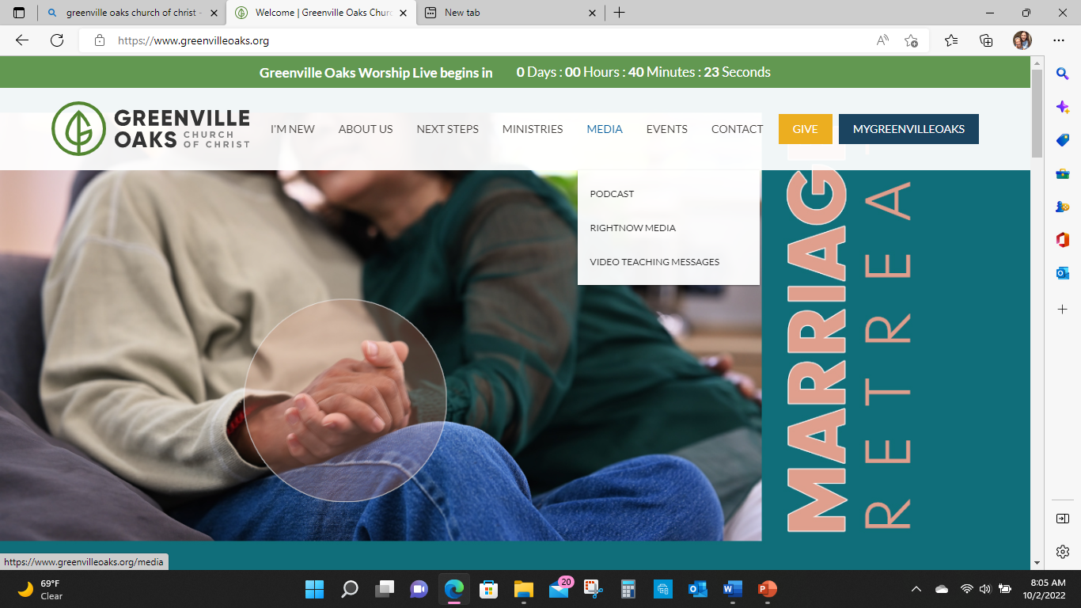

Slide 3
THE CHURCH
Community of Christ Followers
Fulfilling Christ’s Mission
Through Unity and Power of the Holy Spirit
To the Glory of God

Slide 4
Tag Lines
Just Do It
Betcha Can’t Eat Just One
Have It Your Way
I’m Loving It
Think Outside The Bun
Like A Good Neighbor
What’s In Your Wallet?

Slide 5
Paul
The Fellowship of His Sufferings

Slide 6
Paul
What do we know about Paul?
What do we not know about Paul?

Slide 7
Paul
Earliest canonical NT writer.
From prosecutor to missionary.
A message of a crucified man raised to life by God.
A message of a new age that will transform the whole world.
Pastoral letters to established communities.
The challenge of Paul’s unspoken message.

Slide 8
Paul’s Ethics
No systematic presentation of “Christian ethics”.
No “manual of discipline” or “code of conduct”.
Primarily responds ad hoc to pastoral problems as they arise.
Are Paul’s moral norms from traditional sources or derived from logic internal to his gospel?
Some scholars suggest there is no direct connection between Paul’s ethical prescriptions and his theological proclamation.
Paul’s gospel provides motivation to do what is right but does not generate a singular Christian account of “what is right”.

Slide 9
Paul’s Ethics
Our study will seek to demonstrate how Paul’s ethical teachings are rooted in his theological thought.
Paul’s ethics and theology are packed together.
His theology progresses and unfolds as he writes.
Paul’s constant aim is to shape the behavior of his churches.
His theology is not an exercise, it is a tool for constructing community.
Everything is brought under the scrutiny of the gospel.

Slide 10
Theological Motifs for Pauline Ethics
Eschatology (Parousia) / New Beginnings
The Cross
The New Community in Christ

Slide 11
New Creation
The death and resurrection of Jesus was an apocalyptic event that signaled the end of the old age and the beginning of the new.
Divine-Cosmic-Catastrophic-Paradigm Shift
The church finds its identity and vocation by recognizing its role within the cosmic drama of God’s reconciliation of the world to himself.

Slide 12
New Creation
“For the love of Christ controls us, since we have concluded this, that Christ died for all; therefore all have died. And he died for all so that those who live should no longer live for themselves but for him who died for them and was raised. So then from now on we acknowledge no one from an outward human point of view. Even though we have known Christ from such a human point of view, now we do not know him in that way any longer. So then, if anyone is in Christ, he is a new creation; what is old has passed away - look, what is new has come! And all these things are from God who reconciled us to himself through Christ, and who has given us the ministry of reconciliation.” (2 Corinthians 5: 14-18)

Slide 13
New Creation
A Jewish fundamental belief of apocalyptic thought was the doctrine of “two ages”.
The present age of evil and suffering superseded by a messianic age when God fully restores Israel.
Paul proclaims that the church has already entered the eschatological age.

Slide 14
New Creation
“For look, I am ready to create new heavens and a new earth! The former ones will not be remembered; no one will think about them anymore. But be happy and rejoice forevermore over what I am about to create! For look, I am ready to create Jerusalem to be a source of joy, and her people to be a source of happiness. Jerusalem will bring me joy, and my people will bring me happiness. The sound of weeping or cries of sorrow will never be heard in her again.” (Isaiah 65:17-19)

Slide 15
New Creation
Paul proclaims that the church has already entered the eschatological age.
The old age is passing away, the new age has appeared in Christ, and the church stands at the juncture between the ages.
But the church waits for consummation of it’s hope.
The “Already/Not Yet” exist in tension.
Holy Spirit is assurance of what is to come.

Slide 16
1 Thessalonians
“For from you the message of the Lord has echoed forth not just in Macedonia and Achaia, but in every place reports of your faith in God have spread, so that we do not need to say anything. For people everywhere report how you welcomed us and how you turned to God from idols to serve the living and true God and to wait for his Son from heaven, whom he raised from the dead, Jesus our deliverer from the coming wrath. (1 Thess 1:8-10)

Slide 17
1 Thessalonians
“And may the Lord cause you to increase and abound in love for one another and for all, just as we do for you, so that your hearts are strengthened in holiness to be blameless before our God and Father at the coming (Parousia) of our Lord Jesus with all his saints.” (1 Thess 3:12-13)

Slide 18
1 Thessalonians
“Now may the God of peace himself make you completely holy and may your spirit and soul and body be kept entirely blameless at the coming (Parousia) of our Lord Jesus Christ. He who calls you is trustworthy, and he will in fact do this.” (1 Thess 5:23-24)

Slide 19
1 Thessalonians
“Now we do not want you to be uniformed, brothers and sisters, about those who are asleep, so that you will not grieve like the rest who have no hope. For if we believe that Jesus died and rose again, so also we believe that God will bring with him those who have fallen asleep as Christians. For we tell you this by the word of the Lord, that we who are alive, who are left until the coming of the Lord, will surely not go ahead of those who have fallen asleep. For the Lord himself will come down from heaven with a shout of command, with the voice of the archangel, and with the trumpet of God, and the dead in Christ will rise first. Then we who are alive, who are left, will be suddenly caught up together with them in the clouds to meet the Lord in the air. And so we will always be with the Lord.” Therefore encourage one another with these words. (1 Thess 4:13-18)

Slide 20
1 Thessalonians
“So then we must not sleep as the rest, but must stay alert and sober. For those who sleep, sleep at night and those who get drunk are drunk at night. But since we are of the day, we must stay sober by putting on the breastplate of faith and love and as a helmet our hope for salvation. For God did not destine us for wrath but for gaining salvation through our Lord Jesus Christ. He died for us so that whether we are alert or asleep we will come to life together with him . Therefore encourage one another and build up each other, just as you are in fact doing.” (1 Thess 5:6-11)

Slide 21
The Righteousness of God
“In other words, in Christ God was reconciling the world to himself, not counting people’s trespasses against them, and he has given us the message of reconciliation. Therefore we are ambassadors for Christ, as though God were making His plea through us. We plead with you on Christ’s behalf, “Be reconciled to God!” God made the one who did not know sin to be sin for us, so that in him we would become the righteousness of God.” (2 Corinthians 5:19-21)

Slide 22
The Righteousness of God
Paul does not say:
“that we might know about the righteousness of God”
“that we might believe in the righteousness of God”
“that we might receive the righteousness of God”
But rather:
“that we may become the righteousness of God”
We are in a new and right relationship with God.
The church incarnates the righteousness of God!

Slide 23
Fellow Heirs
“The Spirit himself bears witness to our spirit that we are God’s children. And if children, then heirs (namely, heirs of God and also fellow heirs with Christ) – if indeed we suffer with him so we may also be glorified with him. For I consider that our present sufferings cannot even be compared to the glory that will be revealed to us. For the creation eagerly waits for the revelation of the sons of God. For the creation was subjected to futility – not willingly but because of God who subjected it – in hope that the creation itself will also be set free from the bondage of decay into the glorious freedom of God’s children.”

Slide 24
Fellow Heirs
“For we know that the whole creation groans and suffers together until now. Not only this, but we ourselves also, who have the first fruits of the Spirit, groan inwardly as we eagerly await our adoption, the redemption of our bodies. For in hope we were saved. Now hope that is seen is not hope, because who hopes for what he sees? But if we hope for what we do not see, we eagerly wait for it with endurance.” (Romans 8:16-25)

Slide 25
Summary
Paul frames the church community within a divine cosmic paradigm shift in which suffering and joy will both be present until the Parousia.
The church community is the eschatological beachhead where the power of God has invaded the world.
The church community is to live faithfully between the times under Spirit’s control and moral discernment.

