Slide 1
Being God’s Image
Women and Men in the Kingdom of God

Slide 2
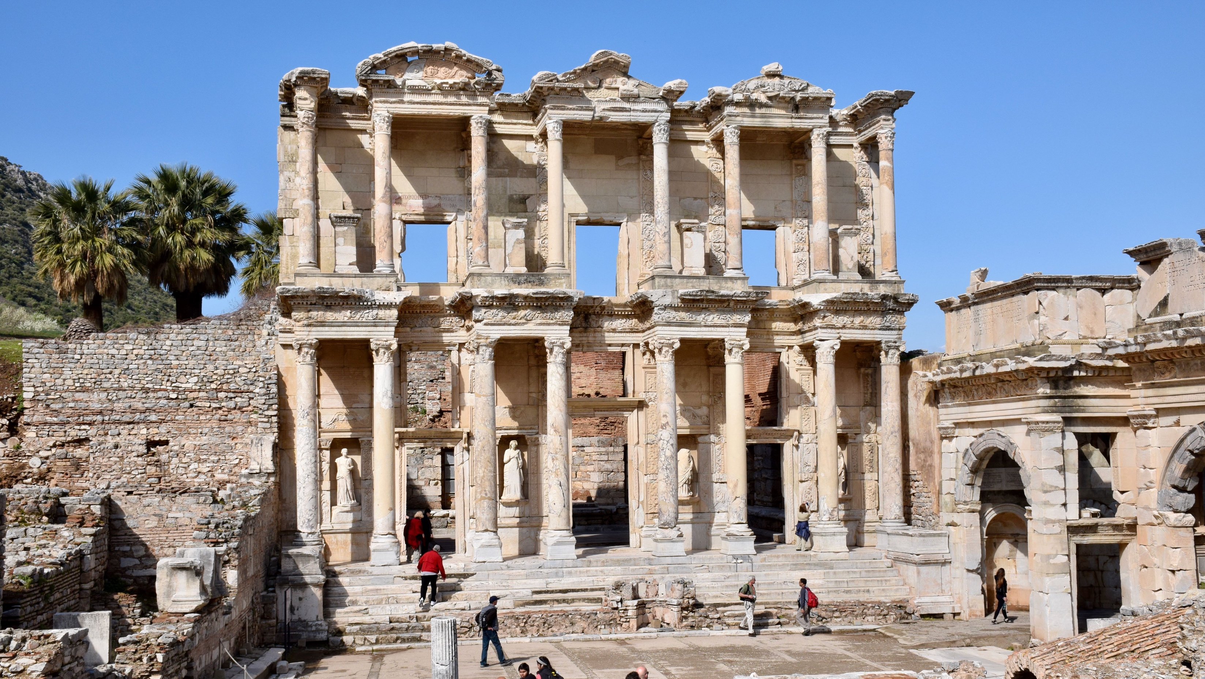
Biblical Study Tour: July 1–12, 2024

Slide 3
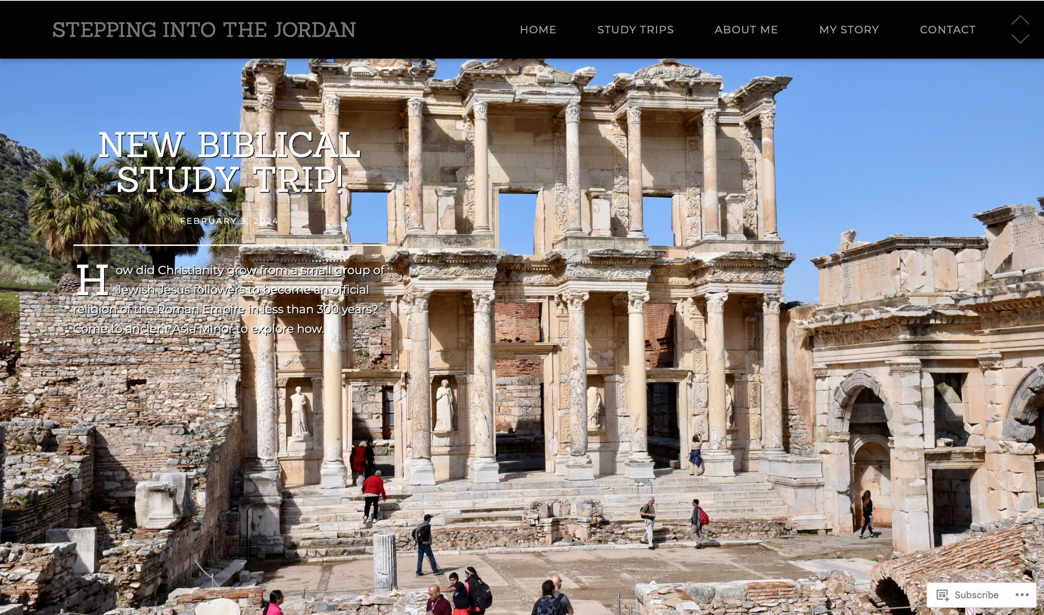
www.SteppingIntoTheJordan.com

Slide 4
Direct Link
https://steppingintothejordan.com/study-trips/

Slide 5
March 22–23, 2024 (Friday & Saturday)

Slide 6
Direct Link
https://www.smu.edu/perkins/publicprograms/summit-for-faith-and-learning

Slide 7
What is Patriarchy? Gen 27

Slide 8
Utilizes Archaeology and Anthropology
Examines key social structures of Israel
Israel as a village society
Israel as a state

Slide 9
Patriarchy
A social organization marked by the supremacy of the father in the clan or family, the legal dependence of wives and children, and the reckoning of descent and inheritance in the male line.
Broadly: Control by men of a disproportionately large share of power.
Merriam-Webster Dictionary

Slide 10
It should not surprise us to find patriarchy in the Bible.
What is more interesting is when we see the Bible break from patriarchy.

Slide 11
Does the Bible represent patriarchy
according to our modern definition?

Slide 12
Families in the Biblical World
Endogamous – marry within ethnic groups
Patrilineal – descent through male lineage
Patrilocal – bride moves to husband’s family
Polygynous – husbands w/multiple wives
Patriarchal – father is head of household

Slide 13
Patriarchy
A social system
Social order, roles and structure
Patriarchy is not sexism
Sexism: women inferior to men
Historical tendency towards sexist beliefs

Slide 14
The “Beit Av”
Hebrew for “Father’s Household”
Multi-generational family units.
Extended families (3-4 generations)
The patriarch is the senior male by lineage.
Head of the household
Passed down to oldest son.
Oldest son receives a “double portion” of inheritance.
Why does the oldest son receive a “double portion?”

Slide 15
The LORD descended in the cloud and stood with him there, and proclaimed the name, “The LORD.” The LORD passed before him, and proclaimed,
“The LORD, the LORD,
a God merciful and gracious, slow to anger,
and abounding in steadfast love and faithfulness,
keeping steadfast love for the thousandth generation,
forgiving iniquity and transgression and sin,
yet by no means clearing the guilty,
but visiting the iniquity of the parents
upon the children
and the children’s children,
to the third and the fourth generation.”
Exodus 34:5–7 (NRSV)
Where do you see patriarchy in this verse?

Slide 16
Individual Rights in Ancient World
The social world of the Bible is communal.
Self-identity is secondary to family identity
Identity comes from the Father’s Household (Beit Av)
Life begins at adoption, not birth.
Survival of the family on their land was everyone’s primary concern.
This was “eternal life.”

Slide 17
Protocol for Fathers of a Household
To protect and provide for his land and children, the father of a household is authorized to:
Adopt or excommunicate sons and daughters
Recruit workers and warriors
Negotiate marriages and covenants
Host strangers
Designate heirs

Slide 18
Protocol for Mothers of a Household
To protect and provide for their land and children, mothers of households:
Bear children and arrange for other wives to bear children
Manage the household by supervising domestic production, rationing, and food production.
Teach clan traditions
Mediate domestic conflicts
Designate heirs

Slide 19
Rebekah
When Esau was forty years old, he married Judith daughter of Beeri the Hittite, and Basemath daughter of Elon the Hittite; and they made life bitter for Isaac and Rebekah.
Gen 26:34–35 (NRSV)
Who is to blame for these marriages?

Slide 20
Rebekah
When Isaac was old and his eyes were dim so that he could not see, he called his elder son Esau and said to him, “My son”; and he answered, “Here I am.” He said, “See, I am old; I do not know the day of my death. Now then, take your weapons, your quiver and your bow, and go out to the field, and hunt game for me. Then prepare for me savory food, such as I like, and bring it to me to eat, so that I may bless you before I die.”
Gen 27:1–4

Slide 21
Rebekah
Now Rebekah was listening when Isaac spoke to his son Esau. So when Esau went to the field to hunt for game and bring it, Rebekah said to her son Jacob, “I heard your father say to your brother Esau, ‘Bring me game, and prepare for me savory food to eat, that I may bless you before the LORD before I die.’ Now therefore, my son, obey my word as I command you. Go to the flock, and get me two choice kids, so that I may prepare from them savory food for your father, such as he likes; and you shall take it to your father to eat, so that he may bless you before he dies.” But Jacob said to his mother Rebekah, “Look, my brother Esau is a hairy man, and I am a man of smooth skin. Perhaps my father will feel me, and I shall seem to be mocking him, and bring a curse on myself and not a blessing.”
Gen 27:5–12

Slide 22
Rebekah
His mother said to him, “Let your curse be on me, my son; only obey my word, and go, get them for me.” So he went and got them and brought them to his mother; and his mother prepared savory food, such as his father loved. Then Rebekah took the best garments of her elder son Esau, which were with her in the house, and put them on her younger son Jacob; and she put the skins of the kids on his hands and on the smooth part of his neck. Then she handed the savory food, and the bread that she had prepared, to her son Jacob.
Gen 27:13–17
Is Rebekah within her rights?
Why or why not?

Slide 23
Rebekah
Now Esau hated Jacob because of the blessing with which his father had blessed him, and Esau said to himself, “The days of mourning for my father are approaching; then I will kill my brother Jacob.” But the words of her elder son Esau were told to Rebekah; so she sent and called her younger son Jacob and said to him, “Your brother Esau is consoling himself by planning to kill you. Now therefore, my son, obey my voice; flee at once to my brother Laban in Haran, and stay with him a while, until your brother’s fury turns away—until your brother’s anger against you turns away, and he forgets what you have done to him; then I will send, and bring you back from there. Why should I lose both of you in one day?”
Gen 27:41–45

Slide 24
Rebekah
Then Rebekah said to Isaac, “I am weary of my life because of the Hittite women. If Jacob marries one of the Hittite women such as these, one of the women of the land, what good will my life be to me?”
Then Isaac called Jacob and blessed him, and charged him, “You shall not marry one of the Canaanite women. Go at once to Paddan-aram to the house of Bethuel, your mother’s father; and take as wife from there one of the daughters of Laban, your mother’s brother. May God Almighty bless you and make you fruitful and numerous, that you may become a company of peoples. May he give to you the blessing of Abraham, to you and to your offspring with you, so that you may take possession of the land where you now live as an alien—land that God gave to Abraham.” Thus Isaac sent Jacob away; and he went to Paddan-aram, to Laban son of Bethuel the Aramean, the brother of Rebekah, Jacob’s and Esau’s mother.
Gen 27:46–28:5

Slide 25
Is Rebekah condemned for her actions?
How do her actions reflect patriarchy?
Rebekah’s actions save the household.
She is fully within her rights as the mother.

Slide 26
Summary
Patriarchy in the Bible is different than our modern definition.
The social world of the Bible is communal
Individual concerns are of little importance.
Women (mothers) played a vital role in the leadership of the household.
Rebekah is one example of a woman who steps in to protect the survival of her household.
Her actions are not condemned.

Slide 27
Next Week
Deborah the Chieftain
Read Judges 4–5

