Slide 1
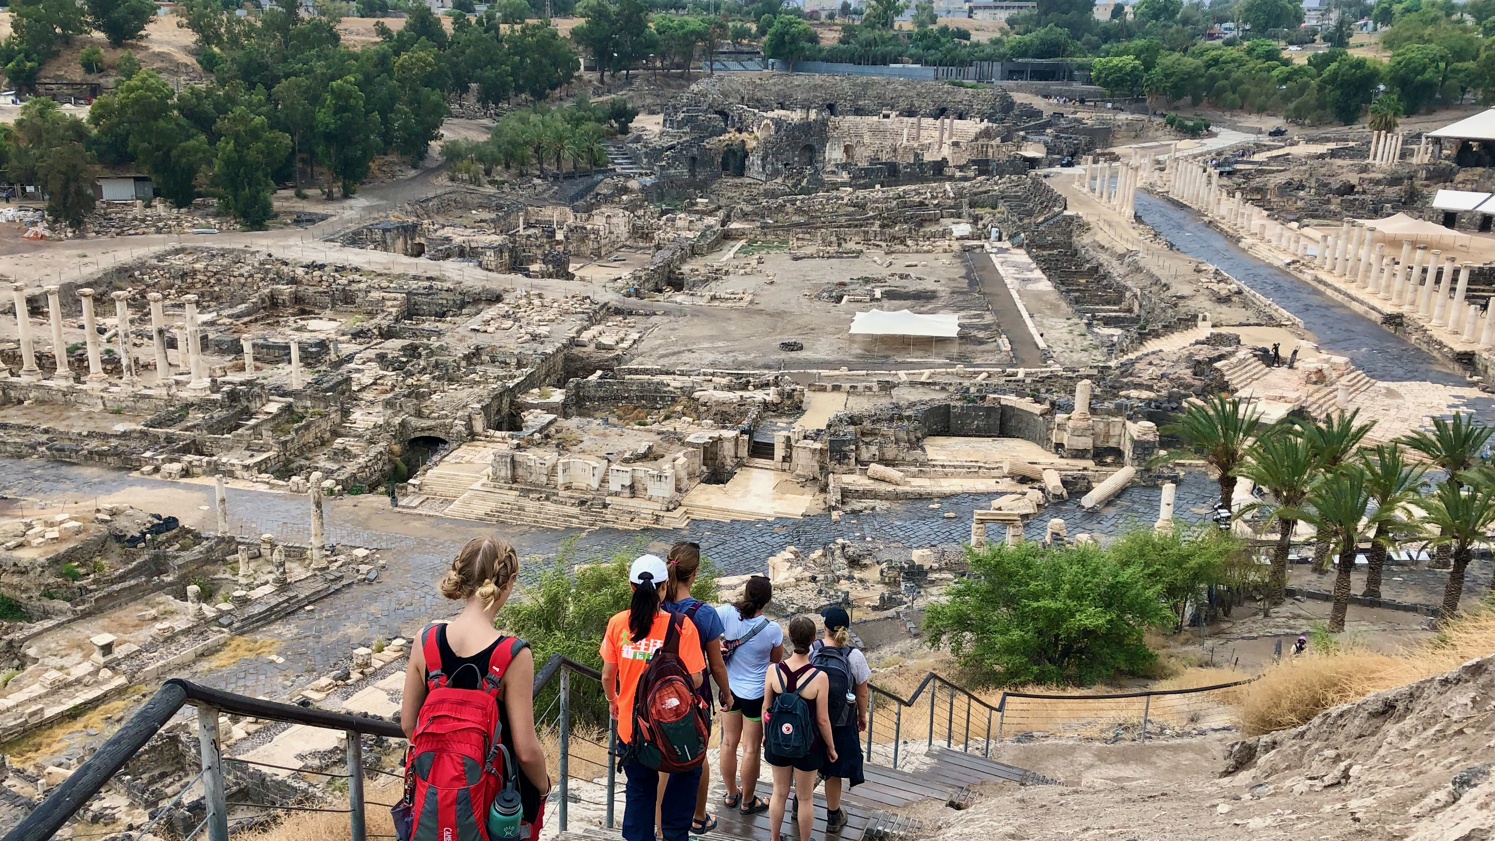
Ancient Insights
The Cultural Context of Jesus’s Teachings

Slide 2
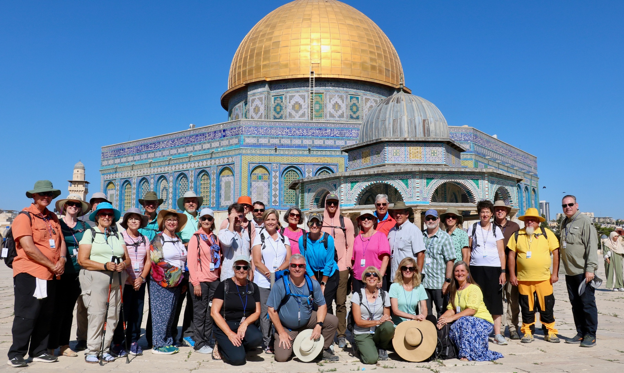
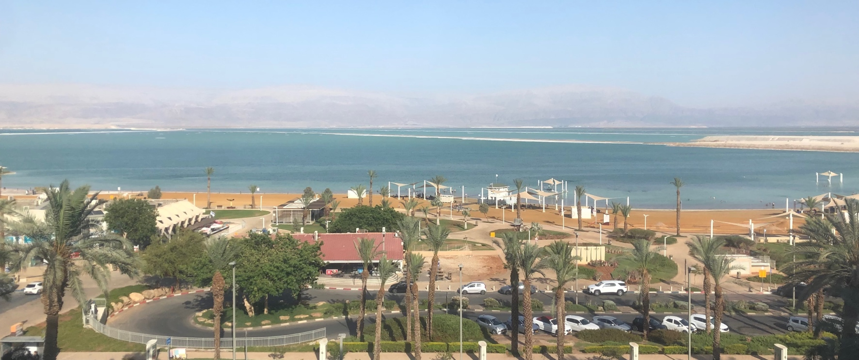
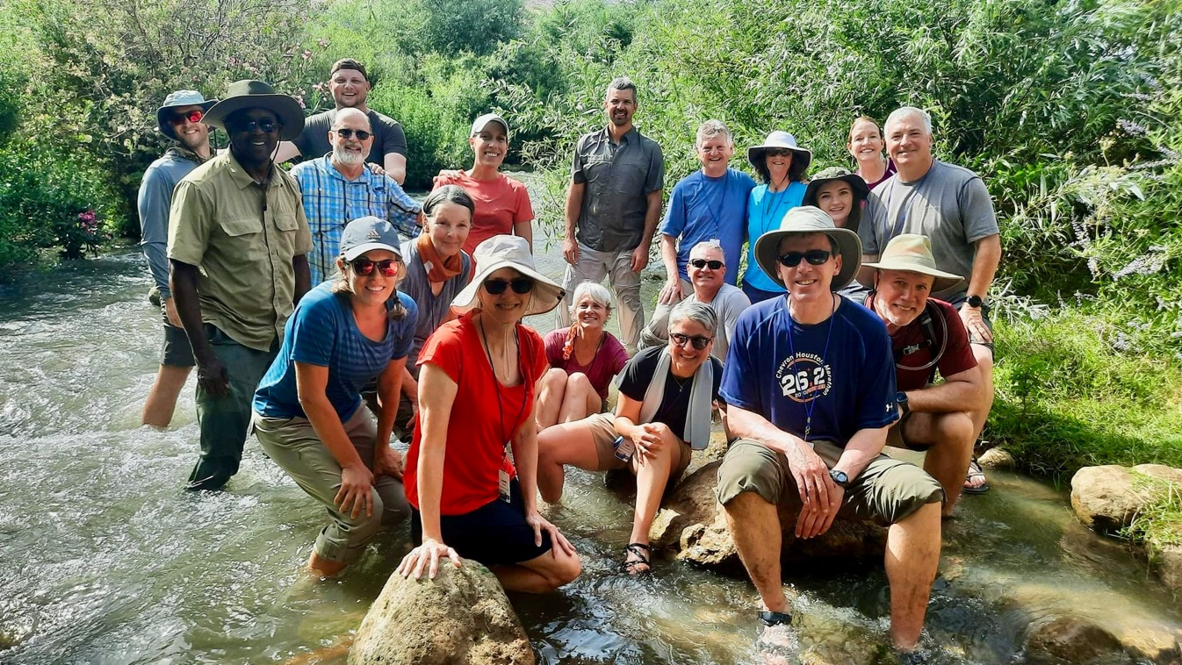
Israel Study Tour
June 30–July 12, 2024
Registration Open!

Slide 3
SteppingIntoTheJordan.com

Slide 4
Direct Link
https://steppingintothejordan.com/study-trips/

Slide 5
Objective and Method
70 Faces of Scripture
Different lenses reveal different insights.
The teachings of Jesus in the Gospels reflect the “culture of the day.”
Our Lens: Examine the culture of the Second Temple Period to shed light on Jesus’s teachings.

Slide 6
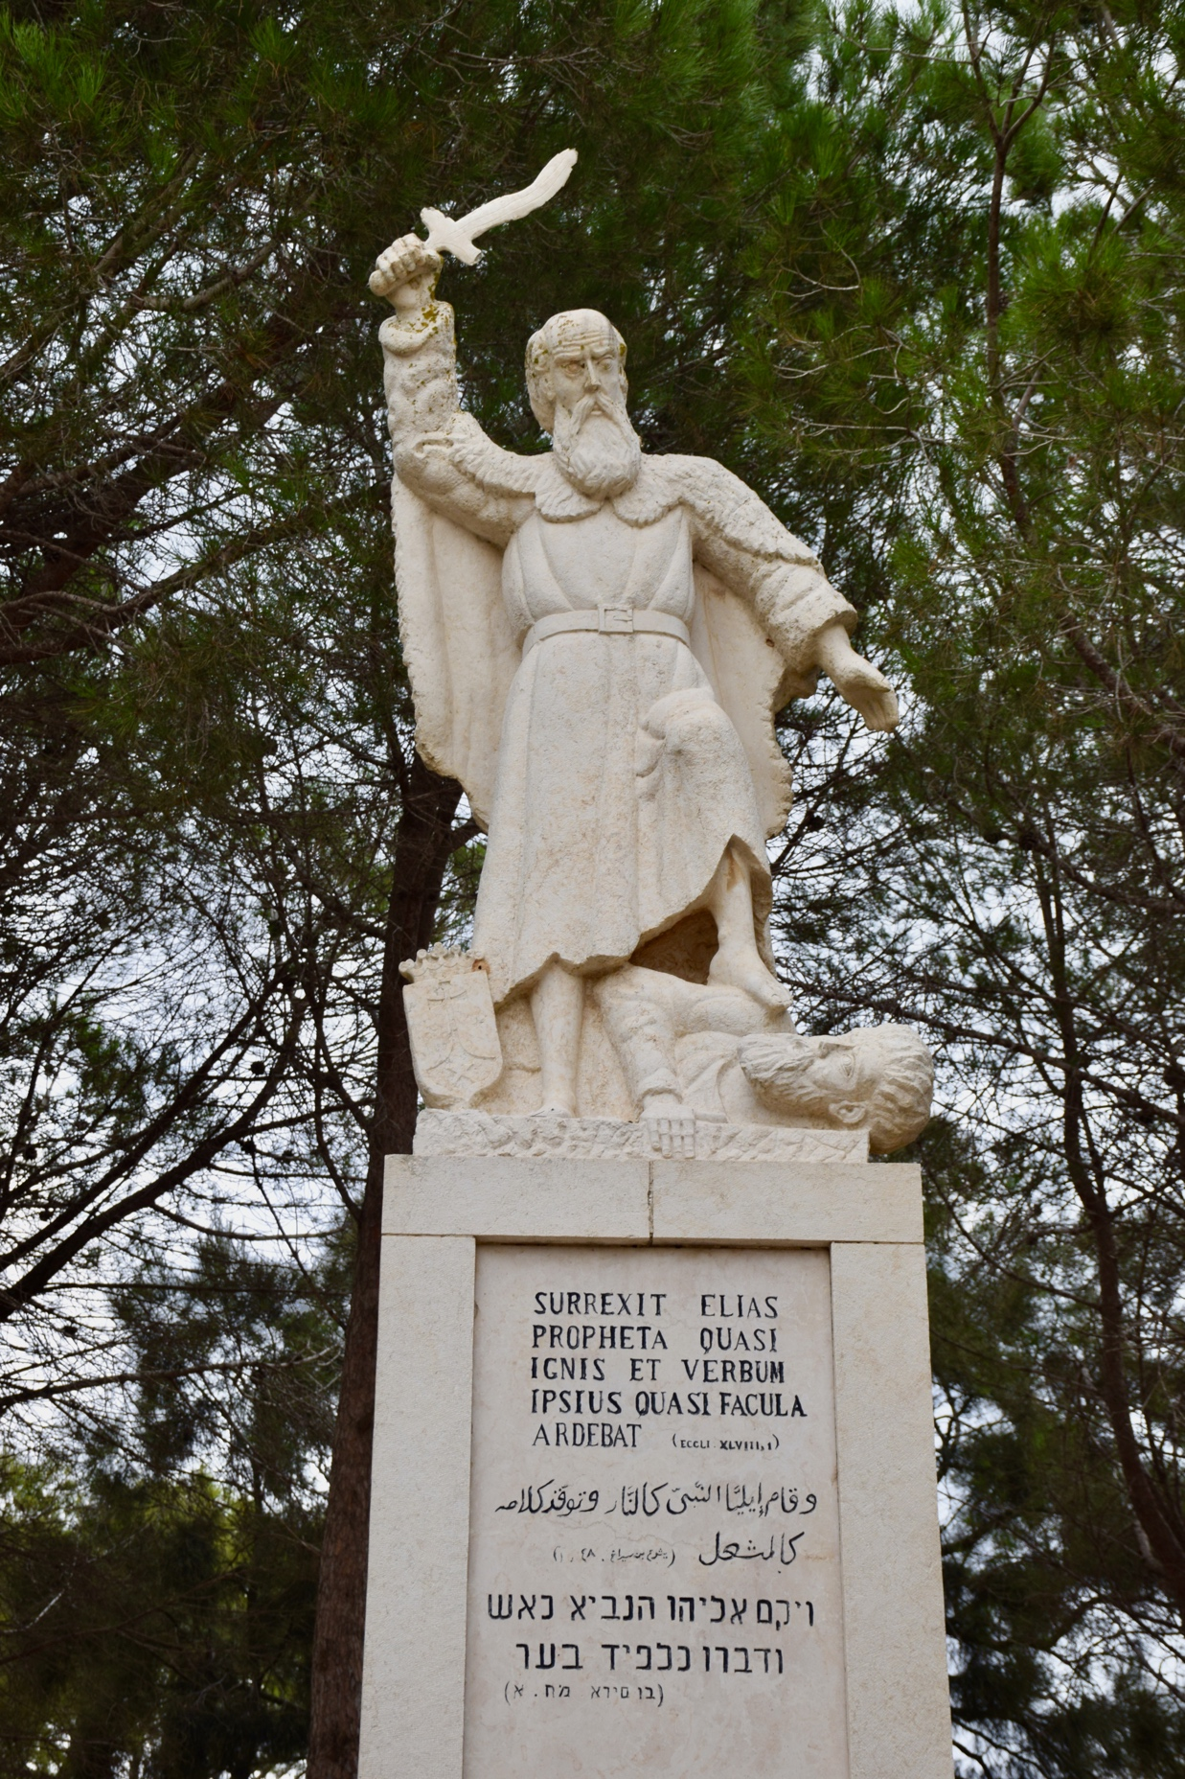
What’s So Special
About Elijah?

Slide 7
What’s So Special About Elijah?
Now when Jesus came into the district of Caesarea Philippi, he asked his disciples, “Who do people say that the Son of Man is?” And they said, “Some say John the Baptist, but others Elijah, and still others Jeremiah or one of the prophets.”
Matt 16:13–14 (NRSV)

Slide 8
A Quick Review
To Ahab: “No rain until I say so.”
Stayed with widow of Zarephath (Phoenicia)
Battled Prophets of Ba’al on Mt. Carmel.
Ran away to Mt. Horeb
Taken up in a chariot of fire

Slide 9
Elijah at Mt. Horeb
He got up, and ate and drank; then he went in the strength of that food forty days and forty nights to Horeb the mount of God. At that place he came to a cave, and spent the night there.
Then the word of the LORD came to him, saying, “What are you doing here, Elijah?” He answered, “I have been very zealous for the LORD, the God of hosts; for the Israelites have forsaken your covenant, thrown down your altars, and killed your prophets with the sword. I alone am left, and they are seeking my life, to take it away.”
1 Kings 19:8–10

Slide 10
Later Prophecy about Elijah
Remember the teaching of my servant Moses, the statutes and ordinances that I commanded him at Horeb for all Israel.
Lo, I will send you the prophet Elijah before the great and terrible day of the LORD comes. He will turn the hearts of parents to their children and the hearts of children to their parents, so that I will not come and strike the land with a curse.
Mal 4:4–6
When will Elijah return?
What will he do?

Slide 11
What’s Special about Elijah?
Zealous for the LORD.
Didn’t Die.
He’s coming back.
Helps restore Israel.
Saves Israel from the Day of the LORD

Slide 12
How was Elijah viewed in Second Temple/Rabbinic Judaism?
Elijah comes back...a lot.

Slide 13
Elijah is Phinehas
Rabbi Shim’on Ben Lakish taught: Phinehas is Elijah. The Holy One, Blessed Be He, said to him: “Just as you brought peace between me and the Children of Israel, so too in the future will you bring peace between us. As it is written: “Behold, I will send you Elijah the prophet before the coming of the awesome and fearful day of the LORD. He shall reconcile parents with children and children with their parents, so that, when I come, I do not strike the whole land with utter destruction.
Midrash Agaddah (Buber) Parashat Pinchas 25
How does Rabbi Shim’on Ben Lakish justify this claim?

Slide 14
Phinehas
Just then one of the Israelites came and brought a Midianite woman into his family, in the sight of Moses and in the sight of the whole congregation of the Israelites, while they were weeping at the entrance of the tent of meeting. When Phinehas son of Eleazar, son of Aaron the priest, saw it, he got up and left the congregation. Taking a spear in his hand, he went after the Israelite man into the tent, and pierced the two of them, the Israelite and the woman, through the belly. So the plague was stopped among the people of Israel. Nevertheless those that died by the plague were twenty-four thousand.
The LORD spoke to Moses, saying: “Phinehas son of Eleazar, son of Aaron the priest, has turned back my wrath from the Israelites by manifesting such zeal among them on my behalf that in my jealousy I did not consume the Israelites. Therefore say, ‘I hereby grant him my covenant of peace. It shall be for him and for his descendants after him a covenant of perpetual priesthood, because he was zealous for his God, and made atonement for the Israelites.’”
Num 25:6–13

Slide 15
Elijah in Esther
What did Elijah—may he be remembered for good—do? He appeared as Harbona and said to the king: “And what is more, a gallows stake is standing in Haman’s house, 50 cubits high, which Haman made for Mordecai—the man whose words saved the king!
Esther Rabbah 10

Slide 16
Elijah in Esther
Esther said, “A foe and enemy, this wicked Haman!” Then Haman was terrified before the king and the queen. The king rose from the feast in wrath and went into the palace garden, but Haman stayed to beg his life from Queen Esther, for he saw that the king had determined to destroy him. When the king returned from the palace garden to the banquet hall, Haman had thrown himself on the couch where Esther was reclining; and the king said, “Will he even assault the queen in my presence, in my own house?” As the words left the mouth of the king, they covered Haman’s face. Then Harbona, one of the eunuchs in attendance on the king, said, “Look, the very gallows that Haman has prepared for Mordecai, whose word saved the king, stands at Haman’s house, fifty cubits high.” And the king said, “Hang him on that.” So they hanged Haman on the gallows that he had prepared for Mordecai. Then the anger of the king abated.
Esther 7:6–10
In this rabbinic view, what does Elijah accomplish?

Slide 17
Elijah and Rabbi Akiva
The daughter of Kalba Savua betrothed herself to Rabbi Akiva. When her father heard what had happened, he vowed that his daughter would not benefit at all from his property. She then went and married him in winter. The newlywed couple slept on straw in a barn, and Akiva had to pick out the straw from his wife’s hair. He said to her, “If only I could afford it, I would present you with a Jerusalem of Gold.” That evening, Elijah the prophet came to them in the guise of a mortal, and cried out at the door, “Give me some straw, for my wife is about to give birth and I have nothing for her to lie on.” “See!” Akiva observed to his wife, “there is a man who lacks even straw!” She counseled him, “Go and become a scholar.” So he left her, and spent 12 years studying under Rabbi Eliezer ben Hyrcanus and Rabbi Yehoshua ben Channaniyah...
When he returned home, he had with him 24,000 disciples. Everyone flocked to meet him, including his wife...When she went to see him, his disciples wished to repulse her. “Make way for her,” he told them, “for what is mine and yours is truly hers.”
Nedarim 50a

Slide 18
Why Does Elijah Appear to Akiva?
Elijah’s appearance compels Akiva’s wife to send him away to study Torah.
Rabbi Akiva becomes one of the most influential rabbis of the period after the Temple was destroyed.
Had a large number of disciples.
His teachings had a great influence on the Mishnah.

Slide 19
Elijah in the Gospels

Slide 20
Elijah and John the Baptist
As they went away, Jesus began to speak to the crowds about John: “What did you go out into the wilderness to look at? A reed shaken by the wind? What then did you go out to see? Someone dressed in soft robes? Look, those who wear soft robes are in royal palaces. What then did you go out to see? A prophet? Yes, I tell you, and more than a prophet. This is the one about whom it is written,
‘See, I am sending my messenger ahead of you,
who will prepare your way before you.’
Truly I tell you, among those born of women no one has arisen greater than John the Baptist; yet the least in the kingdom of heaven is greater than he. From the days of John the Baptist until now the kingdom of heaven has suffered violence, and the violent take it by force. For all the prophets and the law prophesied until John came; and if you are willing to accept it, he is Elijah who is to come. Let anyone with ears listen!
Matt 11:7–15

Slide 21
How is John the Baptist Elijah?
Mal 4:4–6
Turn the hearts of the parents to their children.
Turn the hearts of the children to their parents.
Saves Israel before the Day of the LORD.
A call to repentance.

Slide 22
Elijah John and the Baptist
Six days later, Jesus took with him Peter and James and his brother John and led them up a high mountain, by themselves. And he was transfigured before them, and his face shone like the sun, and his clothes became dazzling white. Suddenly there appeared to them Moses and Elijah, talking with him...
As they were coming down the mountain, Jesus ordered them, “Tell no one about the vision until after the Son of Man has been raised from the dead.” And the disciples asked him, “Why, then, do the scribes say that Elijah must come first?” He replied, “Elijah is indeed coming and will restore all things; but I tell you that Elijah has already come, and they did not recognize him, but they did to him whatever they pleased. So also the Son of Man is about to suffer at their hands.” Then the disciples understood that he was speaking to them about John the Baptist.
Matt 17:1–3, 9–13

Slide 23
Elijah and the Crucifixion
From noon on, darkness came over the whole land until three in the afternoon. And about three o’clock Jesus cried with a loud voice, “Eli, Eli, lema sabachthani?” that is, “My God, my God, why have you forsaken me?” When some of the bystanders heard it, they said, “This man is calling for Elijah.” At once one of them ran and got a sponge, filled it with sour wine, put it on a stick, and gave it to him to drink. But the others said, “Wait, let us see whether Elijah will come to save him.”
Matt 27:45–49
Why do they think Jesus is calling for Elijah?

Slide 24
Elijah and the Crucifixion
My God, my God, why have you forsaken me?
Why are you so far from helping me, from the words of my groaning?
Psa 22:1
Why do they think Jesus is calling for Elijah?

Slide 25
Calling for Elijah?
Nothing in Jesus’s quote from Ps. 22:1 mentions Elijah.
Is this an opportunity for Elijah’s supernatural aid?
Is the Crucifixion the expected Day of the LORD?
There is a general assumption that Elijah comes back!

Slide 26
Is Elijah’s return literal or symbolic?

Slide 27
Summary
Jewish traditions about Elijah help us understand Elijah in the Gospels.
Elijah comes back...a lot.
Elijah is zealous for God.
Elijah turns hearts towards repentance.
Elijah works to save Israel from destruction.

Slide 28
Next Week
Jesus and the Canaanite Woman
Matt 15:21–28 / Mark 7:24–30
1 Kings 17:8–24
1 Kings 19:1–18

