Slide 1
Being God’s Image
Women and Men in the Kingdom of God

Slide 2
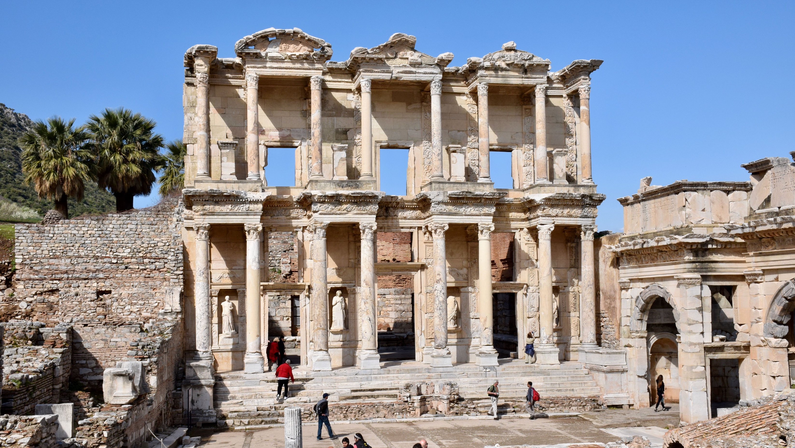
Biblical Study Tour: July 1–12, 2024

Slide 3
www.SteppingIntoTheJordan.com

Slide 4
Direct Link
https://steppingintothejordan.com/study-trips/

Slide 5
March 22–23, 2024 (Friday & Saturday)

Slide 6
Direct Link
https://www.smu.edu/perkins/publicprograms/summit-for-faith-and-learning

Slide 7
Silent Women 1 Cor 14:34–36

Slide 8
Thoughts?
Judge for yourselves: is it proper for a woman to pray to God with her head unveiled? Does not nature itself teach you that if a man wears long hair, it is degrading to him, but if a woman has long hair, it is her glory? For her hair is given to her for a covering. But if anyone is disposed to be contentious—we have no such custom, nor do the churches of God.
1 Cor 11:13–16 (NRSV)

Slide 9
How does culture influence
how we interpret scripture?

Slide 10
Quotes from our History
“Women in pants on the rostrum or managing conventions” not only disobey Paul’s command of silence, but also are in danger of “eternal death” in spite of all their “tender, tearful, heartfelt talks.”
David Lipscomb, 1892
“If the saloon cannot be destroyed except by woman’s suffrage, we say let the saloon stay.”
E.W. Herndon, 1888

Slide 11
The biblical writers wrestle with changing circumstances
Israel’s Exile
Israel’s Return from Exile
Crucified and Risen Messiah
Gentiles as Part of the People of God

Slide 12
Continued Changing Circumstances
Slavery
Antisemitism
Segregation
Roles of women and men in the workplace and home.

Slide 13
How do we interpret scripture
in light of changing circumstances?
(and still remain faithful to the text)

Slide 14
Interpretation
Literary Context
Historical Context
Translation Issues
Holistic Witness of Scripture
Recognize that we are meant to wrestle with the text.
We always bring our own socio-historical context when we interpret Scripture.

Slide 15
Jerusalem University College

Slide 16
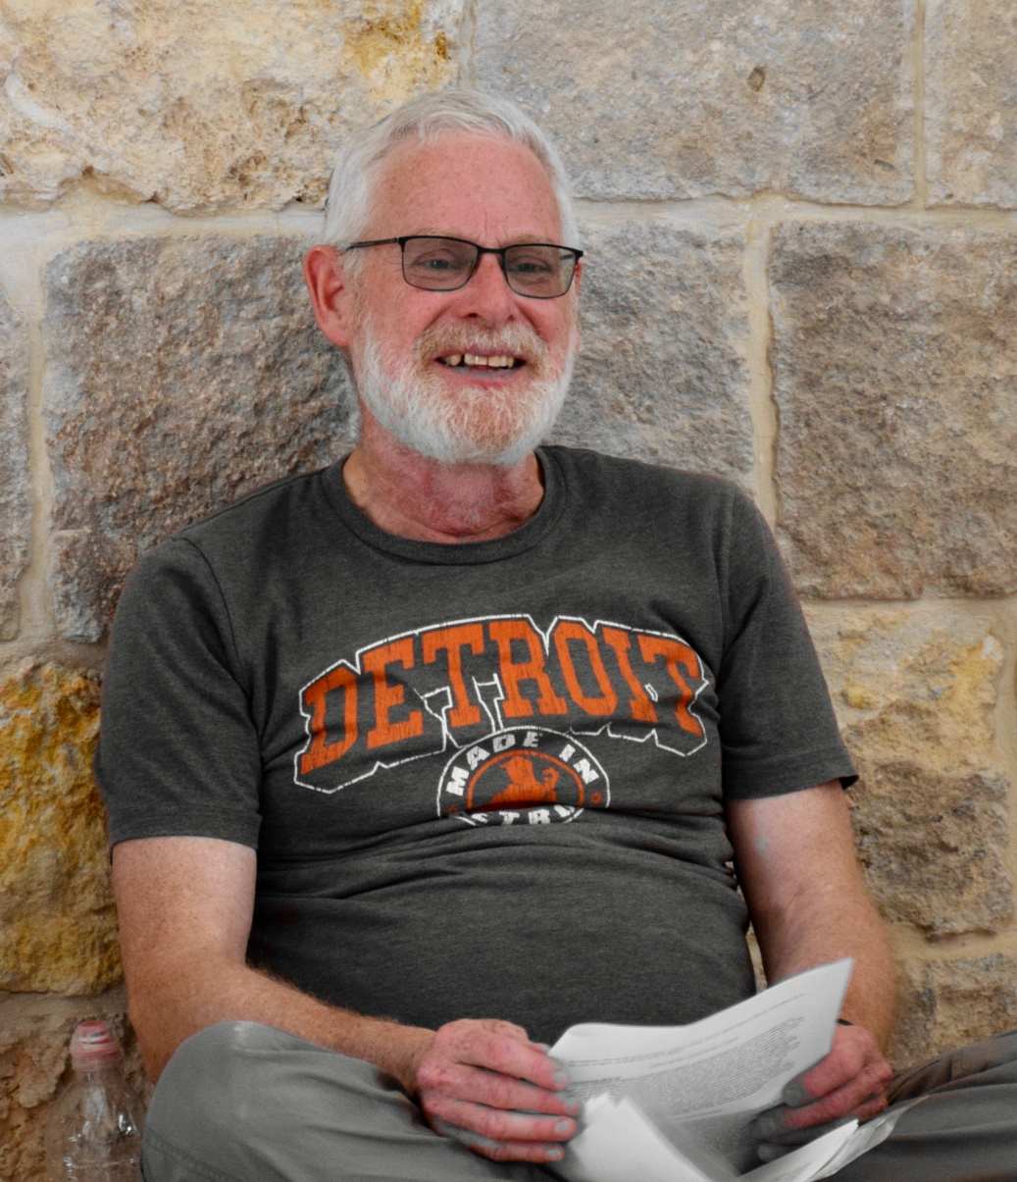
Classic Rabbinic Literature
Major Paper
Select NT Text that interprets an OT Text.
Find Classic Rabbinic Commentary on Same OT Text/Topic
Compare and Contrast
Rabbi Moshe Silberschein

Slide 17
“As a woman, my wife does not have
the same obligation to study Torah that I do as a man.”
“She is free to study Torah—and she
does—but she is not obligated to
study it as I am as a man.”
Rabbi Dr. Eldon Clem

Slide 18
1 Cor. 14:34-35
Women should be silent in the churches. For they are not permitted to speak, but should be subordinate, as the law also says. If there is anything they desire to know, let them ask their husbands at home. For it is shameful for a woman to speak in church. (NRSV)

Slide 19
Where does “The Law” Say This?
Commentaries generally reference 2 options.
Gen 3:16?
“The Curse”
“To the woman he said, ‘I will greatly increase your pangs in childbearing; in pain you shall bring forth children, yet your desire shall be for your husband, and he shall rule over you.’”

Slide 20
Where does “The Law” Say This?
Num 12
Miriam, Aaron & Moses’ Cushite Wife
God punishes Miriam (and not Aaron) with leprosy for their actions.
Why isn’t Aaron punished?
Neither Text offers a sound basis for female silence.

Slide 21
Torah doesn’t say that anywhere.
There is nothing in Classic Rabbinic Literature on this subject.
Archaeological evidence doesn’t support this conclusion either.
Rabbi Moshe Silberschein

Slide 22
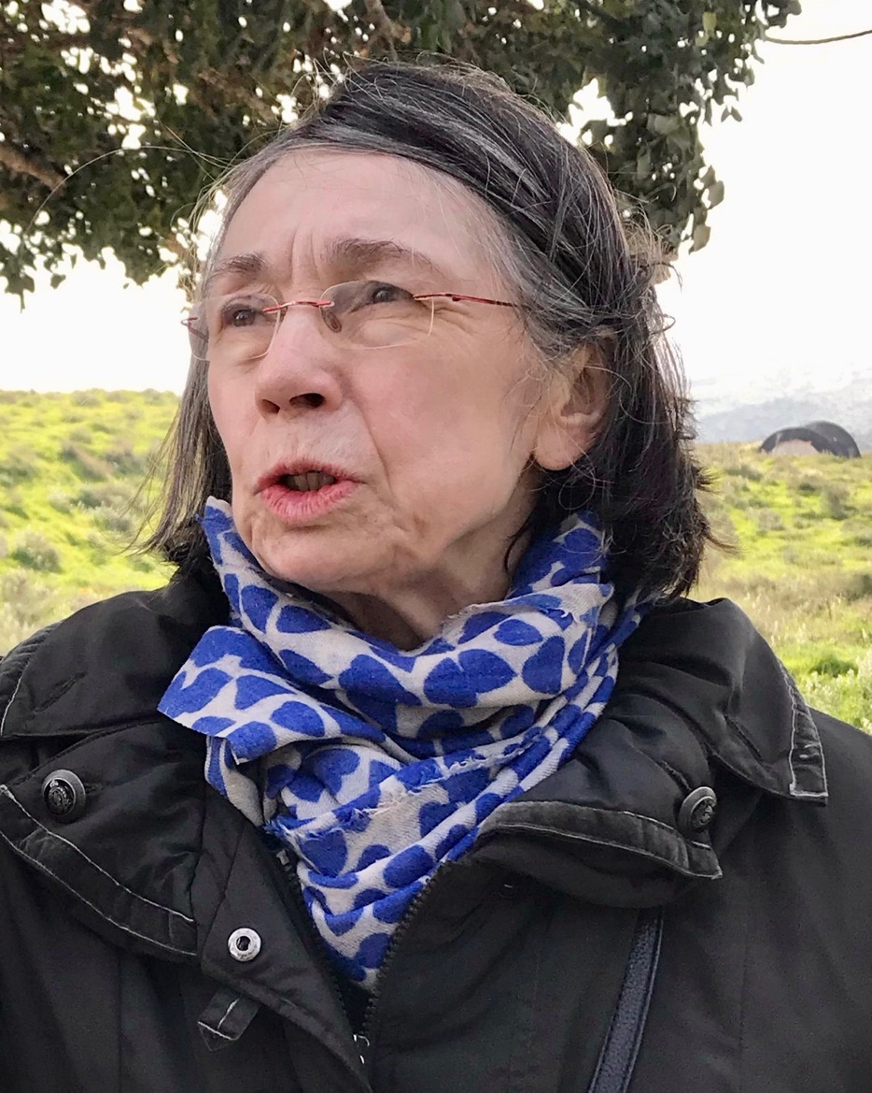
OT Hermeneutics of Early Church Fathers
Torah doesn’t say that anywhere.
Look at the scripture in context.
Paul is referencing Roman civic law, not Torah or rabbinic traditions.
Rev. Dr. Petra Heldt

Slide 23
Historical Context: Paterfamilias
Husband/Father had absolute power.
Women were subject to father or husband.
Education for women was limited beyond “basic” level.
Women exerted power via influence.
within the confines of the home, not in public.

Slide 24
1 Cor. 14:34-35
Women should be silent in the churches. For they are not permitted to speak, but should be subordinate, as the law also says. If there is anything they desire to know, let them ask their husbands at home. For it is shameful for a woman to speak in church.

Slide 25
Historical Context
Paul is living in 1st century Roman world.
We can’t expect him to think like a 21st century Christian.
Paterfamilias is the cultural norm.
Balancing act between freedom, social constructs, traditions, and unity.
His main focus is the edification of the Body.

Slide 26
What do you notice?
Any man who prays or prophesies with something on his head disgraces his head, but any woman who prays or prophesies with her head unveiled disgraces her head—it is one and the same thing as having her head shaved. For if a woman will not veil herself, then she should cut off her hair; but if it is disgraceful for a woman to have her hair cut off or to be shaved, she should wear a veil.
1 Cor 11:4–6
Women are praying and prophesying!!

Slide 27
Head Coverings – 1 Cor 11:4-16
Jewish Practice
Gentile Practice
Men Heads Covered
Women Heads Uncovered
Men Heads Uncovered
Women Heads Covered

Slide 28
Literary Context
Now in the following instructions I do not commend you, because when you come together it is not for the better but for the worse. For, to begin with, when you come together as a church, I hear that there are divisions among you; and to some extent I believe it.
1 Cor 11:17-18

Slide 29
Order and Edification
But if there is no one to interpret, let them be silent in church and speak to themselves and to God. (1 Cor 14:28)
If a revelation is made to someone else sitting nearby, let the first person be silent. (1 Cor 14:30)
Women should be silent in the churches. For they are not permitted to speak, but should be subordinate, as the law also says. (1 Cor 14:34)

Slide 30
My Personal Take
I believe Paul is referencing civic or household codes, not Torah in this passage.
His view is in line with the social structure of the Roman world of the 1st century (as we should expect it to be).
Likewise, our practice should be in line with the social structure of our culture.
His argument is part of a larger discussion on order and edification of the body.

Slide 31
Next Week
Read Gen 1

