Slide 1
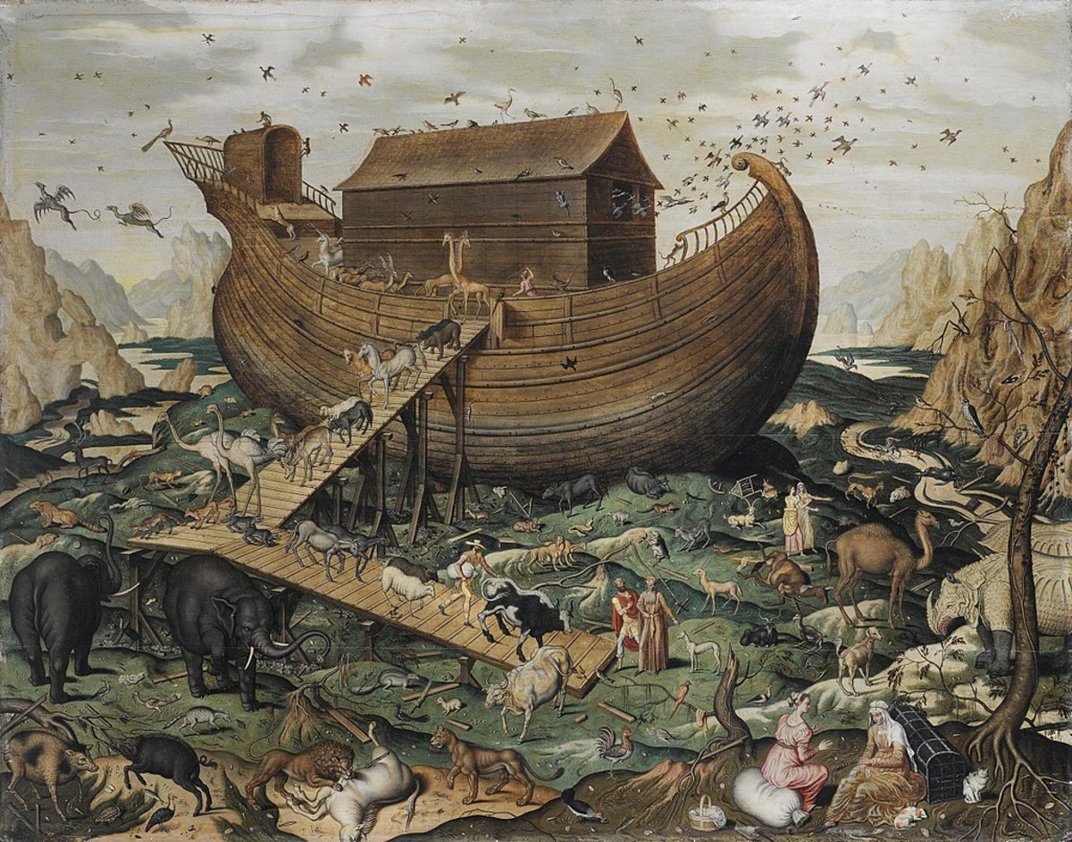
The Flood

Slide 2
Objective and Method
70 Faces of Scripture
Different lenses reveal different insights.
What can we learn by looking at the flood stories through different lenses?

Slide 3
Our Lenses
Children Stories
“Asking Questions...”
Ancient Near Eastern Flood Stories
Film Adaptations (Visual Hermeneutics)
Creation and the Flood
There is value in “sitting in the tension.”

Slide 4
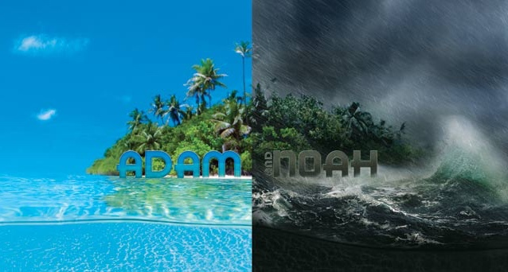

Slide 5
How to Organize Genesis?
Method 1: Narrowing Lens
Universal → Specifc
Primordial History (Gen 1:1–11:26)
Abrahamic/Israelite Origins (Gen 11:27–50:26)
Method 2: Tôleḏōt (Generations)
The text is marked by the repeating phrase: “These are the descendants of...”
Ten primary characters

Slide 6
Tôleḏōṯ (תּוֹלְדֹת)
Gen 2:4 – “These are the generations of the heavens and the earth.”
Gen 5:1 – “This is the list of the descendants of Adam.”
Gen 6:9 – “These are the descendants of Noah.”
Gen 10:1 – “These are the descendants of Noah’s sons...”
Gen 11:10 – “These are the descendants of Shem.”
Gen 11:27 – “Now these are the descendants of Terah.”
Gen 25:13 – “These are the descendants of Ishmael...”
Gen 25:19 – “These are the descendants of Isaac, Abraham’s son...”
Gen 36:1,9 – “These are the descendants of Esau...”
Gen 37:2 – “These are the descendants of Jacob...”

Slide 7
Creation
Then God said, “Let us make humankind in our image, according to our likeness; and let them have dominion over the fish of the sea, and over the birds of the air, and over the cattle, and over all the wild animals of the earth, and over every creeping thing that creeps upon the earth.”
So God created humankind in his image,
in the image of God he created them;
male and female he created them.
God blessed them, and God said to them, “Be fruitful and multiply, and fill the earth and subdue it; and have dominion over the fish of the sea and over the birds of the air and over every living thing that moves upon the earth.” God said, “See, I have given you every plant yielding seed that is upon the face of all the earth, and every tree with seed in its fruit; you shall have them for food. And to every beast of the earth, and to every bird of the air, and to everything that creeps on the earth, everything that has the breath of life, I have given every green plant for food.” And it was so. God saw everything that he had made, and indeed, it was very good. And there was evening and there was morning, the sixth day.
Gen 1:26–31 (NRSV)

Slide 8
The Tôledōt of Adam
This is the list of the descendants of Adam. When God created humankind, he made them in the likeness of God. Male and female he created them, and he blessed them and named them “Humankind” when they were created.
Gen 5:1–2
When people began to multiply on the face of the ground, and daughters were born to them, the sons of God saw that they were fair; and they took wives for themselves of all that they chose. Then the LORD said, “My spirit shall not abide in mortals forever, for they are flesh; their days shall be one hundred twenty years.” The Nephilim were on the earth in those days—and also afterward—when the sons of God went in to the daughters of humans, who bore children to them. These were the heroes that were of old, warriors of renown.
The LORD saw that the wickedness of humankind was great in the earth, and that every inclination of the thoughts of their hearts was only evil continually. And the LORD was sorry that he had made humankind on the earth, and it grieved him to his heart. So the LORD said, “I will blot out from the earth the human beings I have created—people together with animals and creeping things and birds of the air, for I am sorry that I have made them.” But Noah found favor in the sight of the LORD.
Gen 6:1–8

Slide 9
Very Good....to Very Bad
Filling the earth
Be fruitful and multiply (Gen 1:28)
Daughters of Humans and Divine Beings (Gen 6:1–2)
“God saw...”
It was very good (Gen 1:31)
The wickedness of humankind was great... (Gen 6:5)

Slide 10
The Tôledōt of Noah
These are the descendants of Noah. Noah was a righteous man, blameless in his generation; Noah walked with God. And Noah had three sons, Shem, Ham, and Japheth.
Gen 6:9–10
Now the earth was corrupt in God’s sight, and the earth was filled with violence. And God saw that the earth was corrupt; for all flesh had corrupted its ways upon the earth. And God said to Noah, “I have determined to make an end of all flesh, for the earth is filled with violence because of them; now I am going to destroy them along with the earth. Make yourself an ark of cypress wood; make rooms in the ark, and cover it inside and out with pitch.
Gen 6:11–14
“Corrupted” (Heb. Shachat) means “ruined” or “spoiled”
“Destroy” is from the same Hebrew word.
The Hebrew makes the sense of Divine justice more clear than English.

Slide 11
The Tôledōt of Noah
God blessed Noah and his sons, and said to them, “Be fruitful and multiply, and fill the earth. The fear and dread of you shall rest on every animal of the earth, and on every bird of the air, on everything that creeps on the ground, and on all the fish of the sea; into your hand they are delivered. Every moving thing that lives shall be food for you; and just as I gave you the green plants, I give you everything. Only, you shall not eat flesh with its life, that is, its blood. For your own lifeblood I will surely require a reckoning: from every animal I will require it and from human beings, each one for the blood of another, I will require a reckoning for human life.
Whoever sheds the blood of a human,
by a human shall that person’s blood be shed;
for in his own image
God made humankind.
And you, be fruitful and multiply, abound on the earth and multiply in it.”
Gen 9:1–7
What echoes of Genesis 1 do you see here?
What’s different?

Slide 12
The Flood Undoes Creation
Creation
Flood
Order brought from Chaos
Separates waters
Above and below
Uncovers the land
Creates life
Chaos destroys order
Releases waters
Above and Below
Covers the land
Destroys life
The flood represents the ultimate cosmic reset.

Slide 13
Is Noah the Second Adam?
Adam
Noah
God Blesses
Places in protected Garden
Tills Garden
Covers nakedness
3 sons
1 son is cursed
God Blesses
Places in protected “ark”
Tills vineyard
Nakedness covered
3 sons
Curses 1 son (grandson)

Slide 14
Side Note...
“Ark” (Tevah, תֵּבָה) is an unusual word in Hebrew.
Only used in two stories in the Hebrew Bible.
The “ark” in flood story
and Moses placed in a “basket.”

Slide 15
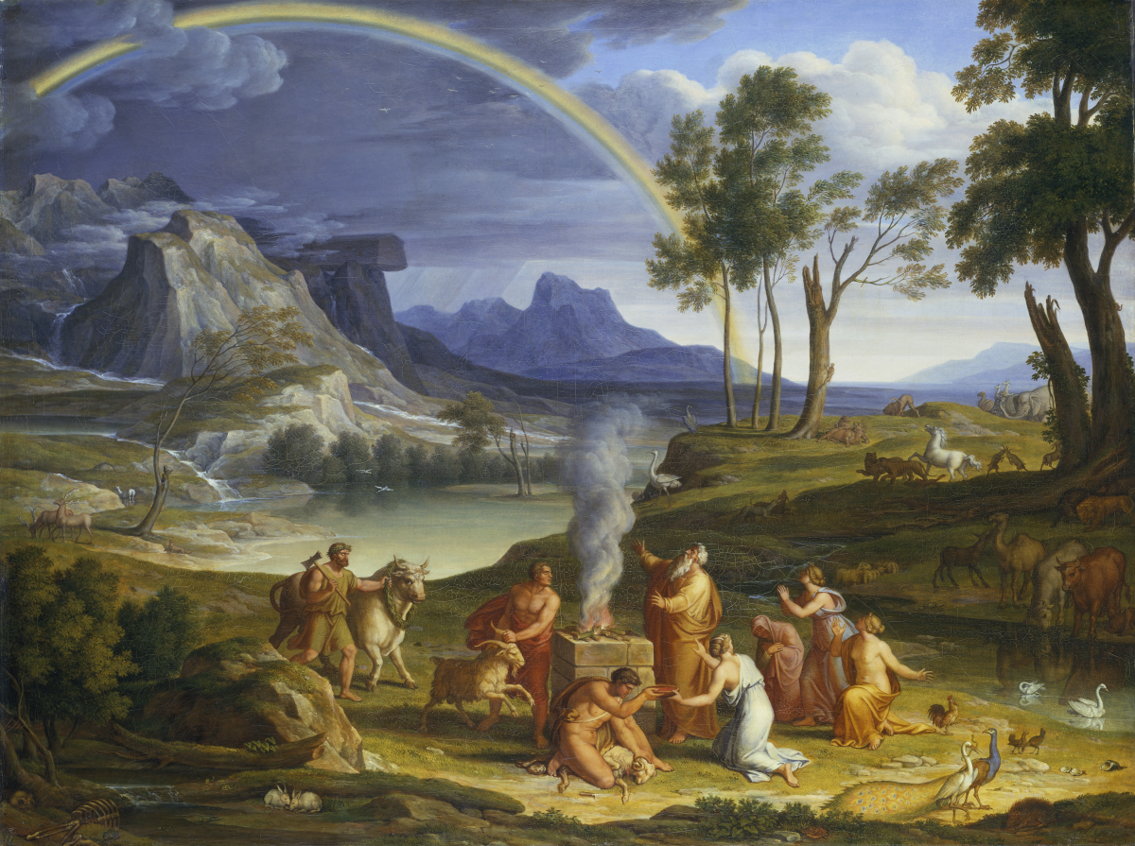
Putting it all Together

Slide 16
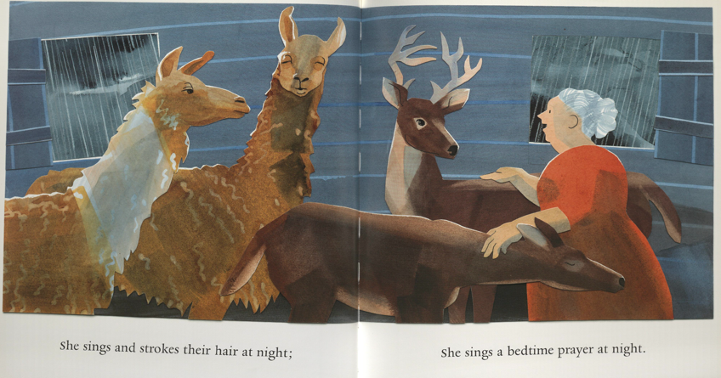
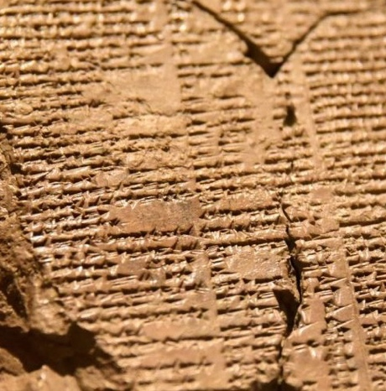
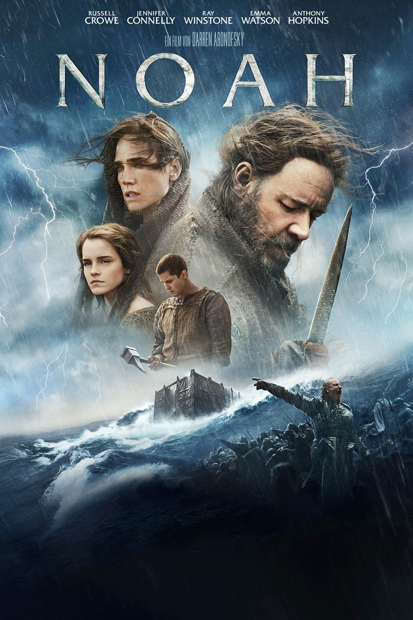
Children Stories
Ancient Flood Stories
Asking Questions
Creation and the Flood
The Flood in Film
What did you see in the flood story that was new to you?

Slide 17
Children Stories
Ancient Flood Stories
Asking Questions
Creation and the Flood
The Flood in Film
How do you see the flood differently?

Slide 18
The Value of Different Lenses
Challenge our “white space” assumptions.
See new details (and depth) in the Bible.
Ask questions about God and God’s relationship to Creation.
How then should we live...?

Slide 19
Summary
We all interpret the “white space” in the Bible.
Reading a story through different lenses exposes the “white space” and expands our understanding of the Bible.
Engaging with different methods creates tension.
We learn by “sitting in the tension.”

Slide 20
Coming Soon!
Nov–Dec: Fulfilling the Mission of Christ
Jess Ellis
Jan–Mar: Women and Men in God’s Kingdom
Rob Kranz

