Slide 1
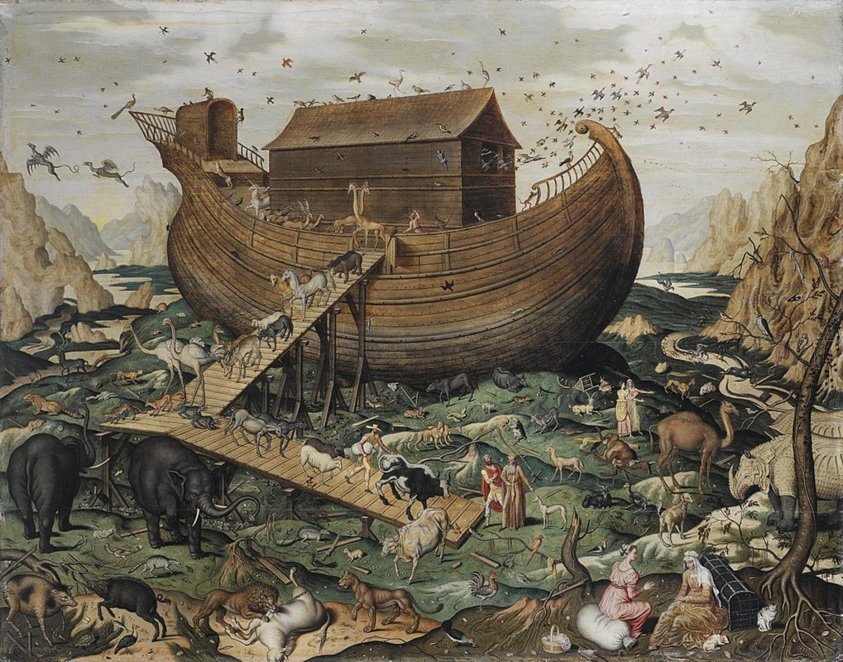
The Flood

Slide 2
Objective and Method
70 Faces of Scripture
Different lenses reveal different insights.
What can we learn by looking at the flood stories through different lenses?

Slide 3
Our Lenses
Children Stories
“Asking Questions...”
Ancient Near Eastern Flood Stories
Film Adaptations
Source Criticism

Slide 4
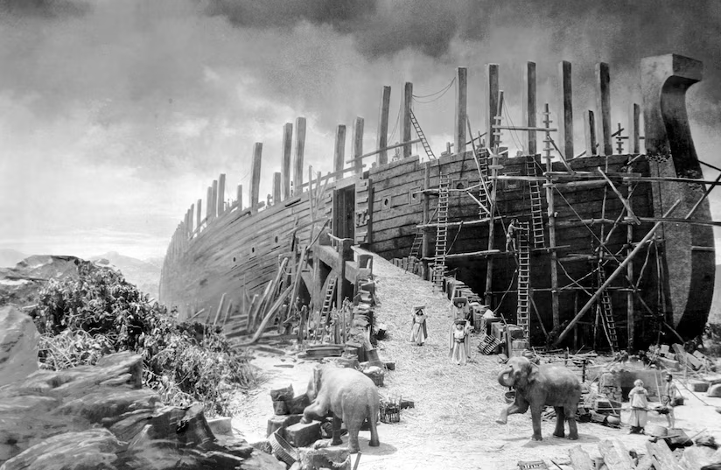
The Flood in Film

Slide 5
Why Film?
Visual Hermeneutics
Highlights the “white space.”
Exposes the interpretive choices we make.
“Active” engagement with the viewer.
Engages multiple senses.
Film “sutures” the viewer into the story.

Slide 6
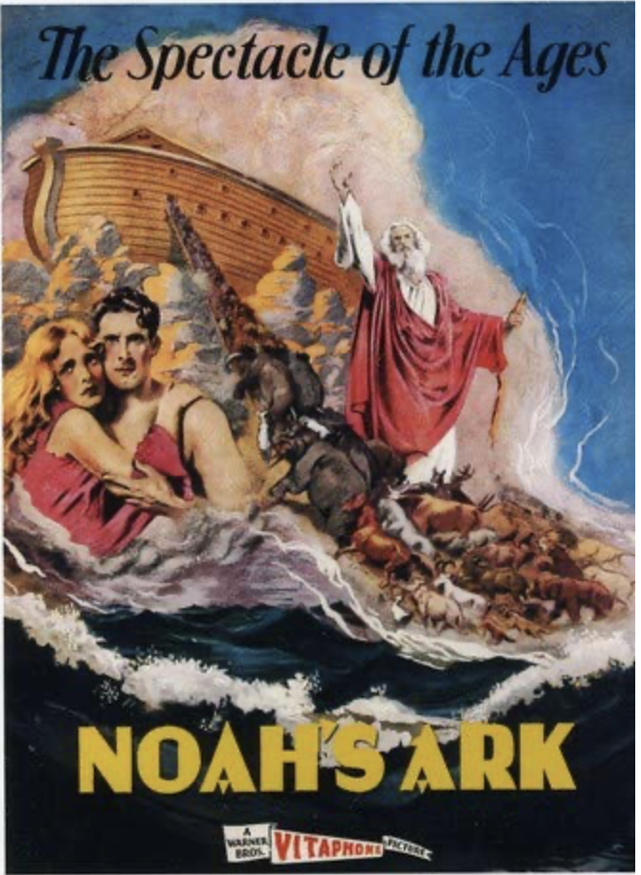
Released in 1928
Director: Michael Curtiz
Budget: $1M ($18M today)
Tells the story of Noah as a parallel to WWI.
Divine retribution for man’s evil.
Allies = Righteous
Axis = Wicked Humanity
Russians = Nephilim

Slide 7
The Movie Trailer
https://www.tcm.com/video/28970/noahs-ark-1929-re-issue-trailer

Slide 9
The Flood Scene
https://www.youtube.com/watch?v=8Mjtr6V5hCE

Slide 10
How does this clip fill in some “white space” in the Text?
What do you see that might be less obvious in the Bible?

Slide 11
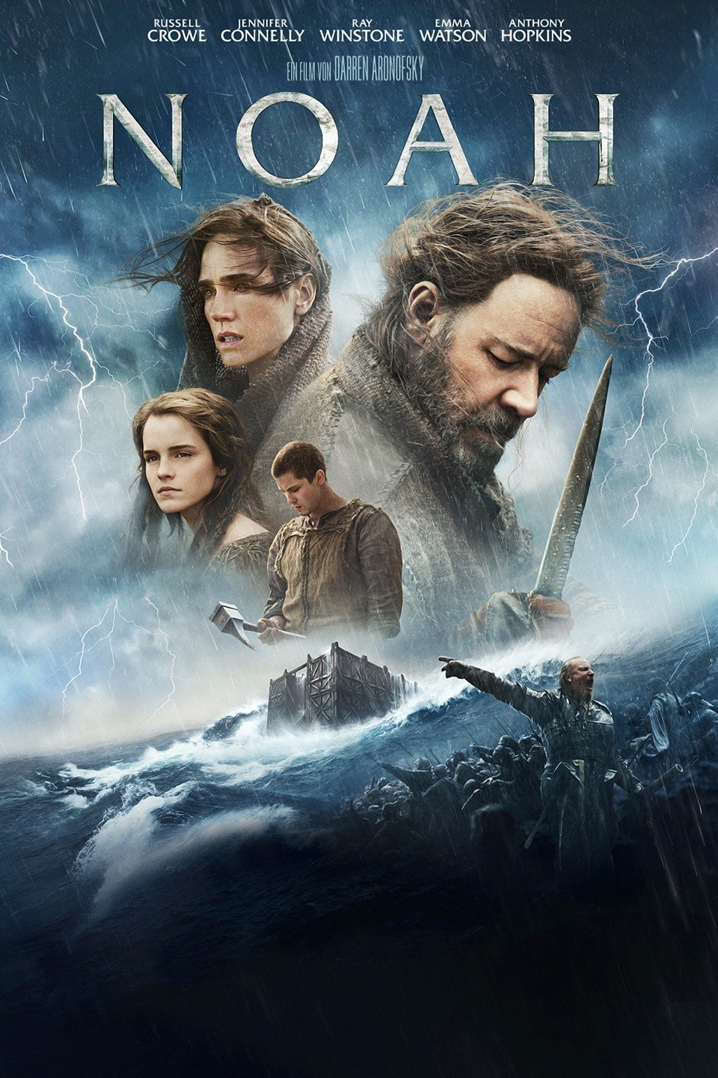
Released in 2014
Director: Darren Aronofsky
Budget: $125M

Slide 12
Under pressure from Christian groups, Paramount
added a disclaimer to the film’s marketing materials:
“The film is inspired by the story of Noah. While artistic license has been taken, we believe that this film is true to the essence, values and integrity of a story that is a cornerstone of faith for millions of people worldwide. The biblical story of Noah can be found in the book of Genesis.”

Slide 13
What “white space” does the film answer?

Slide 14
Noah’s Dreams
https://www.youtube.com/watch?v=btOKeNgd7UU
https://www.youtube.com/watch?v=RHCxhMl08-o

Slide 15
Why dreams like this?
When there are prophets among you,
I the LORD make myself known to them in visions;
I speak to them in dreams.
Not so with my servant Moses;
he is entrusted with all my house.
With him I speak face to face—
clearly, not in riddles;
and he beholds the form of the LORD.
Num 12:6–8 (NRSV)

Slide 16
How does Noah define righteousness?

Slide 17
What is the impact of the flood on Noah?

Slide 18
What does the film tell us about free will vs. Divine providence?

Slide 19
Does the flood solve anything?

Slide 20
Summary
Film exposes the “white space” in the biblical story.
Film helps us ask new questions of the biblical story.
Aronofksy’s Noah engages with Jewish interpretive history of the flood story.

Slide 21
Next Week
Read Gen 1–3
Read Gen 5:28–9:28
How are Adam and Noah similar?
Are there two flood traditions in the Bible?
Wrap-up: How do we engage with this text?

