Slide 1
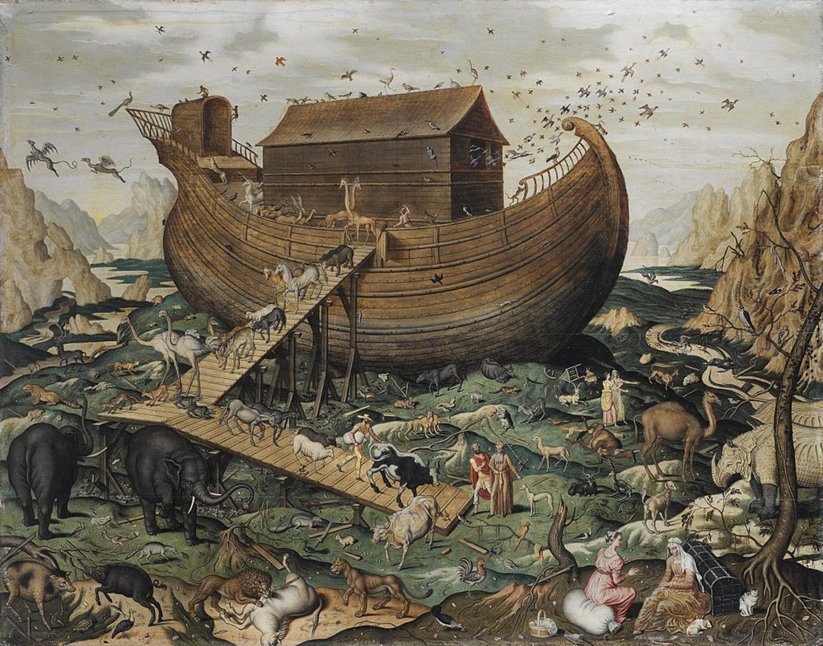
The Flood

Slide 2
Objective and Method
70 Faces of Scripture
Different lenses reveal different insights.
What can we learn by looking at the flood stories through different lenses?

Slide 3
Our Lenses
Children Stories
“Asking Questions...”
Ancient Near Eastern Flood Stories
Film Adaptations

Slide 4
The Flood
Questioning the Text

Slide 5
What questions did you come up with about Noah and the Flood?

Slide 6
The Flood
Ancient Sources

Slide 7
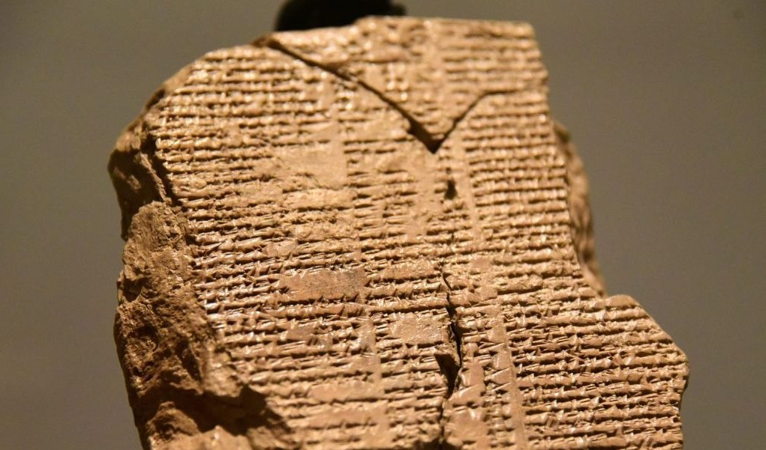
The Epic of Gilgamesh

Slide 8
Gilgamesh
Ancient Mesopotamian Literature
Sumerian, Assyrian, and Babylonian versions
2700–1700 BCE
Gilgamesh on a quest for eternal life
Fails to achieve it.
Consolation prize: enduring fame
Tablet IX tells the story of the Deluge
Gilgamesh meets Utnapishtim (made like a god).

Slide 9
Gilgamesh Epic (Tablet IX)
Shuruppak, a city you know of,
[and which on] Euphrates is situated,
The great gods resolved to send the deluge.
They [sw]ore their father, Anu,
Their counsellor the warrior Enlil,
Their throne-bearer Ninurta,
Their canal-officer Ennugi,
The leader Ea was under oath with them.
He repeated their plans to the reed hut,
“Reed hut, reed hut, wall, wall!
Listen, reed hut, be mindful wall!”
Man of Shuruppak, son of Ubartutu,
Destroy this house, build a ship,
Forsake possessions, seek life,
Build an ark and save life.
Take aboard ship seed of all living things.
The ship which you shall build,
Let her dimensions be measured off.
Let her width and length be equal,
Roof her over like a hidden depth.”

Slide 10
Gilgamesh Epic (Tablet IX)
The wealthy carried the pitch,
The poor brought ... What was needful.
On the fifth day I laid her framework,
One full acre was her floorspace,
Ten dozen cubits each was the height of her walls
Ten dozen cubits each were the edges around her...
I decked her in six,
I divided her in seven,
Her interior I divided nine ways...
Thrice 3600 measures of tar did [I pour out] inside her.

Slide 11
Gilgamesh Epic (Tablet IX)
On the seventh day the ship was completed
[Whatever I had] I loaded upon her:
What silver I had I loaded upon her,
What gold I had I loaded upon her,
What living creatures I had I loaded upon her.
I made go aboard all my family and kin,
Beasts of the steppe, wild animals of the steppe,
all skilled craftsmen I made go on board.

Slide 12
Gilgamesh Epic (Tablet IX)
I gazed upon the appearance of the storm,
The storm was frightful to behold!
I went into the ship and battened my door...
The gods became frightened of the deluge,
They shrank back and went up to Anu’s
highest heaven...
The wind continued, the deluge and
and windstorm leveled the land...
Crumpling over, I sat down and wept,
Tears running down my face...
The boat rested on Mount Nimush...
When the seventh day arrived,
I released a dove to go free,
No landing place came to view,
it turned back.
I released a swallow to go free,
The swallow went and returned,
No landing place came to view,
it turned back.
I sent a raven to go free,
The raven went forth, saw the ebbing of the
waters,
It ate, circled, left droppings,
did not turn back...

Slide 13
Gilgamesh Epic (Tablet IX)
Suddenly, as Enlil arrived,
He saw the boat, Enlil became angry.
He was filled with fury at the gods.
‘Who came out alive?
No man was to survive the destruction!’
Ea made ready to speak, and said to
the warrior Enlil,
‘You, O warrior, are the sage of the gods,
How could you, unreasoning, have brought
on the deluge?
Impose punishment on the sinner for
his sin.’
Then Enlil came up into the ship,
Leading me by the hand,
he brought me up too.
“Hitherto Utnapishtim and his wife shall
become like us gods.
Utnapishtim shall dwell afar-off at the
source of the rivers.
Thus it was they took me afar-off and made
me dwell at the source of the rivers.

Slide 14
Questions
What is similar to Noah and the Flood?
What is different?
Why does Gilgamesh matter?

Slide 15
The Flood
Two Bible Traditions

Slide 16
Explaining Textual Inconsistencies
The Documentary Hypothesis
4 source traditions: J, E, D, P.
Noah story has two traditions merged
J and P

Slide 17
Summary
Asking questions helps us expose areas for interpretation.
Flood stories are all over the place.
They show us how others viewed the flood.
The Bible contains more than one tradition of the flood story.

Slide 18
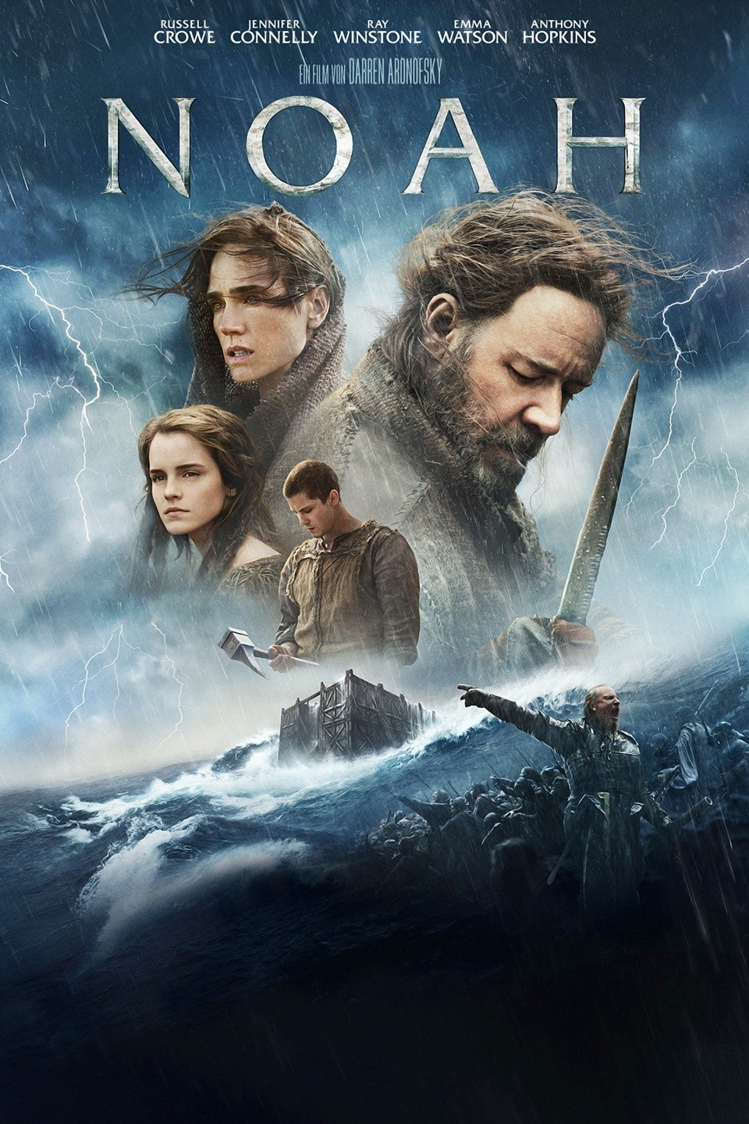
Next Week
Read Gen 5:28–9:28
Film Adaptations
Watch Noah
2014, Darren Aronofsky
Starring Russell Crowe
Amazon Prime

