Slide 1
Being God’s Image
Women and Men in the Kingdom of God

Slide 2
Introduction

Slide 3
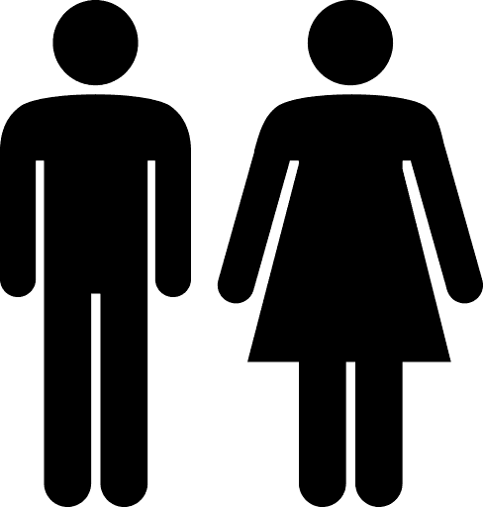
What does the Bible say about gender roles?

Slide 4
Introduction
Why are we doing this study?
Definition of Terms
Address some common (mis)perceptions.
The Road Ahead.

Slide 5
Why this study? Why now?
There is no hidden agenda.
It’s an important issue.
The implications are not theoretical.
It’s important for our children and grandchildren.

Slide 6
As a tradition, we take the Bible very seriously. In this study, we will carefully examine the complete witness of Scripture.
I will not ask you to ignore the Bible. I will ask you to closely examine what it says and how we read it. I will probably challenge you to read it differently.

Slide 7
Definition of Terms

Slide 8
Patriarchy
A social organization marked by the supremacy of the father in the clan or family, the legal dependence of wives and children, and the reckoning of descent and inheritance in the male line.
Broadly: Control by men of a disproportionately large share of power.
Merriam-Webster Dictionary

Slide 9
Androcentric
Centered on, dominated by, or concerned primarily with men as opposed to women. Cf. gynocentric, adj.
Oxford English Dictionary

Slide 10
In many ways, the Bible is a patriarchal and androcentric text.
We need to remember that the Bible was not written TO us; but it was written FOR us.

Slide 11
It should not surprise us to find patriarchy in the Bible.
What is more interesting is when we see the Bible break from patriarchy.

Slide 12
Complementarianism
Complementarianism is the teaching that masculinity and femininity are ordained by God and that men and women are created to complement or complete each other. Complementarians believe that the gender roles found in the Bible are purposeful and meaningful distinctions that, when applied in the home and church, promote the spiritual health of both men and women. Embracing the divinely ordained roles of men and women furthers the ministry of God’s people and allows men and women to reach their God-given potential.
- GotQuestions.org

Slide 13
Egalitarianism
The broadest meaning of egalitarianism is that all people are inherently equal and ought to be treated as such. When used as a doctrinal term within Christianity, egalitarianism has a narrower meaning, suggesting that God does not intend any distinctions between men and women in matters of spiritual leadership...All people are morally and spiritually equal, with identical value, and ought to be offered the same opportunities.
- GotQuestions.org

Slide 14
Some Common (Mis)Perceptions
The “complementarian” view has been the traditional view of Judaism and Christianity for 2,000+ years.
Egalitarianism is a modern byproduct of the Feminist movement of the 20th century.

Slide 15
Some Common (Mis)Perceptions
The “complementarian” view has been the traditional view of Judaism and Christianity for 2,000+ years.
Egalitarianism is a modern byproduct of the Feminist movement of the 20th century.

Slide 16
What is the “Traditional” View?
Women are “weak, frail, impatient, feeble and foolish,” as well as, “inconstant, variable, cruel and lacking the spirit of counsel and regiment.”
John Knox (1514–1572 CE)
Founder of the Presbyterian Church
“By divine and human right, Adam is the master of the woman...There was a greater wisdom in Adam than in the woman.”
Martin Luther (1483–1546 CE)

Slide 17
What is the “Traditional” View?
Women are “defective and misbegotten.”
Thomas Aquinas (1225–1274 CE)
“But man by reason of his sex is ‘imago Dei.’”
Bonaventure (1217–1274 CE)
Italian Bishop, Cardinal, Scholastic Theologian, and Philosopher
“[Satan made] his assault upon the weaker part of that human alliance, that he might gradually gain the whole, and not supposing the man would readily give ear to him or be deceived.”
Augustine of Hippo (354–407 CE)

Slide 18
What is the “Traditional” View?
“The woman taught once, and ruined all. On this account therefore he [Paul] says, ‘let her not teach.’ But what is it to other women that she suffered this? It certainly concerns them; for the sex is weak and fickle.”
John Chrysostom (347–405 CE)
“She has no more qualities than animals, if she even has a brain.”
“She was created in order to serve.”
Rabbi Levi ben Gershon (1288–1344)

Slide 19
What is the “Traditional” View?
“Woe to him whose children are females”.
m. Sanhedrin 11(~200 CE)
“Once Eve was created, Satan was created with her.”
Midrash Genesis Rabbah 17 (300–500 CE)
“Whoever teaches his daughter Torah, teaches her obscenity.”
m. Sotah 21 (~200 CE)

Slide 20
What is the “Traditional” View?
“[The woman] is inclined to be secretive and crafty, because of its weakness . . . . You see, leaving women to do what they like is not just to lose half the battle (as it may seem): a woman’s natural potential for virtue is inferior to a man's, so she's
proportionately a greater danger, perhaps even twice as great.”
Plato, The Laws
“And it is clear that the rule of the soul over the body, and of the mind and the rational element over the passionate, is natural and expedient; whereas the equality of the two or the rule of the inferior is always hurtful . . . . Again, the male is by nature superior, and the female inferior; and the one rules, and the other is ruled; this principle, of necessity, extends to all mankind.”
Artistotle

Slide 21
Traditionalism
The “traditional” view held by Judaism and Christianity was that women were inferior to men in their very nature.
The complementarian view is NOT the traditional view. That’s why its adherents call it “complementarian” and not “traditional.”

Slide 22
Summary
Clarified important terms
The “complementarian” view is NOT the traditional view held for 2,000 years.
Our project: Examine the Bible closely and carefully.

Slide 23
Next Week
Is Egalitarianism a product of the 20th-century Feminist movement?

