Slide 1
Paul’s Worldview
Paul’s misuse of the Old Testament in Romans

Slide 2
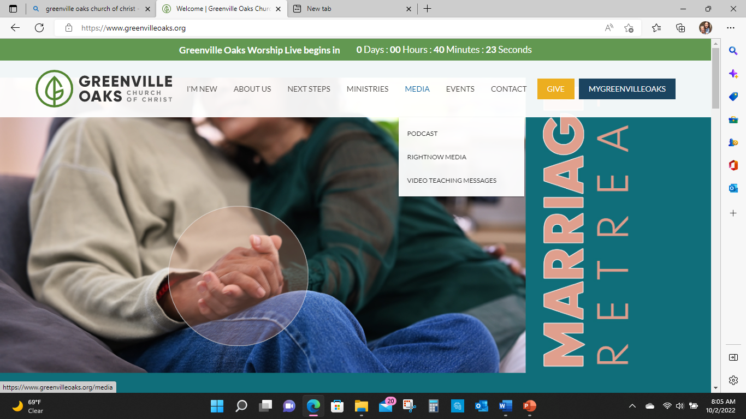

Slide 3
Daniel 7 (Revelation 13)
Daniel has a vision in response to his situation
4 Beast representing 4 “earthly kingdoms”
Babylon, Media, Persia, Greek
Babylon, Media-Persia, Greek, Roman
The vision is a “court” judgement, setting
The kingdoms are judged
The vision is also an “enthronement” setting

Slide 4
9As I continued to watch,
thrones were set in place,
and one ancient of days took His seat.
His clothing was white as snow,
and the hair of His head was like pure wool….
the court sat in judgment, and the books were opened..

Slide 5
As I continued to watch, the beast was slain, and its body was destroyed and thrown into the blazing fire.
As for the rest of the beasts, their dominion was removed,…

Slide 6
In my vision in the night I continued to watch,
and I saw One….. like the Son of Man (a human one)
coming with the clouds of heaven.
He approached the Ancient of Days
and was led into His presence.

Slide 7
14And He was given
dominion,
glory,
and kingship,
that the people of every nation and language
should serve Him.
His dominion is an everlasting dominion
that will not pass away,
and His kingdom is one
that will never be destroyed.

Slide 9
)
Luke 5- Son of man has authority to forgive sins
Son of man is = to Yahweh
Luke 6- Son of man is greater than Sabbath
Mark 8- Son of man dies for you, to follow the son of man you need to die to self
Matt 26- Now is the time

Slide 10
Matthew 26:57 Mark 14:53–65; Luke 22:66-71; John 18:19–24)
Those who had arrested Jesus led Him away to Caiaphas the high priest, where the scribes and elders had gathered.
Now the chief priests and the whole Sanhedrin were seeking false testimony against Jesus in order to put Him to death. But they did not find any, though many false witnesses came forward.

Slide 11
Then the high priest said to Him,
“I charge You under oath by the living God: Tell us if You are the Christ, the messiah, the anointed one, the Son of God.”
Jesus answered“You have said it yourself,” .
“But I say to all of you, from now on you will see the Son of Man sitting at the right hand of Power and coming on the clouds of heaven.”

Slide 12
At this, the high priest tore his clothes and declared, “He has blasphemed! Why do we need any more witnesses? Look, now you have heard the blasphemy.

Slide 13
QUESTIONS???

Slide 14
Acts 6
Followers of Jesus in Jerusalem begin to grow.
Choosing of the seven – Stephen
8Now Stephen, a man full of God’s grace and power, performed great wonders and signs among the people…..
Then they secretly persuaded some men to say, “We have heard Stephen speak blasphemous words against Moses and against God.”
So they stirred up the people and the elders and the teachers of the law. They seized Stephen and brought him before the Sanhedrin

Slide 15
Acts 7 Stephens Sermon
Abraham
Moses
David Solomon
51“You stiff-necked people! Your hearts and ears are still uncircumcised. You are just like your ancestors: You always resist the Holy Spirit!
Was there ever a prophet your ancestors did not persecute? They even killed those who predicted the coming of the Righteous One.
And now you have betrayed and murdered him— you who have received the law that was given through angels but have not obeyed it.”

Slide 16
54When the members of the Sanhedrin heard this, they were furious and gnashed their teeth at him.
But Stephen, full of the Holy Spirit, looked up to heaven and saw the glory of God, and Jesus standing at the right hand of God.
Look,” he said, “I see heaven open and the Son of Man standing at the right hand of God.”
57At this they covered their ears and, yelling at the top of their voices, they all rushed at him, dragged him out of the city and began to stone him. Meanwhile, the witnesses laid their coats at the feet of a young man named Saul.

