Slide 1
FULFILLING THE MISSION OF CHRIST

Slide 2
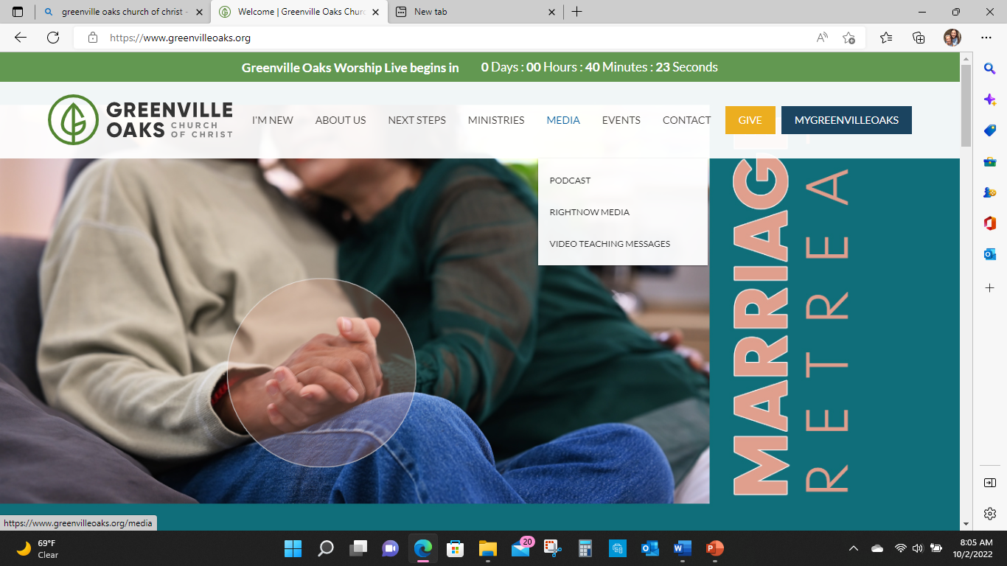

Slide 3
THE CHURCH
Community of Christ Followers
Fulfilling Christ’s Mission
Through Unity and Power of the Holy Spirit
To the Glory of God

Slide 4
The New Community In Christ
“Ekklesia” | The Called Out Ones
“But you are a chosen race, a royal priesthood, a holy nation, a people for his own possession, that you may proclaim the excellencies of Him who has called you out of darkness into His marvelous light; for you once were not a people, but now you are the people of God; you had not received mercy, but now you have received mercy.” (1 Peter 2:9-10)

Slide 5
The New Community In Christ
“Segulah” | Treasured Ones
“For you are a holy people to the Lord, your God: the Lord your God has chosen you to be His treasured (segulah) people, out of all the peoples upon the face of the earth.” (Deuteronomy 7:6)

Slide 6
The New Community In Christ Summary
These overlapping themes (motifs) frame Paul’s ethical thought:
New creation in collision with the present age.
The cross as a paradigm for action.
The community as the locus of God’s saving power.

Slide 7
Why Obey God?
Through union with Christ, we undergo transformation that should cause us to “walk in newness of life.”
Because God has liberated us from the power of sin, we should transfer our allegiance to the one who has set us free.
Because the Holy Spirit is at work in the community of faith, the fruit of the Spirit should be manifest in the community’s life.

Slide 8
Why Obey God?
“What shall we say then? Are we to remain in sin so that grace may increase? Absolutely not! How can we who died to sin still live in it? Or do you not know that as many as were baptized into Christ Jesus were baptized into his death? Therefore we have been buried with him through baptism into death, in order that just as Christ was raised from the dead through the glory of the Father, so we too may live a new life.” (Romans 6:1-4)

Slide 9
Why Obey God?
“For if we have become united with him in the likeness of his death, we will certainly also be united in the likeness of his resurrection. We know that our old man was crucified with him so that the body of sin would no longer dominate us, so that we would no longer be enslaved to sin. For someone who has died has been freed from sin.” (Romans 6:5-7)

Slide 10
Why Obey God?
“There is therefore now no condemnation for those who are in Christ Jesus. For the law of the life-giving Spirit in Christ Jesus has set you free from the law of sin and death.” (Romans 8:1-2)

Slide 11
blue.
by jo ellis

Slide 12
Why Obey God?
”And although you were dead in your transgressions and sins, in which you formerly lived according to this world’s present path, according to the ruler of the kingdom of the air, the ruler of the spirit that is now energizing the sons of disobedience, among whom all of us also formerly lived out our lives in the cravings of our flesh, indulging the desires of the flesh and the mind, and were by nature children of wrath even as the rest... But God, being rich in mercy, because of his great love with which he loved us, even though we were dead in transgressions, made us alive together with Christ – by grace you are saved!” (Ephesians 2: 1-5)

Slide 13
“Alive” Big Daddy Weave
https://youtu.be/aiuw2QX4RpI?feature=shared

Slide 14
Up Next
Bearing God’s Image:
Women and Men in the Kingdom of God
Rob Kranz

